Slide 1
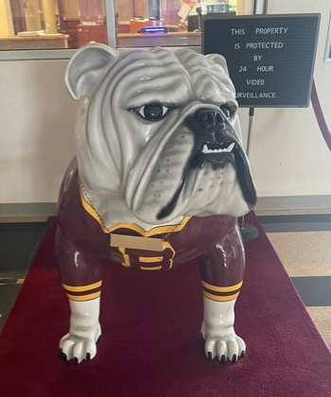
Staff Update
2024-25 School Year

Slide 2
2024 Agenda
Safety & Security – Sanders
Curriculum – Donato
Student Services – Leonard
Technology – Krepps
Café – Morgan
Transportation – Deutsch
HR – Lehman
Payroll – Martin
Finance – Nevling
Summer Projects – Statler
Closing – Dr. Guarente

Slide 3
Safety and Security
Nadine Sanders
Assistant Superintendent

Slide 4
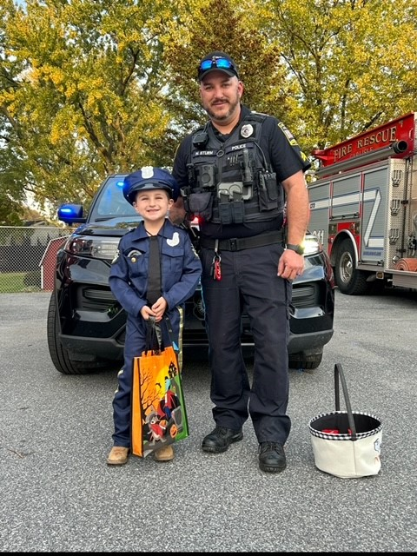
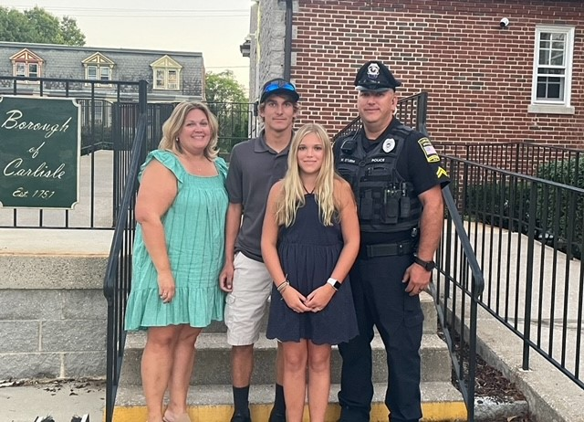
Director of Safety and Security
Corporal Michael Sturm
School Police Office

Slide 5
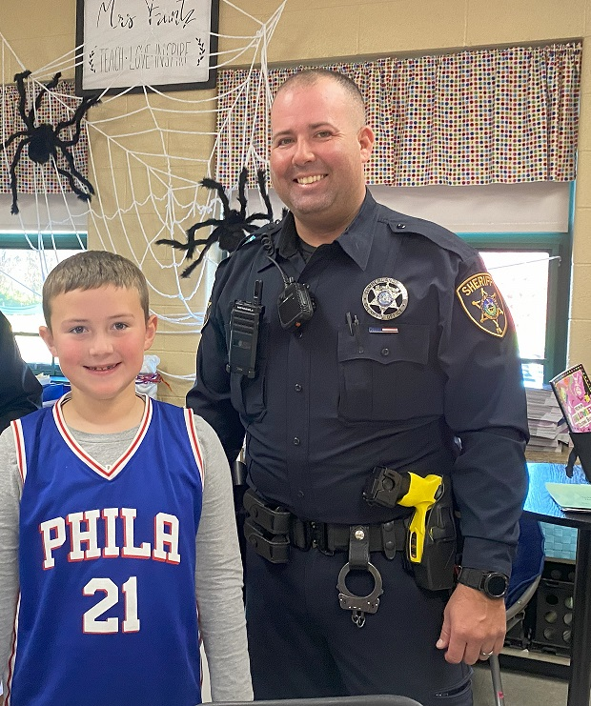
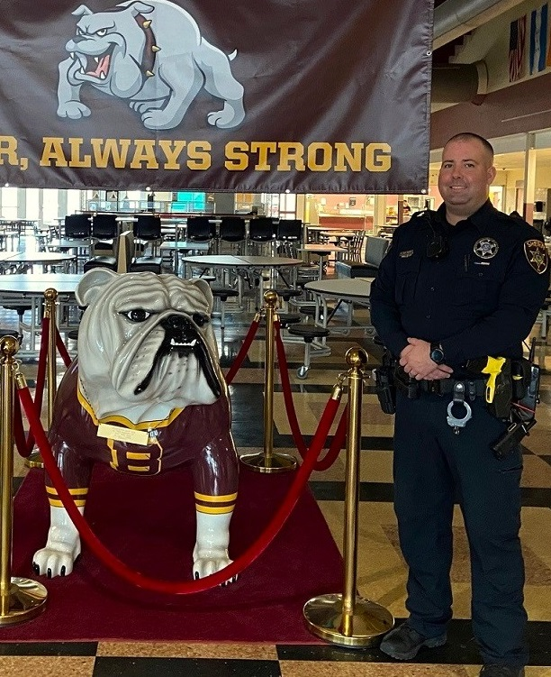
School Resource Officer
Deputy Kyle Schlusser

Slide 6
Navigate 360
If you do not have access to Navigate or are having trouble downloading, please enter a ticket at support@bigspring.k12.pa.us.

Slide 7
Safety and Security Reminders
Safety First
Please use ladders. ☺
Please report any injuries to your supervisor.
Security
Cameras
Badges
Doors

Slide 8
Curriculum and Instruction Mrs. Donato
Academic growth for all students
Over 40 course curriculums were revised, or new courses were written
STEELS
Science, technology & engineering, environmental literacy & sustainability
Continue to focus on skills in our Profile of a Graduate at all levels
Professional learning focused on designing lessons with design qualities, structured literacy, differentiation, and STEELS

Slide 9
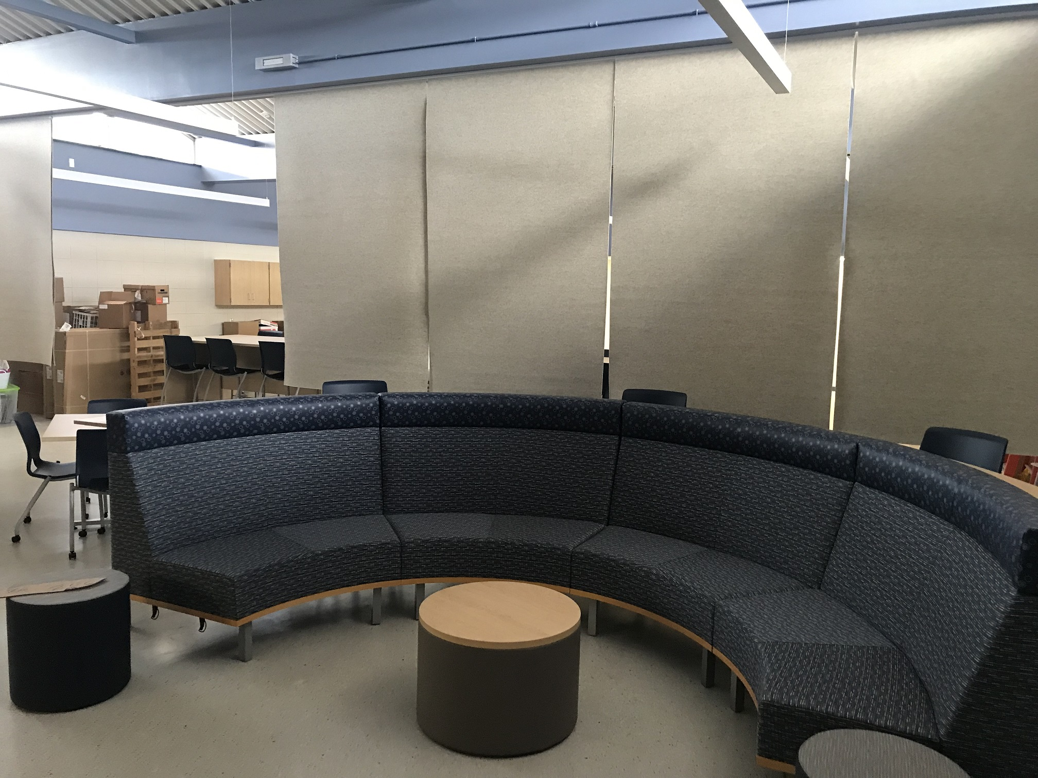
Dr. Abby Leonard Student Services

Slide 10
Paraprofessionals
• Early Release days
• Google Form reporting remains the same as last year
• PaTTAN courses
• You may only complete the 24-25 training series. We are no longer accepting training certificates for older courses

Slide 11
Technology
Rob Krepps

Slide 12
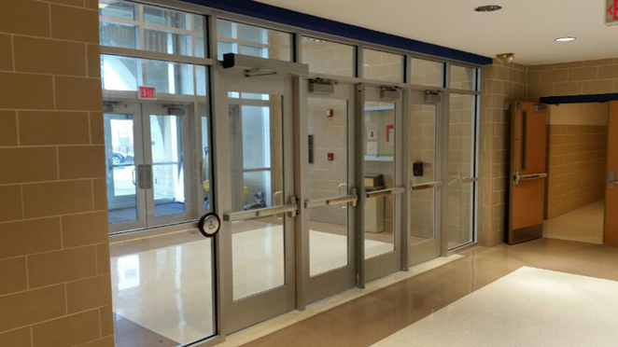
Summer Upgrade Projects
Outer vestibule door security – all buildings
Addition of 56 indoor and 39 outdoor security cameras
Implemented a mobile device management system for iPads
Migrated the district phone system from a local server to the cloud; fax changes
MS and OF Office renovations tech
District website re-design

Slide 13
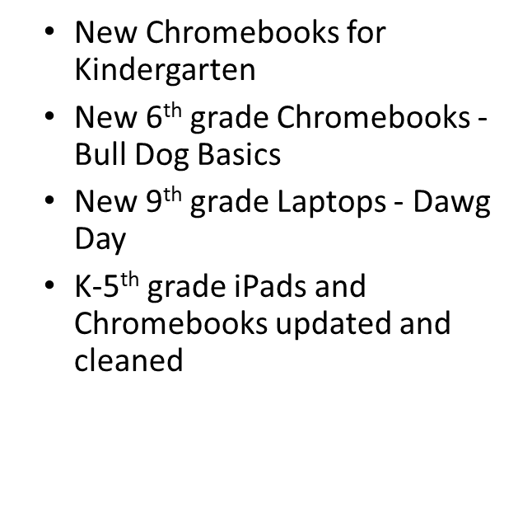
1:1 Devices

Slide 14
Technology Support Procedures
Enter a Help Desk ticket! – 2 methods
Send an email to support@bigspring.k12.pa.us
Telephone x4357 or 8988-435-7580
The technicians routinely watch the help desk queue
If urgent call/email Rob Krepps for escalation
rkrepps@bigspring.k12.pa.us
717-776-2415

Slide 15
Technical Staff Assignments
Hunter Yingling – HS, NV, DO
Todd Friscia – MS, MR, OF
Darin Baughman – Audio/Video all buildings
Mike Fronk – Infrastructure (Network, security)
Patty Stroup – Curriculum applications
Bob Baker – District business applications
Gunnar White - Big Spring Senior - Technology Intern
Lori Martin – Everything else!

Slide 16
Michelle Morgan Dining Services

Slide 17
New Faces & Some in New Places
Sara Bostic – Assistant Director of Dining Services
Jineene Brown moving to MS sometime this year
Jamie Smoker – NV Lead
Jennifer Shuler – HS Addition
Dining Services is fully staffed with three substitutes on deck

Slide 18
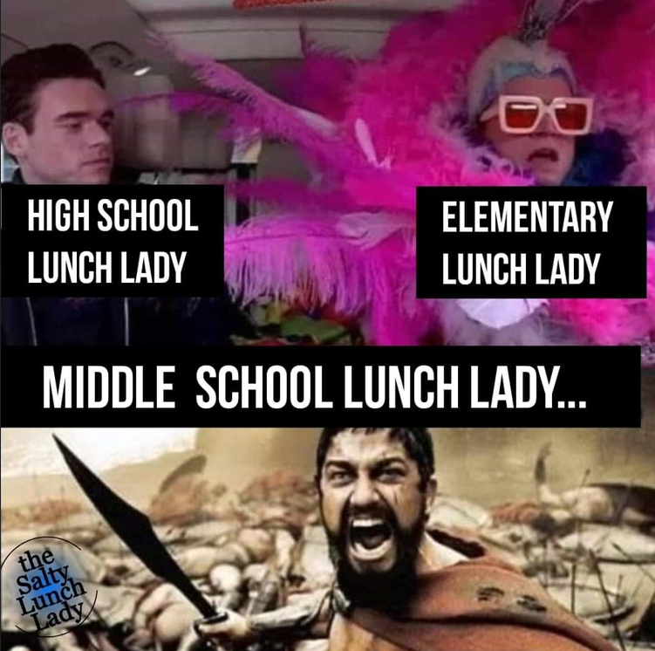
Looking Back….Moving Forward
No charge breakfast continues for PA
Reduced paid students receive free no charged meals
8 % increase in breakfast and 5% increase in lunch
 | 2022-2023 AVG Breakfast Participation | 2023-2024 AVG Breakfast Participation | 2022-2023 AVG Lunch Participation | 2023-2024 AVG Lunch Participation
HS | 29% | 36% | 63% | 84%
MS | 25% | 37% | 84% | 85%
MR | 35% | 39% | 66% | 66%
NV | 45% | 52% | 72% | 71%
OF | 46% | 54% | 58% | 56%
District | 36% | 44% | 68% | 73%

Slide 19
What’s Cooking in SY 2024-2025
Dawg Deals
Fun Lunch Express
HS Student Advisory Committee
Community Farmer's Market
Continued collaboration with Big Spring Family

Slide 20
Come Dine With Us

Slide 21
Nicole Deutsch
Transportation

Slide 22
Transportation
Transfinder – Year 4
95 Regular Bus Routes
33 Regular Van Routes
Over 2,300 Miles per day
GeoTab

Slide 23
Stacy Lehman

Slide 24
Annual Staff Registration
Timeline ​
Checklists will be assigned to staff beginning ~September 15
Due Date for Completion = October 1
Update of Employee Information within TED Records​
Verify Employee Demographics, Contact & Emergency Contacts data​ in CSIU Staff Portal
Sign Agreements & Acknowledgements (Classified Staff Handbook, Swipe Card Agreement, Annual Notices, Food Service Account Agreement, Technology RUP, & Driver's License copy on file ) ​

Slide 25
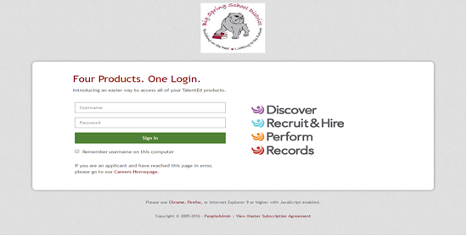
Login to TED with BSSD Network Credentials

Slide 26
Clearances
​
Clearances are valid for 5 years from the processing dates indicated.
Each JULY year letters are mailed home to all active employees who have 1 or more clearances slated to expire within the coming school year (7/1-6/30).
So… What are my clearance dates???
CSIU STAFF Portal >> "My Information" >> Clearances/Mandates Trainings Tab

Slide 27
Staff ID Badges & Swipe Cards
Please continue to wear your ID Badge at all times​
Staff ID Badges will still get you and a guest into any regular home athletic event for FREE
Lost or Stolen cards must be reported to supervisor or DAO within 24 hours
Replacement ID Cards are $10.00

Slide 28
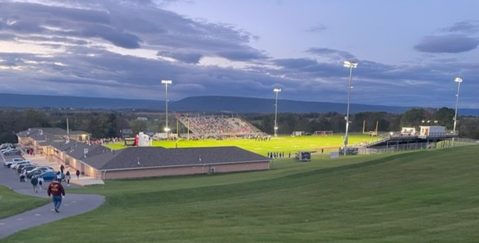
Phyllis Martin
Payroll

Slide 29
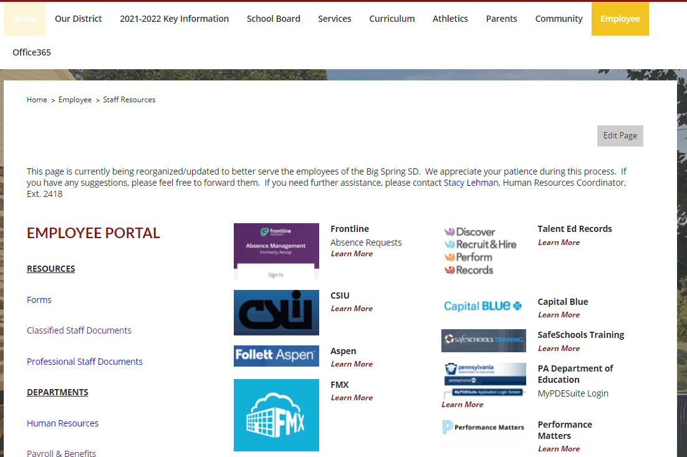
Paycheck – CSIU Staff Portal

Slide 30
Payroll Support
Payroll / Timesheets / Attendance
Demographic changes (Address, Bank, Name Changes)
Frontline (AESOP) Absence Reporting
Healthcare
5% rate increase
Plan Year dates 1 Jan 2024 – 31 Dec 2024
Split RX & Medical (2 cards)
ID Cards from CBC & RX Benefits/CVS Caremark, NVA, ID card for Delta Dental in on the back of Delta Dental brochure
HSA Math for 2024
PSERS: Defined Benefit vs. Defined Contribution
Open Enrollment for 2025 will be held in November

Slide 31
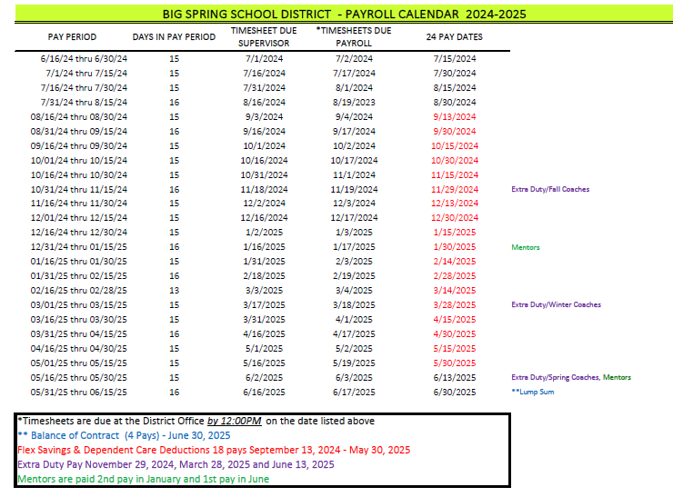
Payroll Calendar SY 2024-25

Slide 32
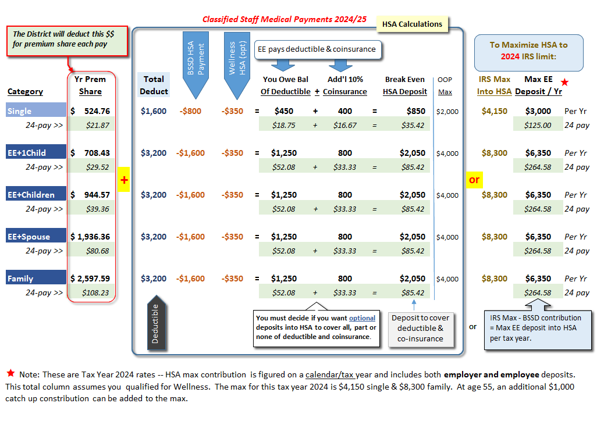
HSA Math 2024

Slide 33
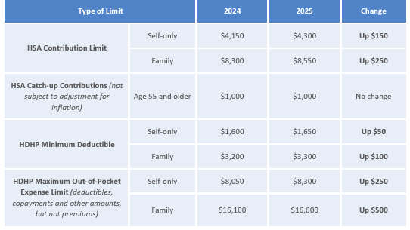
HSA Comparison 2024 to 2025

Slide 34
Ashley Nevling Finance

Slide 35
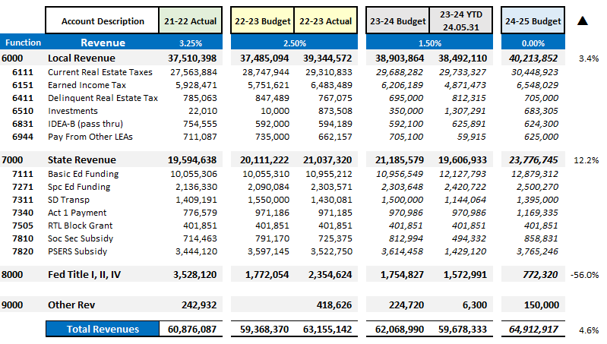
Revenues – History with FY25 Budget
Notes:
Increase in revenue year over year.
No tax increase.
No ESSER Dollars in budget – first time since FY20
Major driver of revenues increasing is state funding. We saw roughly $900,000 more in BEF/SEF/Ready to learn.

Slide 36
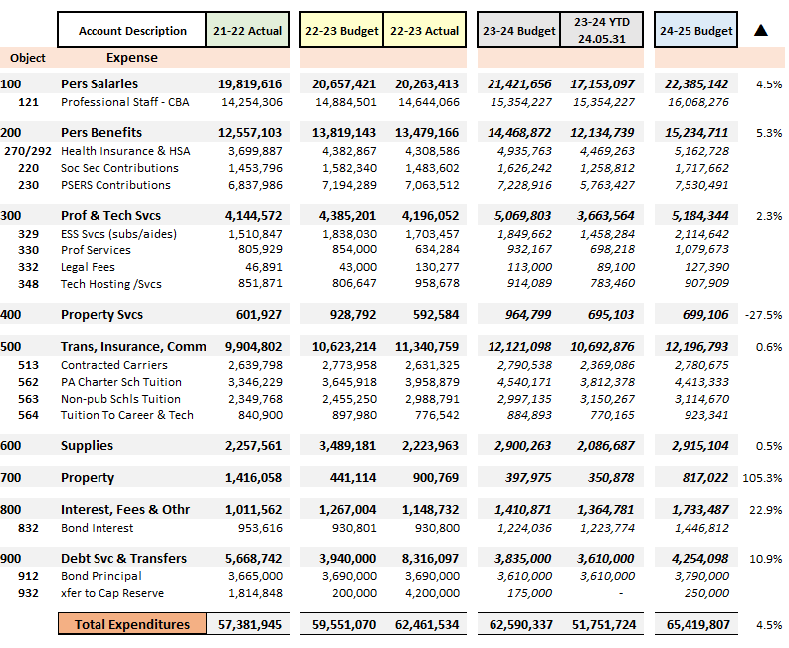
EXPENDITURES
Notes:
Charter school make up 6.7% of our budget. Are expecting a decrease in charter expense next year based on enrollment numbers.

Slide 37
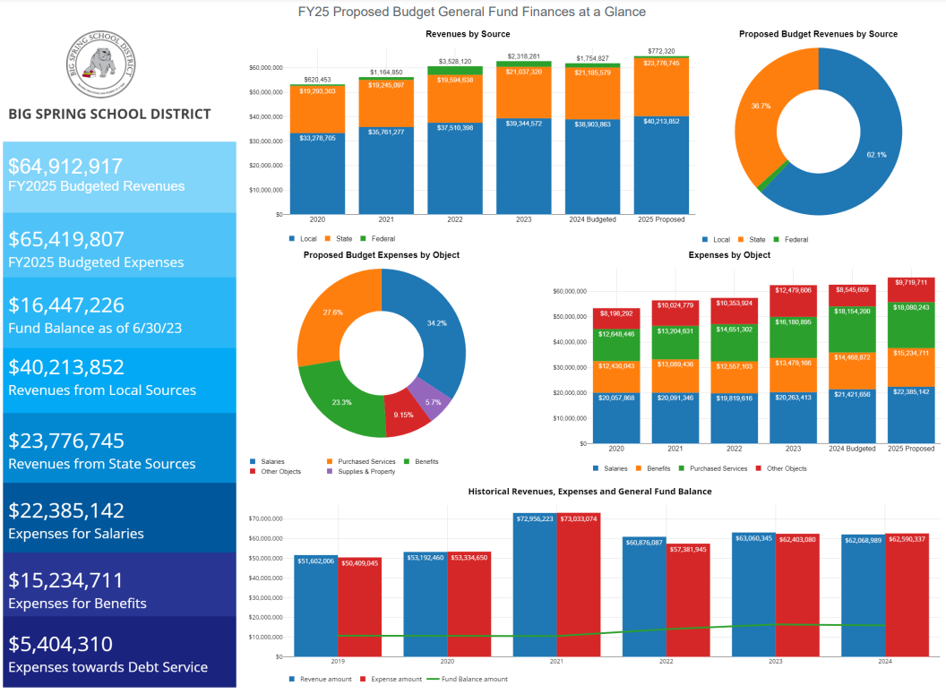

Slide 38
FY25 BUDGETED
EXPENDITURES
($64,912,917)
Debt principal. Transfers to CP and Food Service.
Dues and Fees. Debt interest.
Equipment – useful life > 1 year and > $5,000
Electricity, Tech supplies & software, books, paper, general supplies
Transportation, charter schools, general liability insurance and spec education tuition
Waste disposal, lawn care, water/sewer, repair & maintenance
Health, dental, vision, life insurance, social security, PSERS, tuition reimbursement, worker’s comp, unemployment
Questeq, ESS, staff development, athletic officials, & professional services to CAIU
Notes:
56% ? of the budget is salary and benefits.

Slide 39
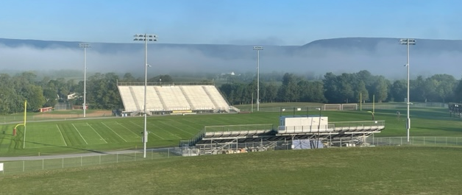
Mike Statler Capital Projects Summer 24

Slide 40
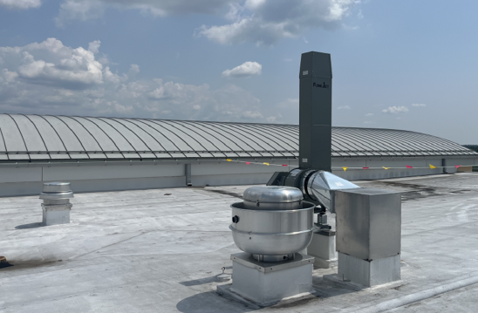
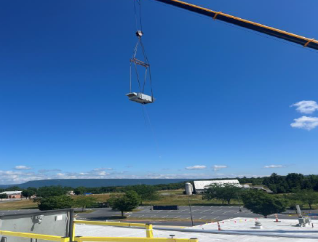
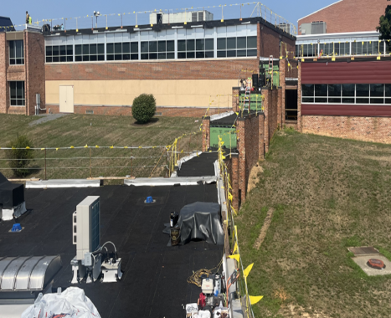
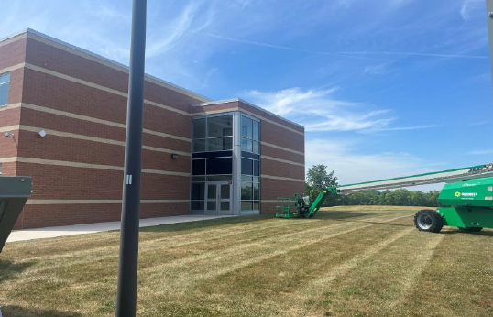
Summer Capital Projects
HS HVAC
MR HVAC
NV HVAC
HS Window
MR/DAO Roof

Slide 41
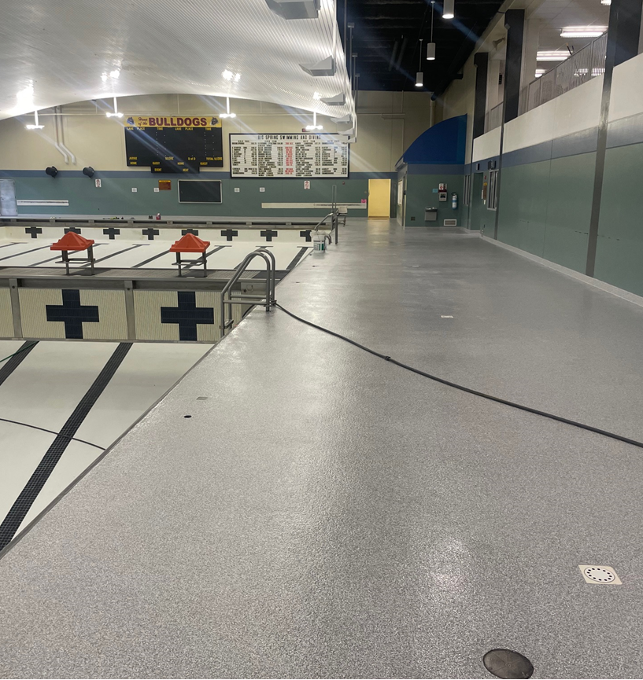
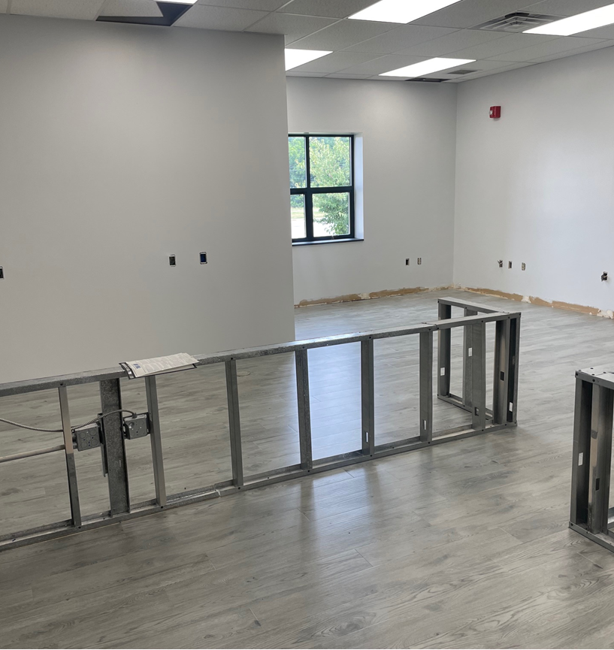
Summer Capital Projects
OF Front Office
MS Front Office
HS Library Carpet
Pool Deck and Power Wash Pool
MS/NV/OF Parking Lots
OF Sidewalks

Slide 42
Business Office Contacts
bus@bigspring.k12.pa.us (all)
ap.bus@bigspring.k12.pa.us (accts payable)
tax.bus@bigspring.k12.pa.us (tax docs)
csiu@bigspring.k12.pa.us (CSIU users)
www.bigspringsd.org
717-776-2000 – main
717-776-4428 - fax
Cheri Frank, Dir x1608 cfrank
Sharon Hoover x2421 shoover
Custodial Svc
Custodial Opns
Warehouse & Distribution
Work orders
Barbara Kuhns x2416 bkuhns
Business Office
General Questions
Tax Accounting
Liability Insurances
Office Depot Ordering
AP / Order receipt
Order invoicing
Check issue
Travel Reimbursement
Ashley Nevling x2407 anveling
Controller
General Fund / GL
Department Budgets
Requisition & POs
Student Activities Accts
Grant Accounting
Procurement cards
Tim Drawbaugh, Dir x1604 tdrawbaugh
Sharon Hoover x2421 shoover
Buildings & Grounds
Bldg Opns
Security
HVAC
Work orders & FMX
Grounds
ID Badges/Door Access (Sharon Hoover)
Stacy Lehman x2418 slehman
Human Resources
Recruiting
TED (Pers) Records
In/out Processing
Worker’s Comp
Clearances
Blackboard Connect
Phyllis Martinx2405 pmartin
martin
Payroll & Benefits
Timesheets
Payroll
Medical Benefits
403b & Section 125 Accts
PSERS Retirement
All Cash/Check deposits
CSIU Employee Portal
Mike Statler x2404 mstatler
Cristy Lentz x2404 clentz
Business Manager
Bob Baker x2457 bbaker
Tech/Application Analyst
Madison Sloop x24143 msloop
PIMS Coordinator
Michelle Morgan, Dir x2423 mmorgan
Melissa Carlson, Chef x2461 Food Service
Breakfast & Lunch
Box lunch for field trips
Healthy eating
Catering
Shelli Kent x2408 skent
Cafe
Café Accounts
Café Accounting
Transportation back up &
7AM – 8:30AM shift
Nicole Deutsch x2419 ndeutsch
Transport
Home <> School Trans
Attendance areas
Bus stops
Field Trips
Athletic trips
Links to: Business Office / Employee Portal

Slide 43
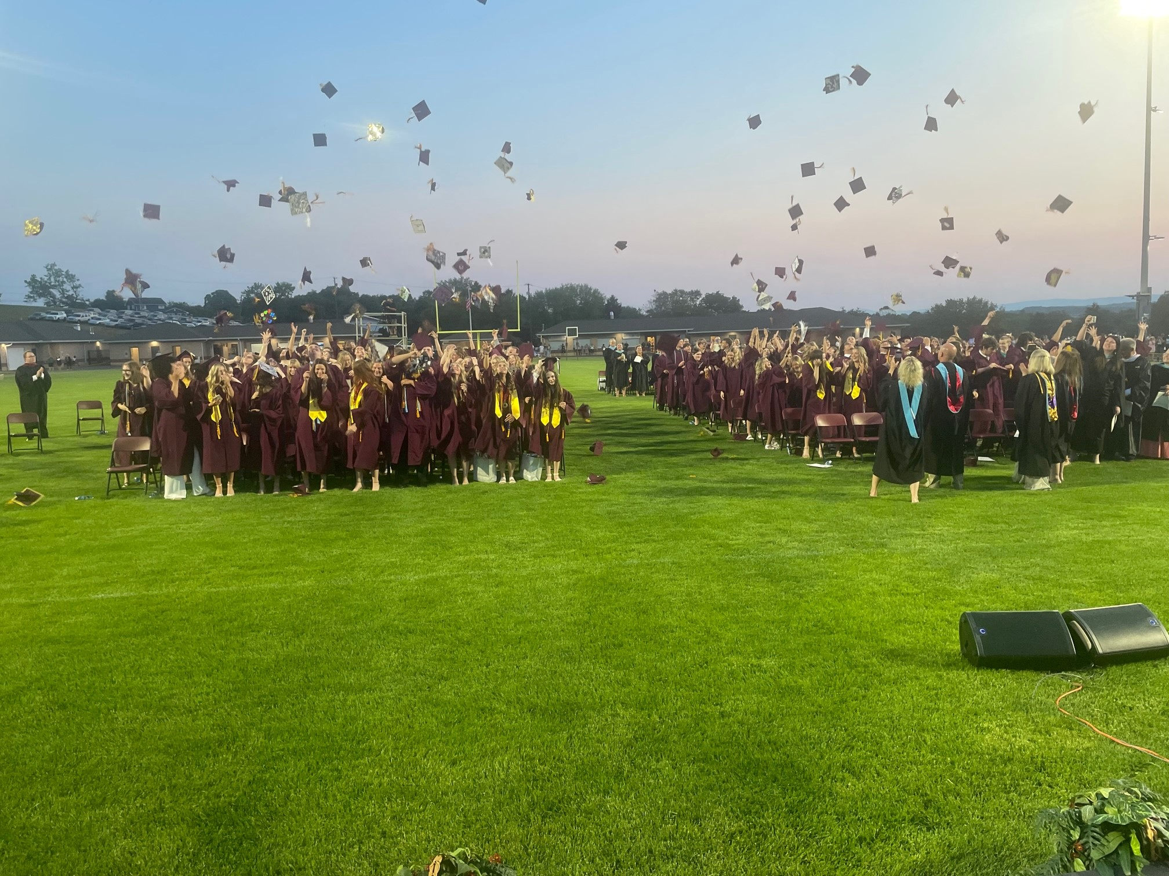
Dr. Nicholas Guarente Closing

