Slide 1

Transportation in Transition
Elem Tier 3 Challenges
28 Oct 2020

Slide 2
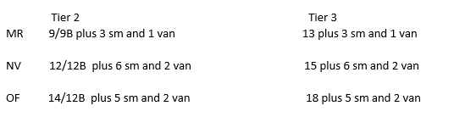
Review
2019 Routes used
With Oct 2020 students (changes unknown)
Capacity challenges
5-day SpEd remains on small buses/vans
Bus traffic to schools will increase

Slide 3
Mt Rock
Also goes to:

Slide 4
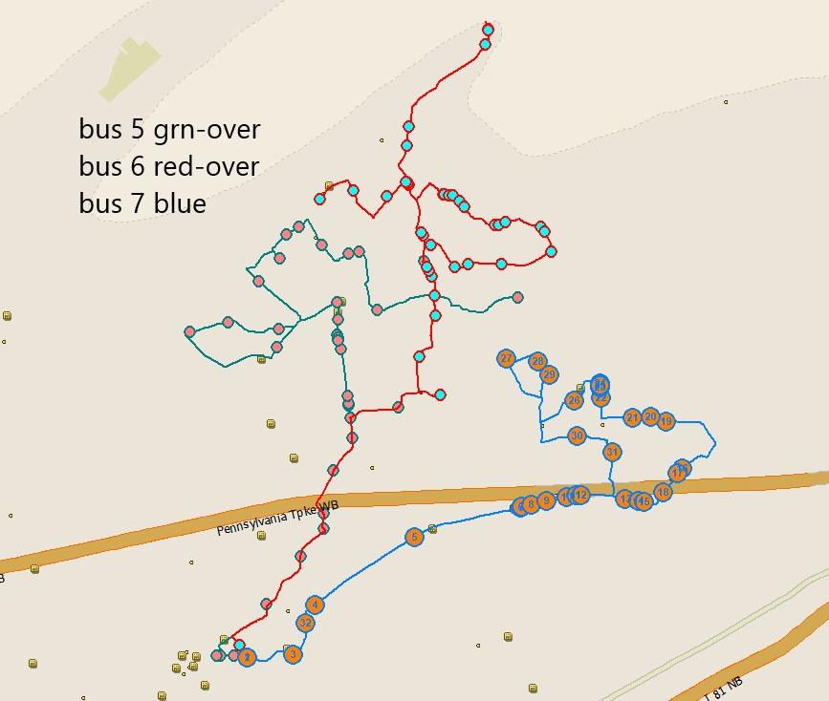
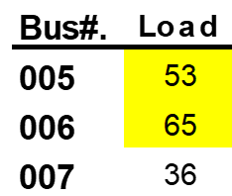
MR Buses

Slide 5
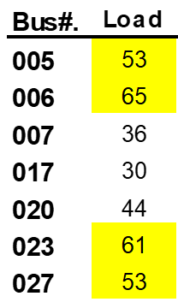
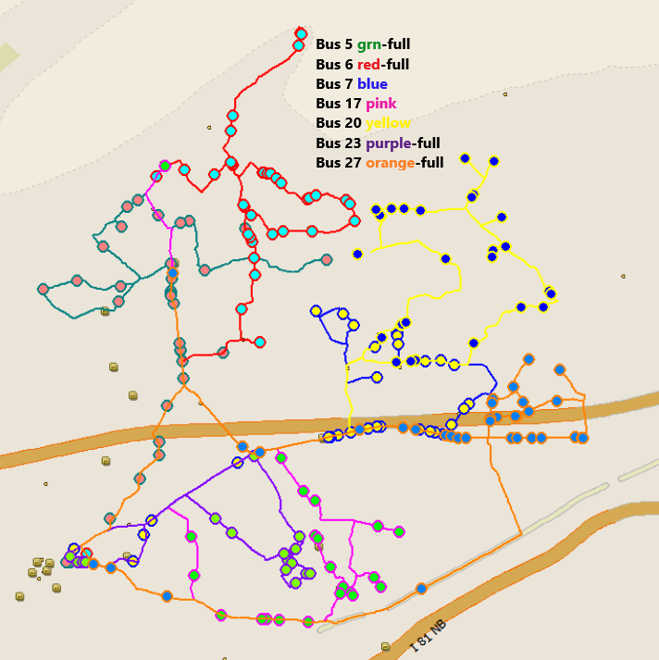
MR Buses

Slide 6
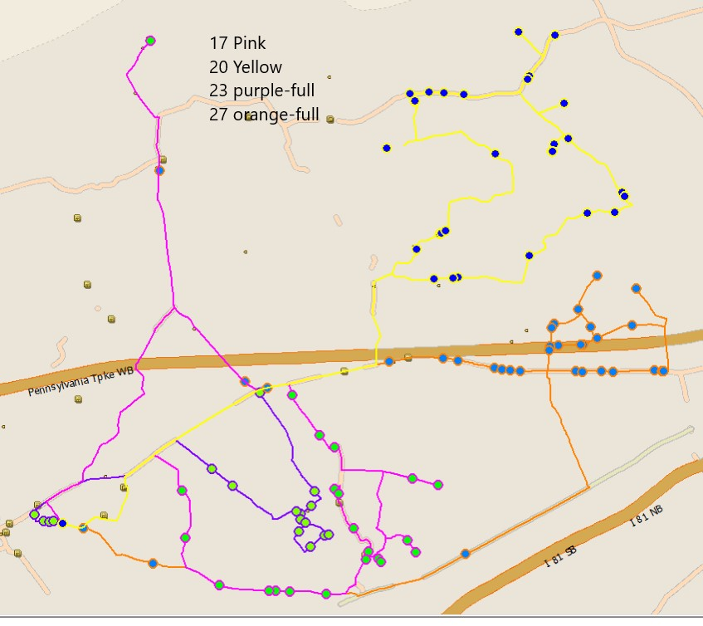
MR Buses

Slide 7
Newville
Also goes to:

Slide 8
Oak Flat
Also goes to:

Slide 9
SpEd - AM

Slide 10
SpEd - PM

Slide 11
Out of District

Slide 12
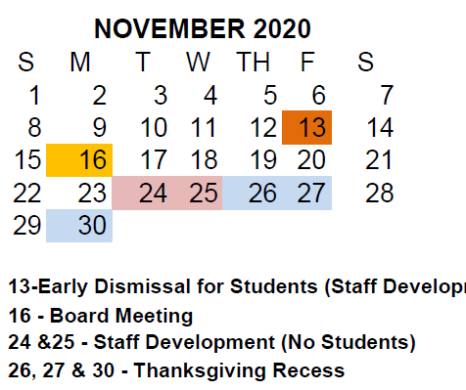
Schedule?
Parent changes due
Input Parent Requests
RE-route
Drivers test/review
New routes issued
Drivers off
Elem Tier 3 begins
2 Nov: Parent Change Due
3-6 Nov: Input changes
9-13 Nov: Routing
16 Nov: Routes issued
17-19: Drivers test/review
20 Nov: Route Conference
23-30 Nov: Drivers off
1 Dec: Elem Tier 3 start

Slide 13
Call Backs
Tues 27 Oct
MS - Bus 18 called back for a student
MR - Put a student on Bus #20 when the mother was there to pick up. Bus was the whole way to Betty Nelson by the time Karen called for it to come back. We did not have it turn around and the mom was driving home to meet the bus.
MR - 3 students not put on Bus #27 and we were not called until all of the buses were gone after 4:00 and Bus 27 was already at the Ritner Hwy.
Mon 26 Oct
MR - called bus 6 back at 3:42 pm.
Fri 23 Oct
OF - called Bus #41 back as he was leaving Newville Elem to come back for a student they missed @3:53pm
OF - put a Kdg student on his bus (Bus #9) when his mom was there to pick him up so she was going to drive up to the top of the mountain (Pinetree Drive) to meet the bus.
Thur 22 Oct
MR - Today we had Bus 23 OF (with a substitute driver) call in to say as he was doing the route, a student told him her siblings weren’t on the bus because they were still playing on the playground. We got their names and I called Cheryl and she confirmed with the two students that they were out playing on the playground and did not get on their bus because they did not hear the bus number being called. I told her that we would not turn the bus around now since he is already dropping off students and their parents would have to come pick them up today.

Slide 14
Call Back Procedures
Call backs need to go away due to complications to all other pax and schools – and increased traffic in Tier 3
If a school misses a kid, they call the parents and asks them to p/u.
Revise radio procedures as to call when a call back is within 2-minutes.
If discovered as bus pulls away, use driver channel to request.
If bus is more than 2-minutes from school, they move on.
School calls parents and asks them to pu.

Slide 15
Secondary
A look ahead

Slide 16
Secondary AM:

Slide 17
Secondary PM:

Slide 18
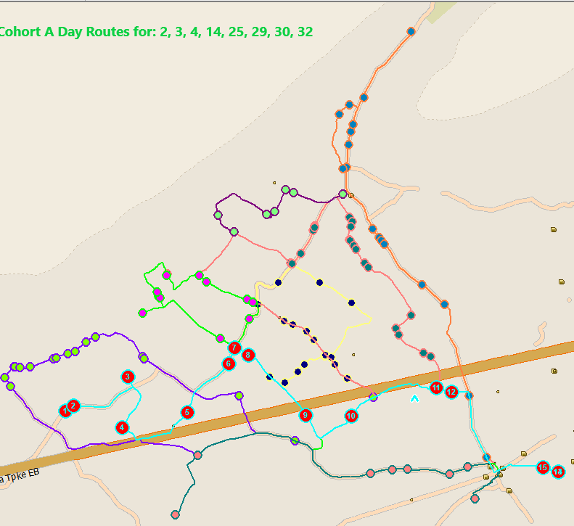
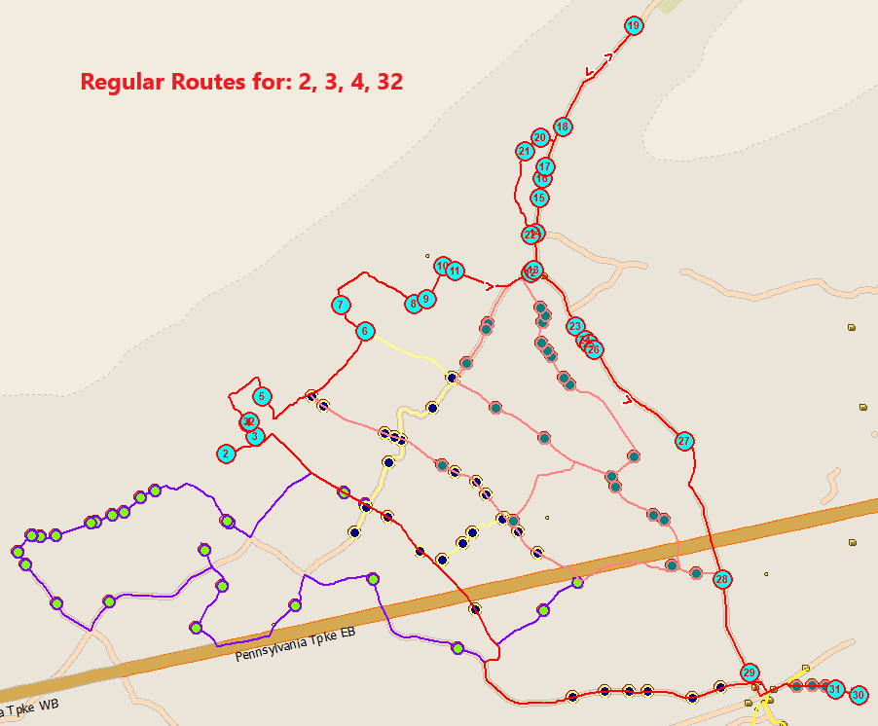
48-pax limit floods the zone

Slide 19
FMXing

Slide 20

FMX Transportation Request Process
I need transportation……
Required fields:
Event name
Building
P/u location
Destination
Departure time
Return time
Total # of pax
Number of vehicles
Purpose of trip
Staff member in charge
Chaperones
Athletic Trip
Athletic Van
District Vehicle
Field Trip
Spec Ed
Spec Ed Van
Make request in FMX
What type?
Field Trip
Yes
Yes
Optional fields:
Arrival time at dest.
Depart time from dest
Type vehicle needed
Overnight trip
Handicap bus needed
Will stop for meals
Description
Deitch Assigns Bus & Driver
Transportation Coordinator
Approval?
Deitch Buses:
Prints trip ticket
Completes trip
Finalizes trip in FMX
No
No
No
Are more than 4 buses out?
Transportation Coordinator
Contacts requestor to reschedule
Yes

Slide 21

Questions?

