Slide 1
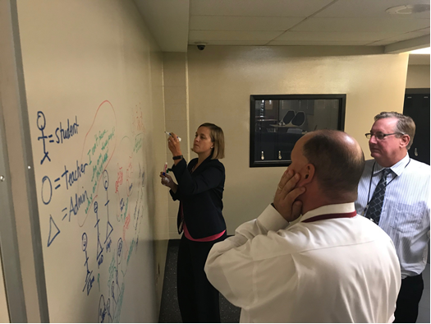
Budget Update
21 05 17

Slide 2
Fund 32 & 51

Slide 3
Fund 10

Slide 4
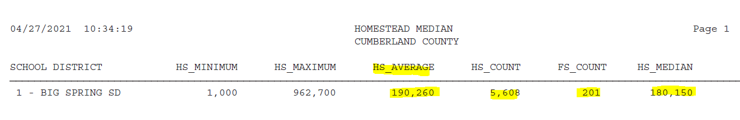
HS/FS

Slide 5
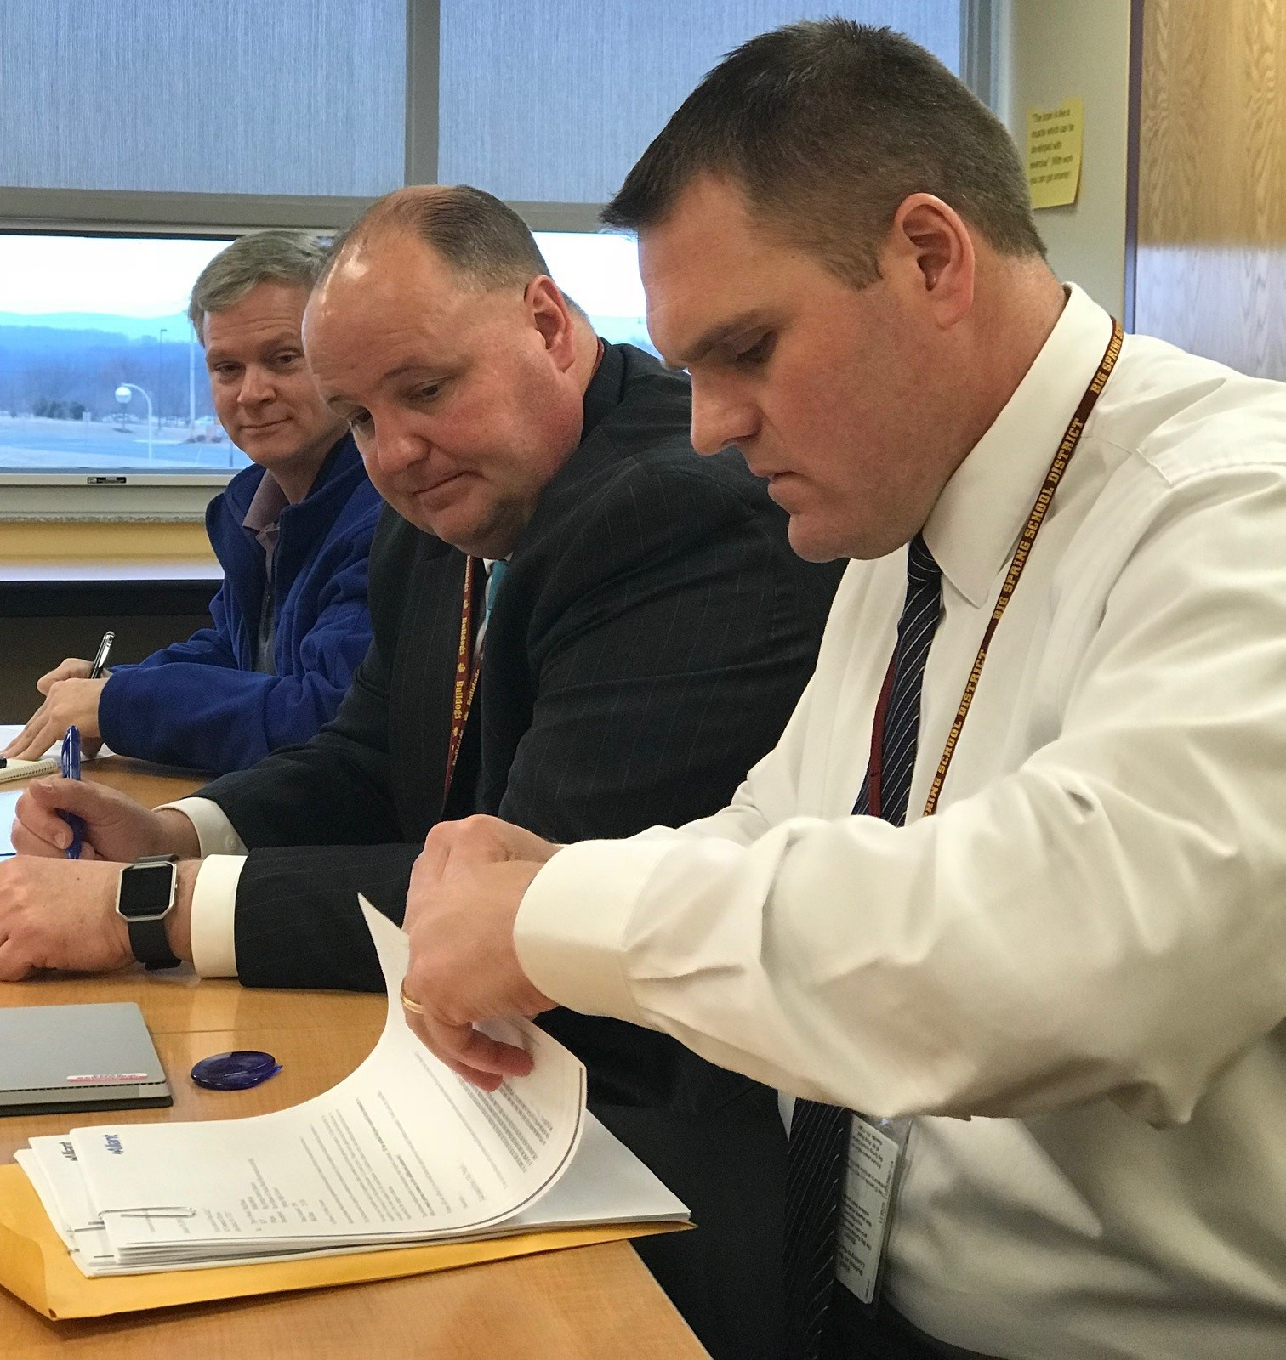
ESSER II CRRSA

Slide 6
ESSER III ARP

Slide 7
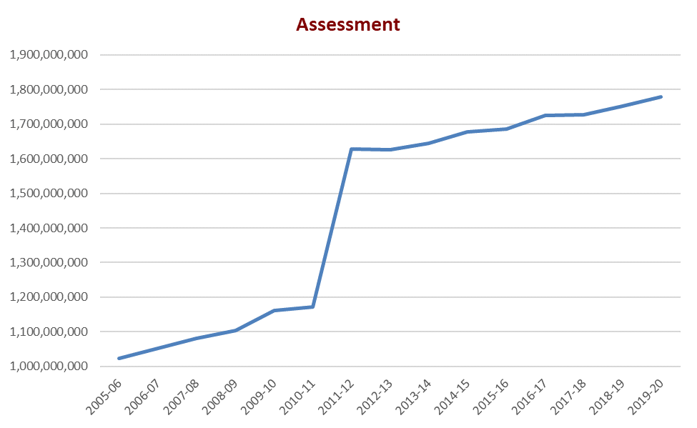
Act 1 – Adjusted Index History

Slide 8
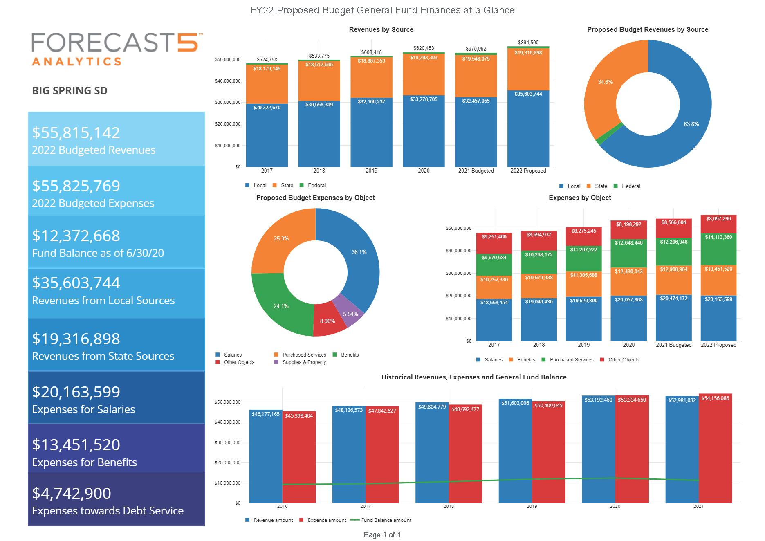

Slide 9
Proposed Final
Budget by Object
$55,825,769

Slide 10
Proposed Final
Budget by Function
$55,825,769

Slide 11
Projection @ 3.7%

Slide 12
Projection @ 3.25%

Slide 13
The Piper Options

Slide 14
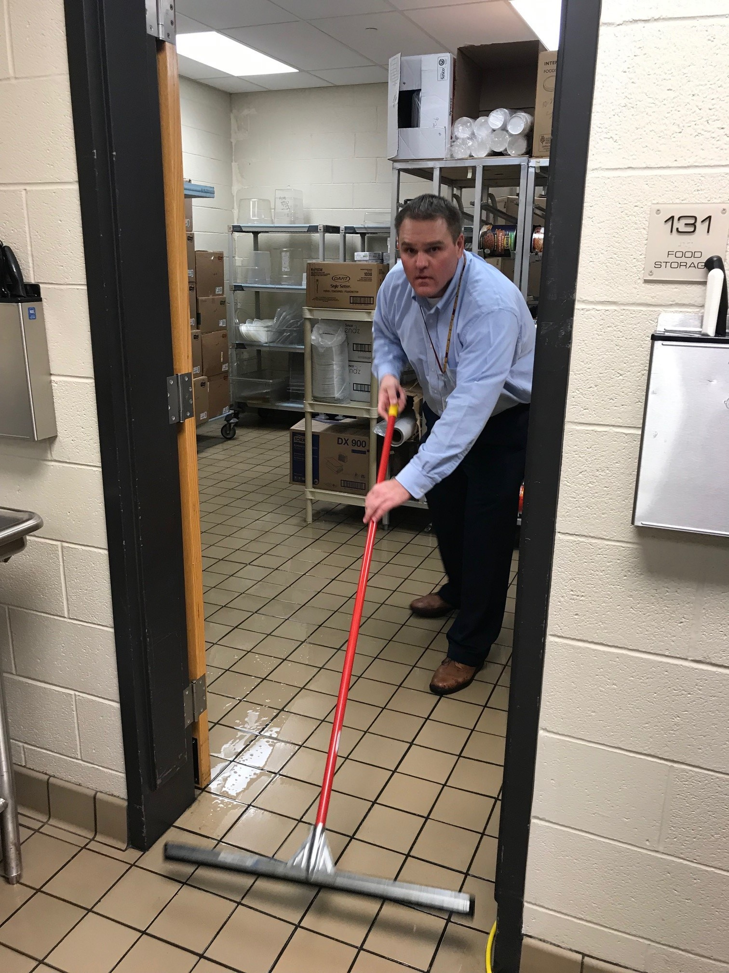

The End
Questions?

