Slide 1
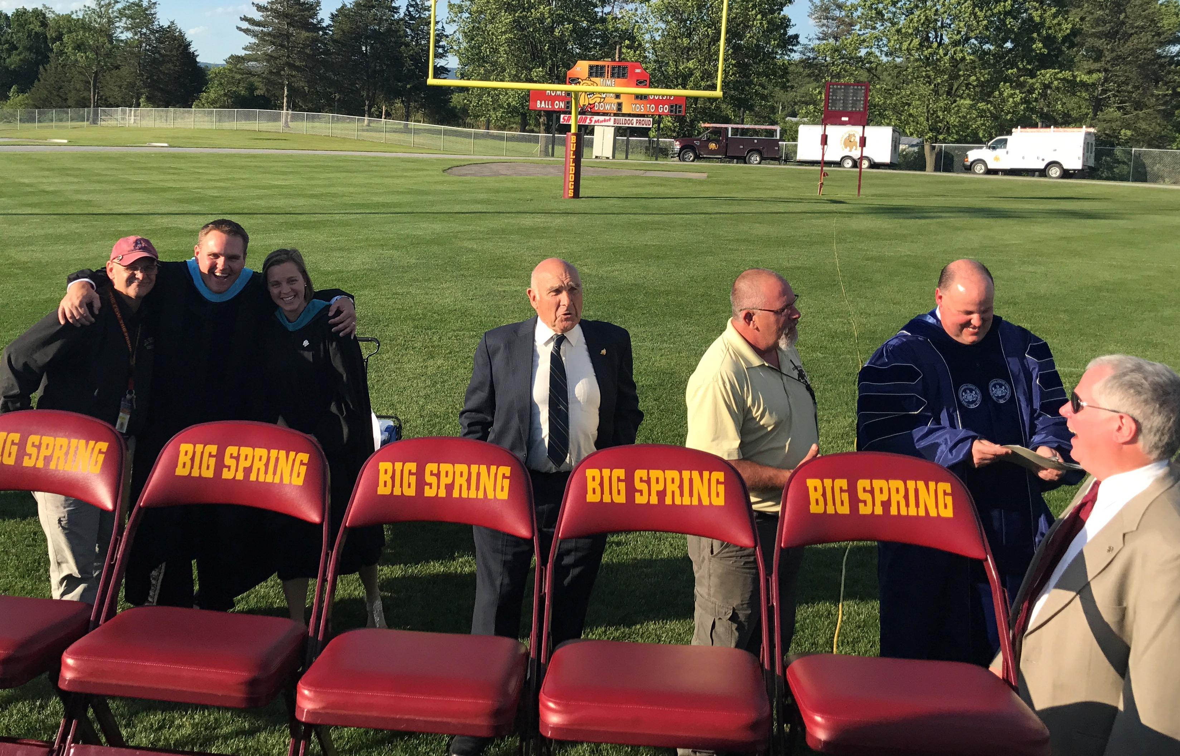

Slide 2

Finance Update
21-05-03

Slide 3


FY21 YE Projection

Slide 4
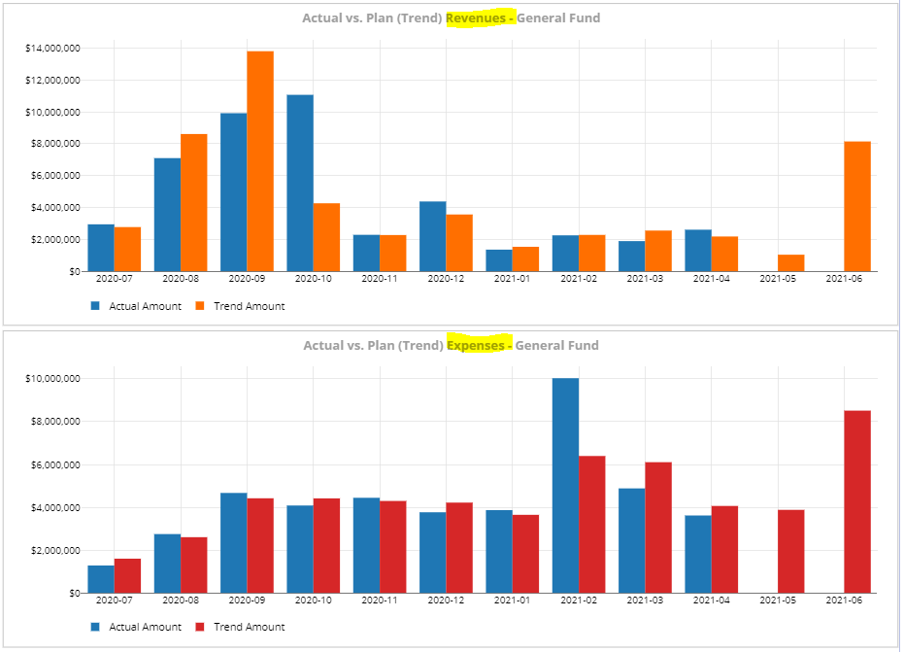
FY21 Trend

Slide 5
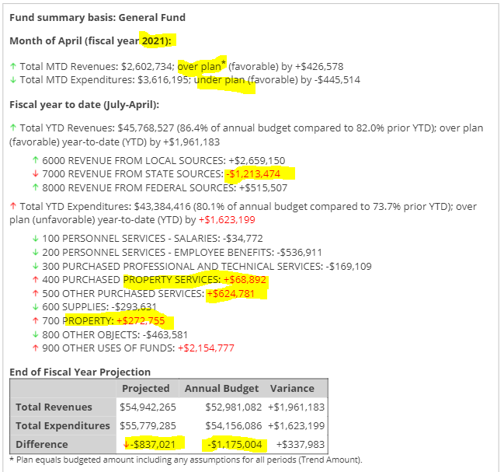
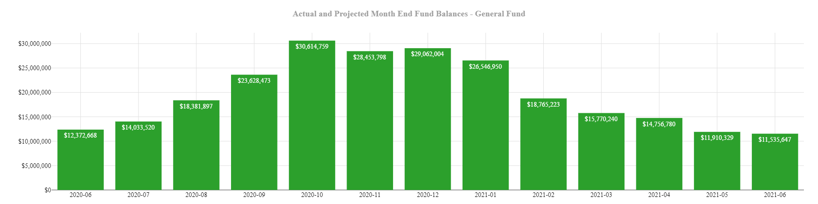
Projected
YE FY21

Slide 6


FY22 Budget Update

Slide 7
Revenue Changes / Assumptions
Increased BEF to match last year $150K
Deleted duplicate Soc Sec subsidy -$705K
Add $300K ESSER II rev in FY22
Add $300K ESSER III rev in FY23
Increased Transportation subsidy $400K (fix)
2 Mos assessment increase
Added $100K to EIT

Slide 8
Expense Changes / Assumptions
Reduced transportation -$100K
Added student interns @ pool (4) and DAO (2) $12K
Corrected (reduced)2021 Bond refi debt -$429K
Teacher reduction changed from 7 to 8
Add 10 aide posns
For FY 23-26 all salary & benefits ↑3%; medical at 7.5%

Slide 9
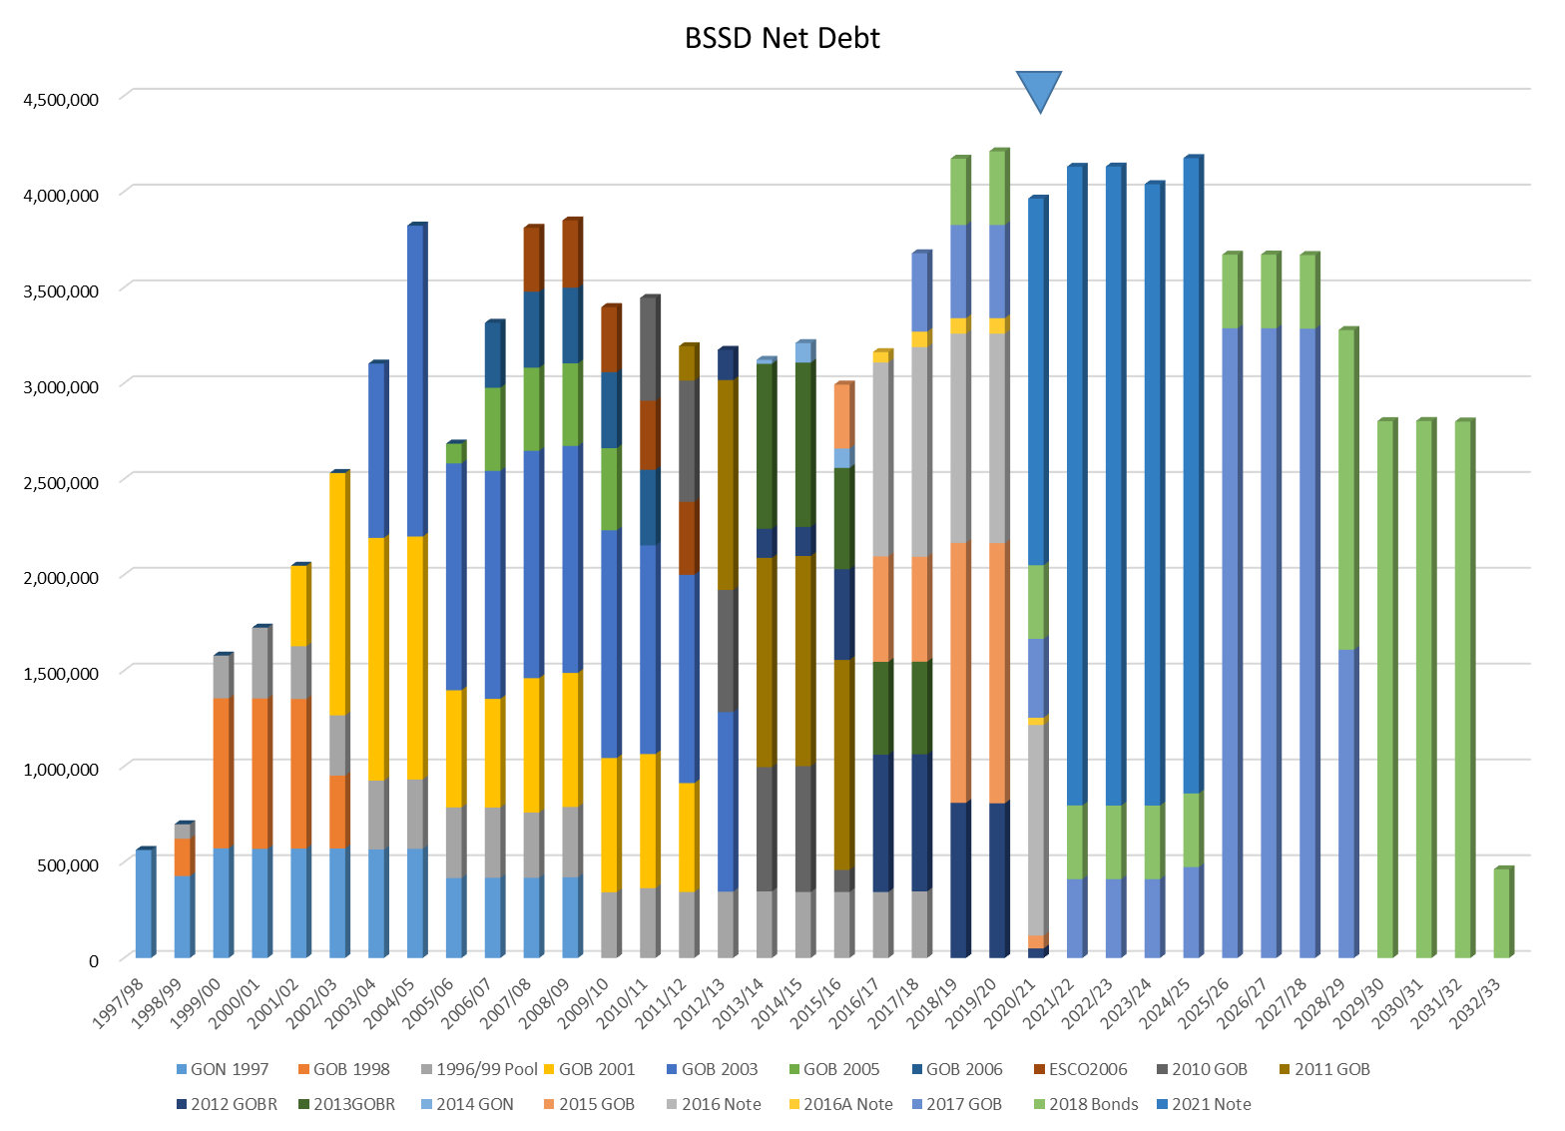
Debt Service

Slide 10
Personnel

Slide 11

Expenditures

Slide 12
Expenditures by Object

Slide 13
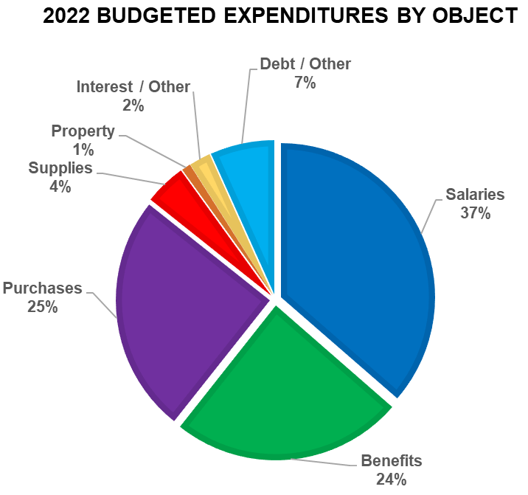
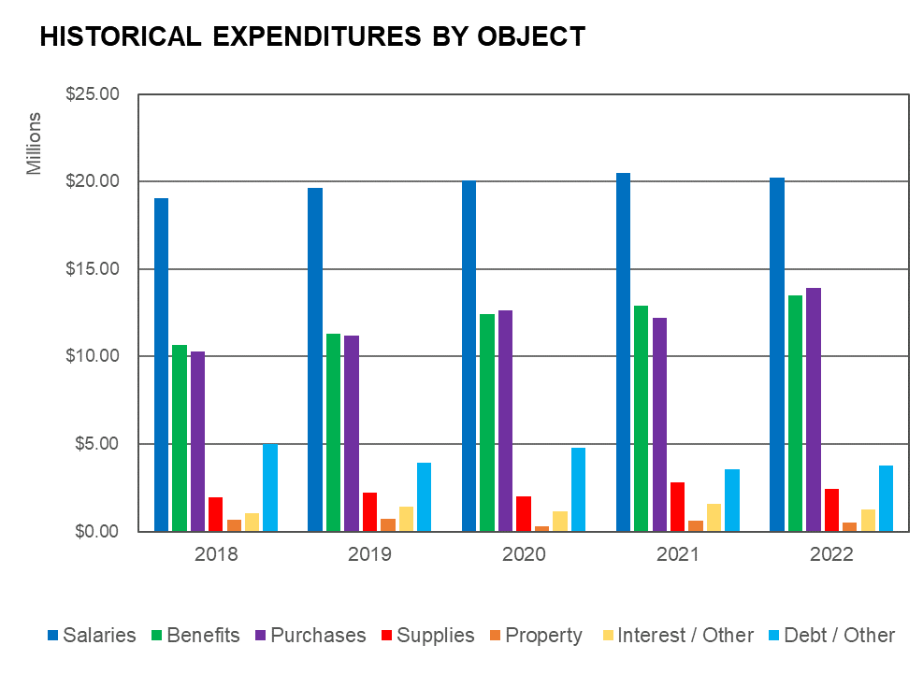
Spend By
Object

Slide 14
Expenditures by Function

Slide 15
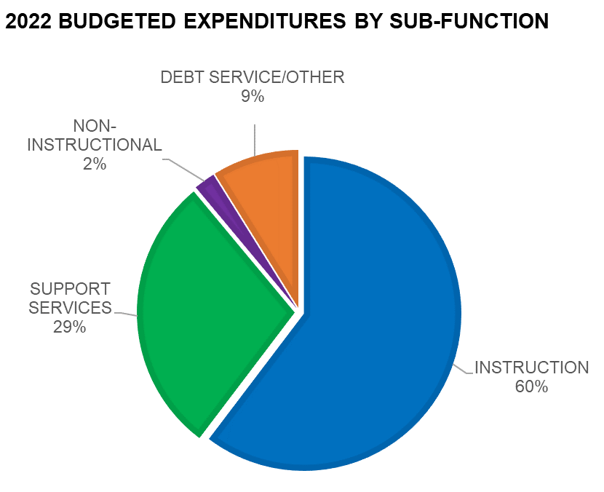
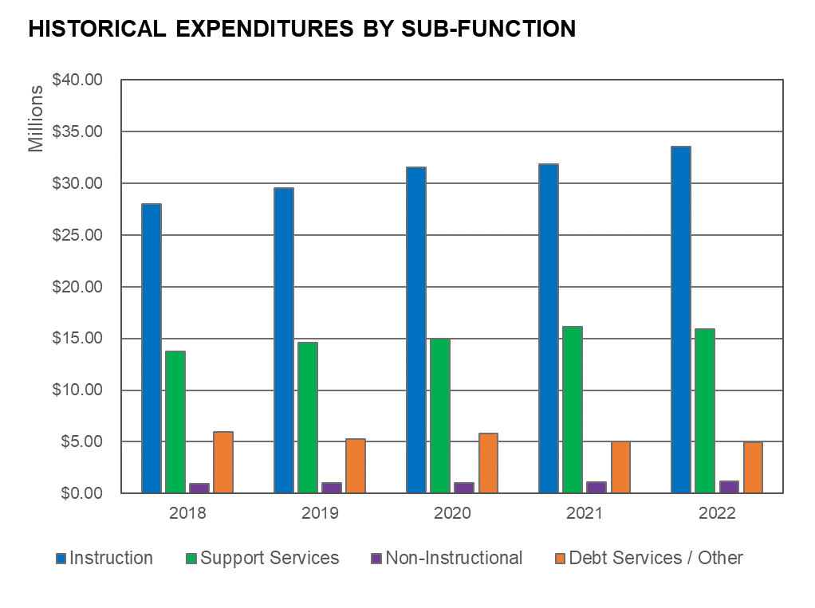
Spend by Function

Slide 16
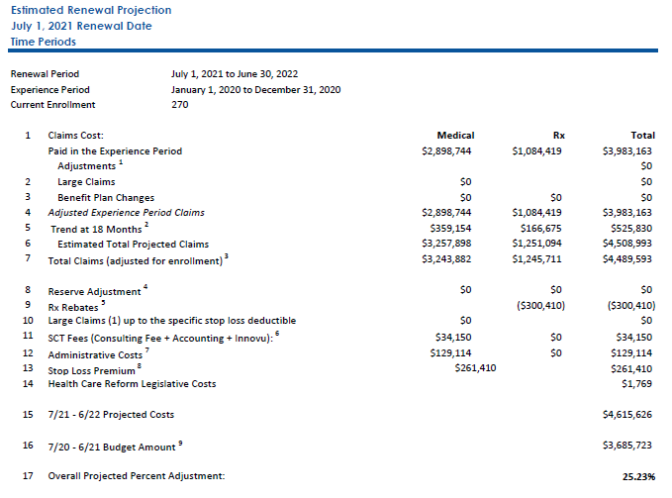
FY22 Premium Increase
25.23%

Slide 17

Revenues

Slide 19
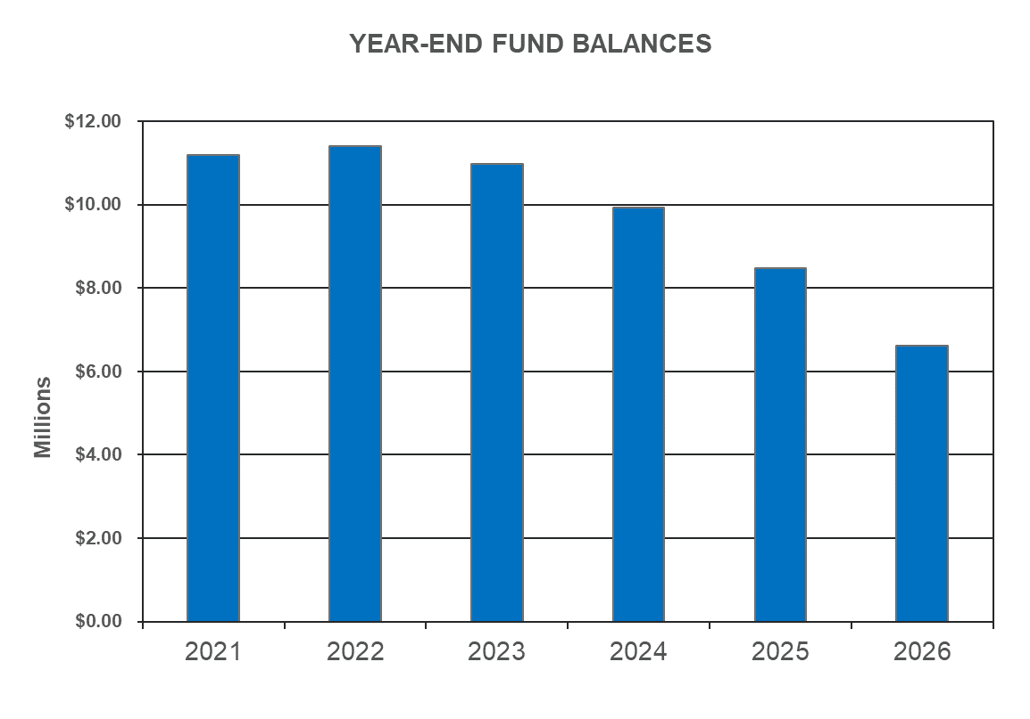
Projection – 3.7%

Slide 20
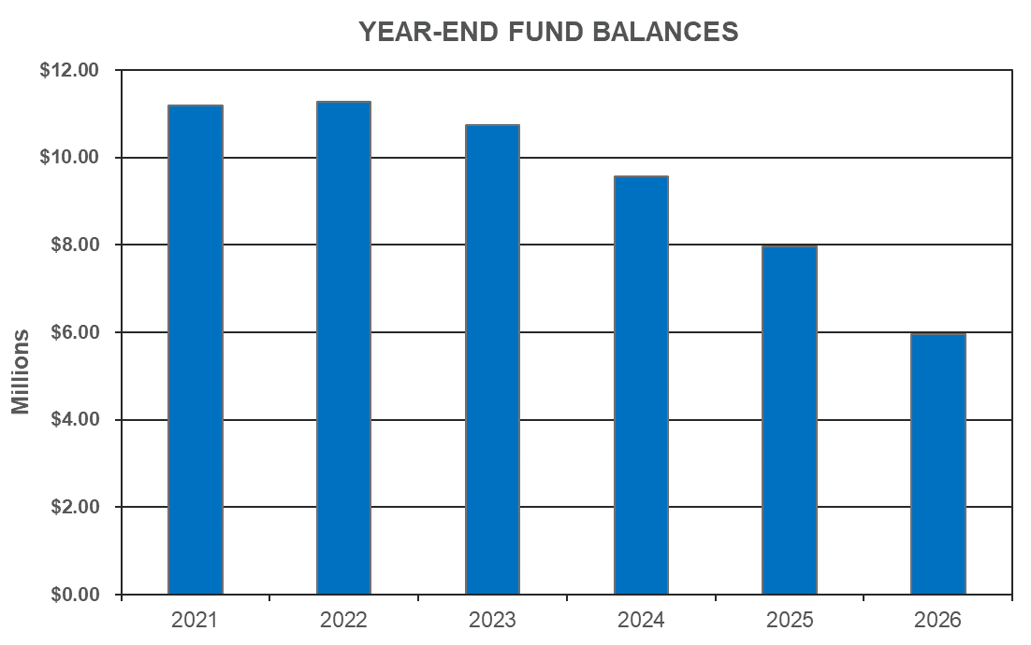
Projection @ 3.25%

Slide 21
Tax Rate Options

Slide 22
Budget Schedule

Slide 23

Questions?

Slide 25
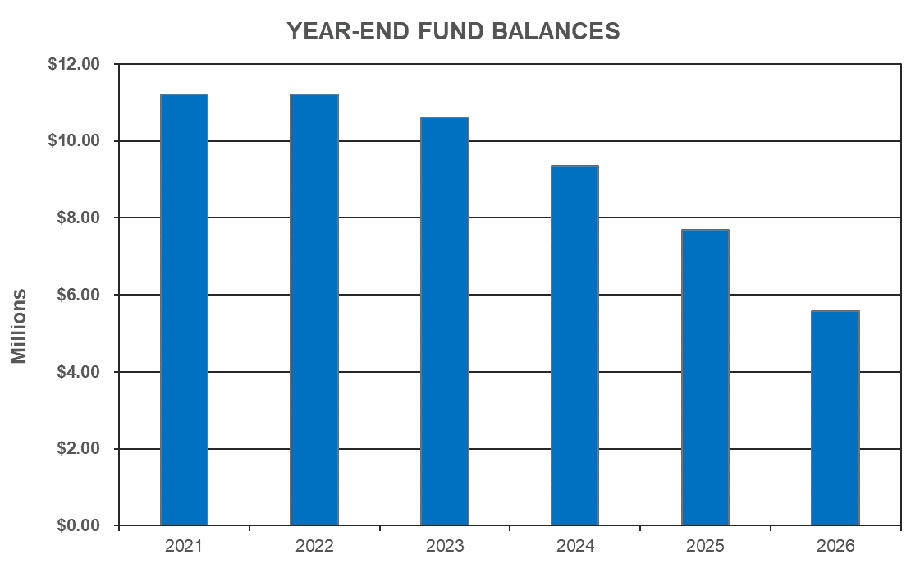
Projection @ 3.00%

