Slide 1
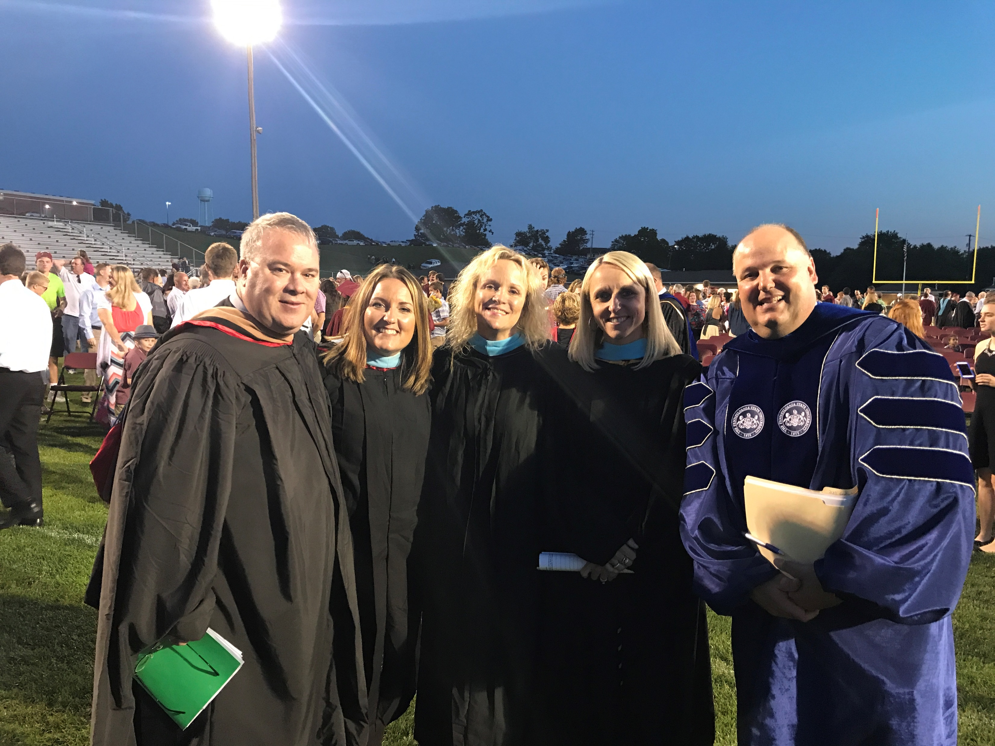

Finance Committee Meeting
21 04 19
FY22 Budget Update

Slide 2

Funds Update

Slide 3
Capital Projects Reserve Fund (32)

Slide 4
General Fund (10) Balance

Slide 5
Café Fund

Slide 6

Grants
PCCD, GEER
& ESSER

Slide 7
GEER

Slide 8
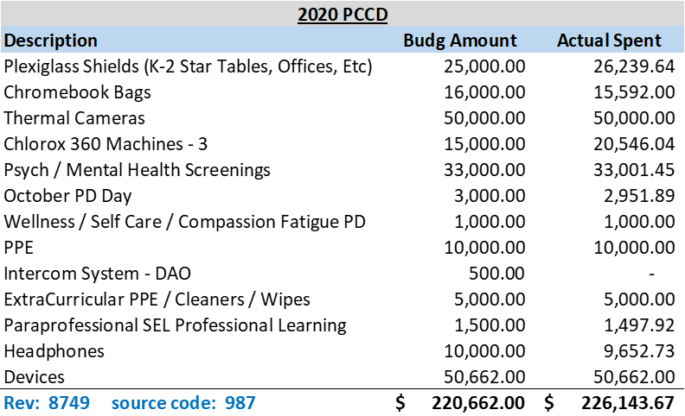
PCCD

Slide 9
CARES ESSER I

Slide 10
CRRSA ESSER II

Slide 11
ARP ESSER III

Slide 12
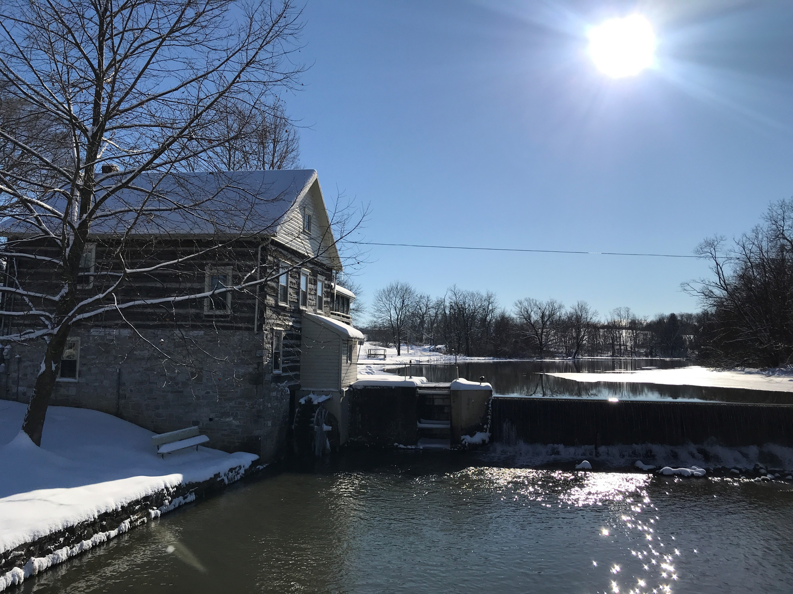
FY21 Budget Update

Slide 13
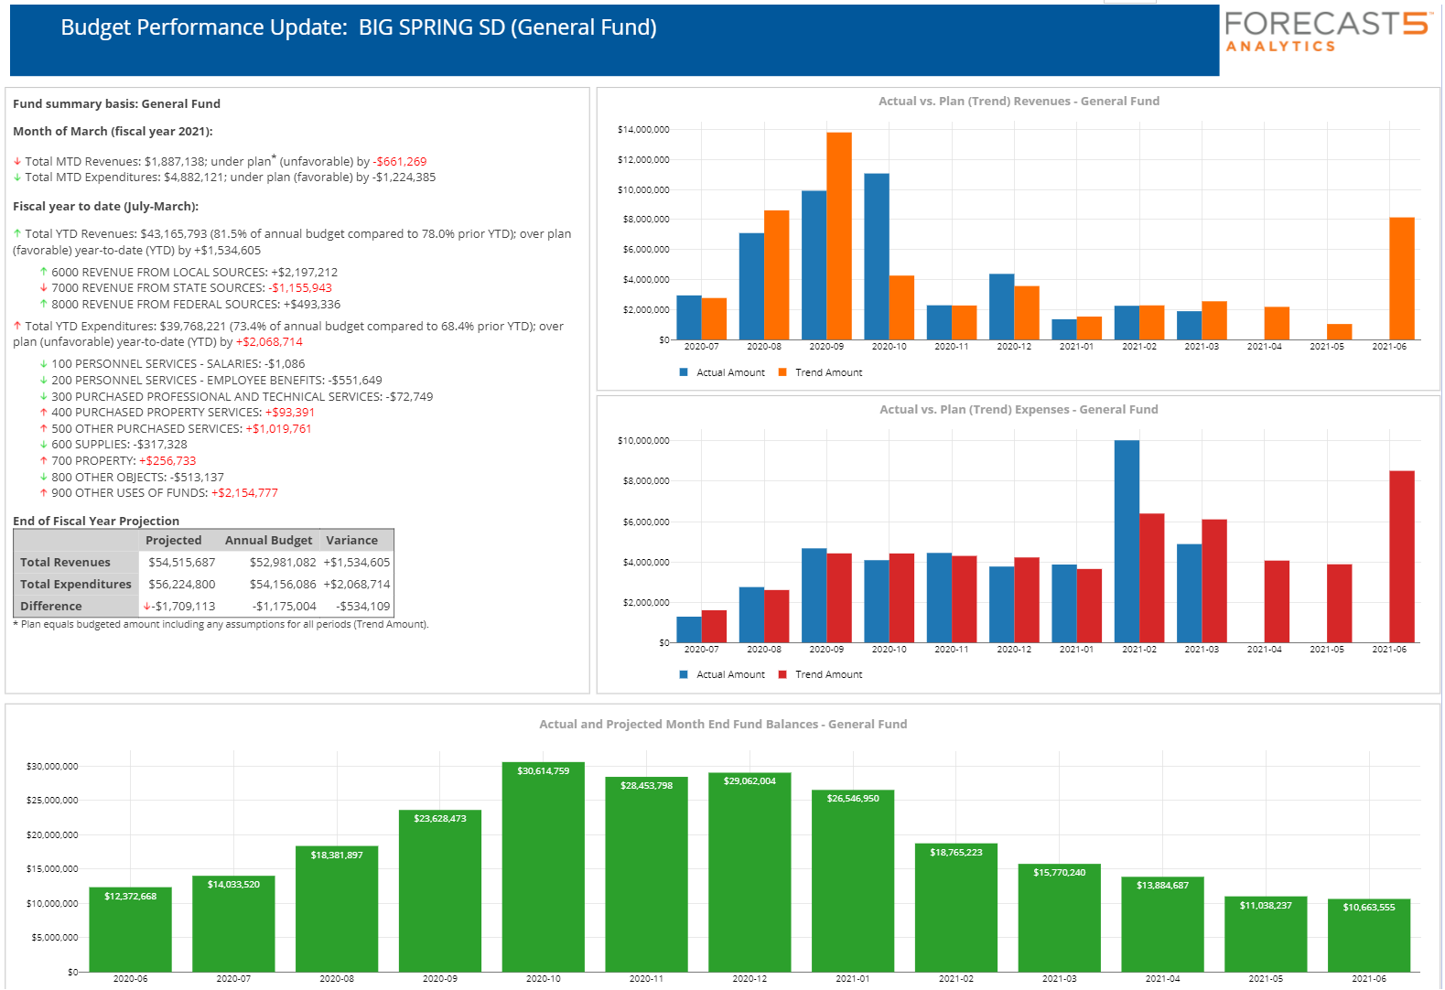

Slide 14
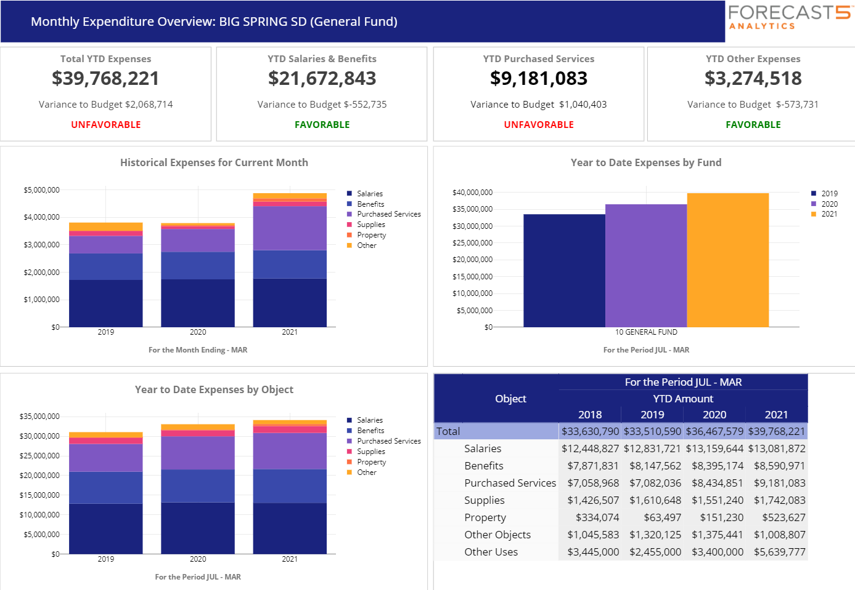

Slide 15
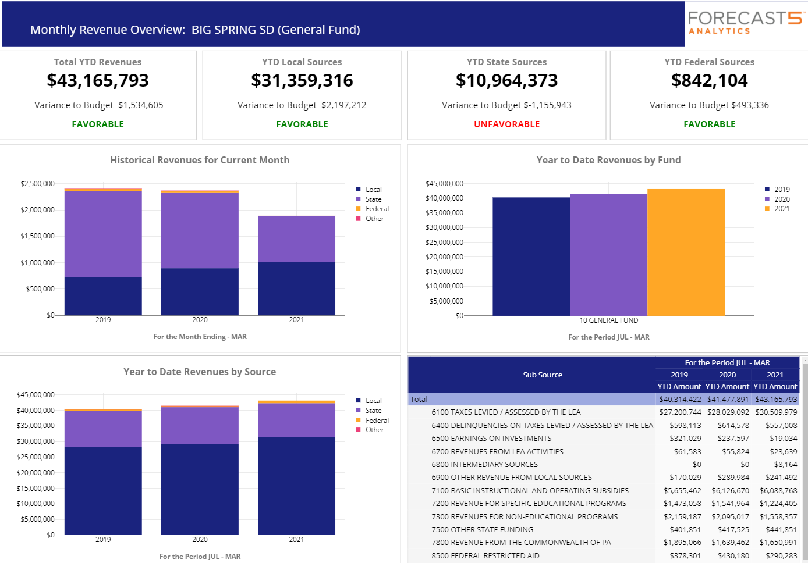

Slide 16
FY21 Forecast

Slide 17

FY22 Budget

Slide 18
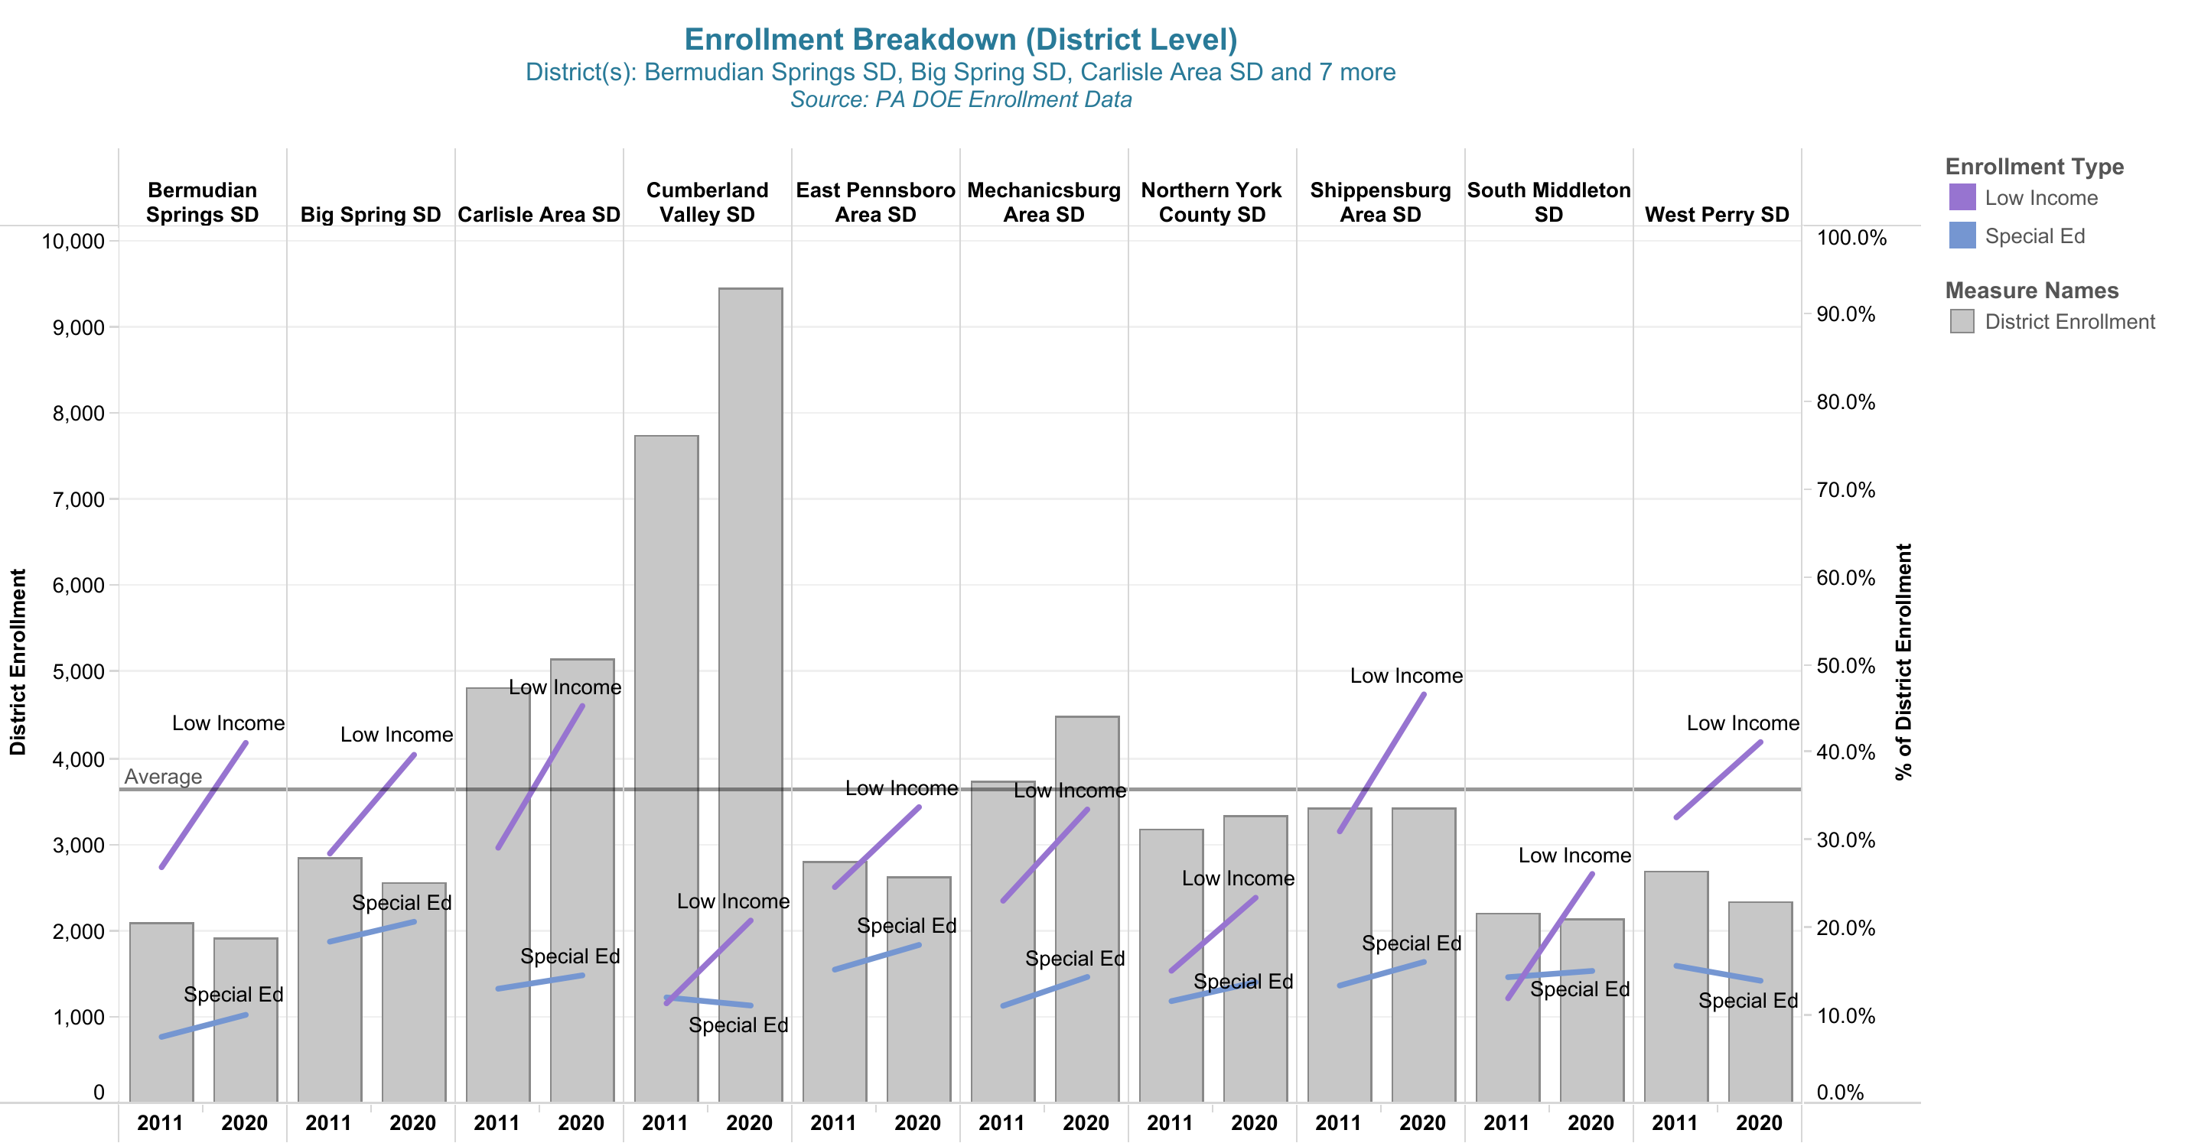
Enrollment

Slide 19
Personnel

Slide 20
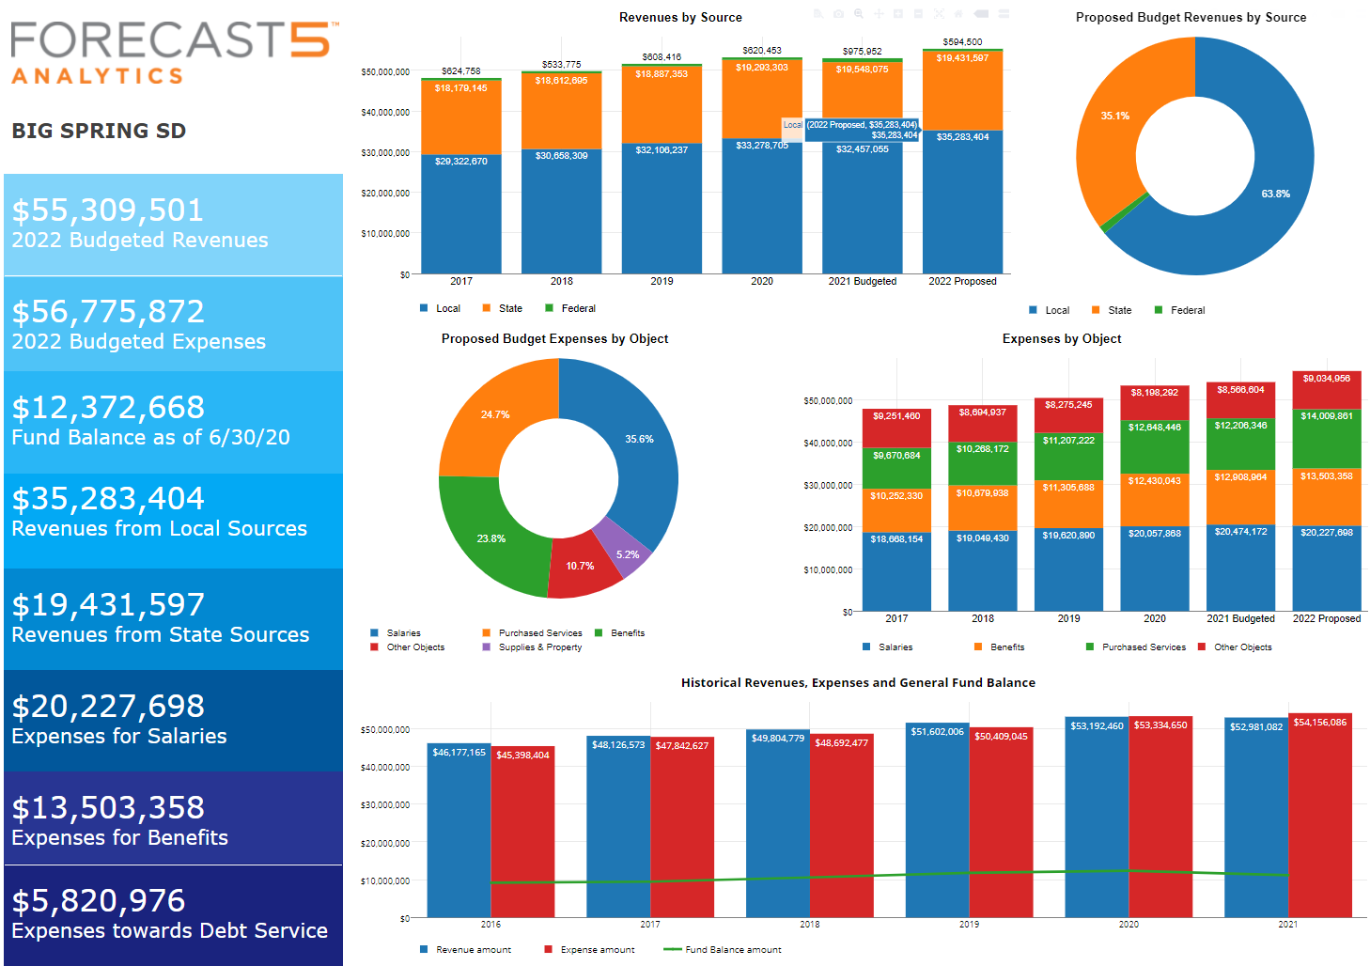
FY 22 Budget Snapshot

Slide 21

Spending Challenges

Slide 22
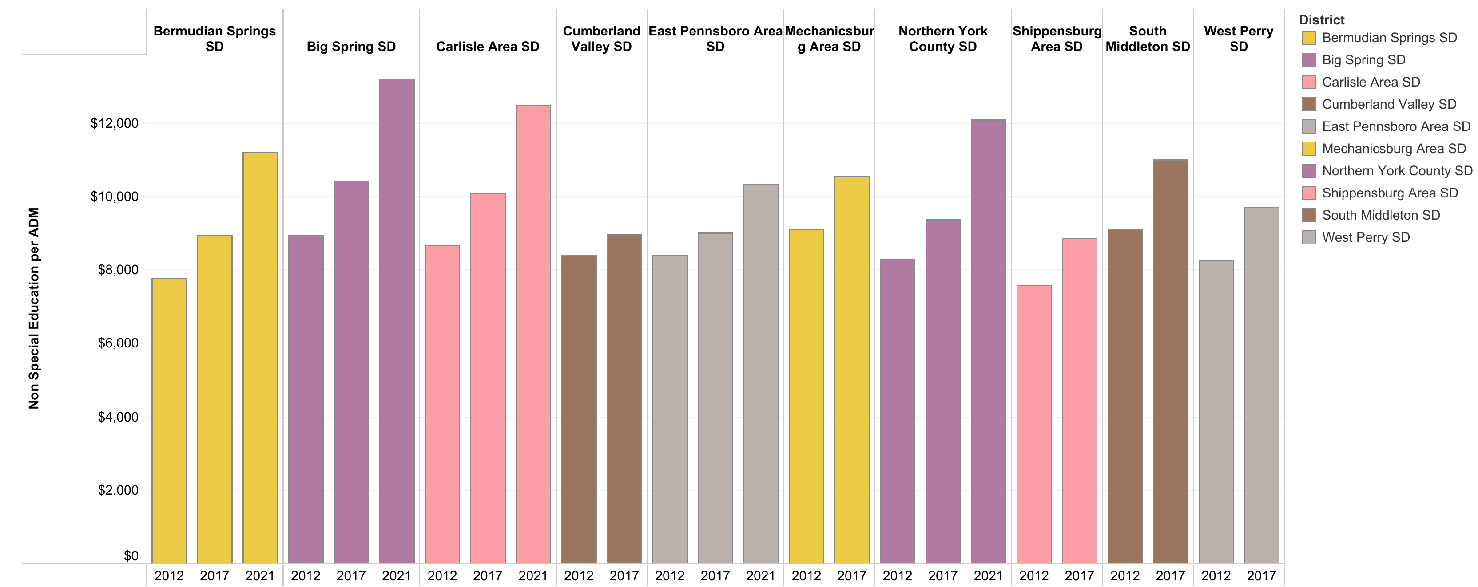
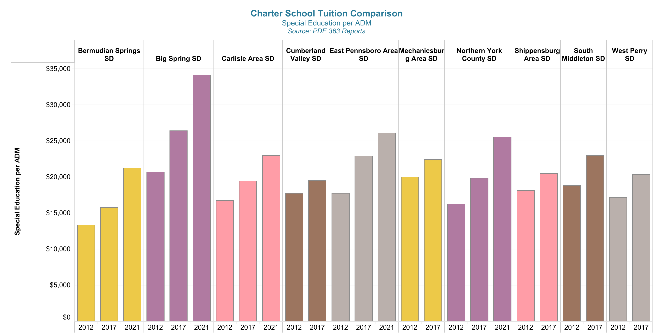
Charter School Tuition
REd
SpEd

Slide 23
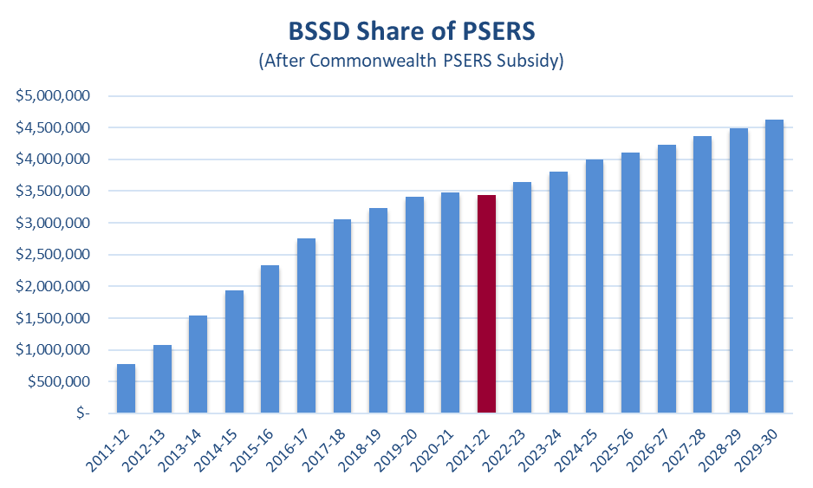
PSERS Contribution FY22:

Slide 24
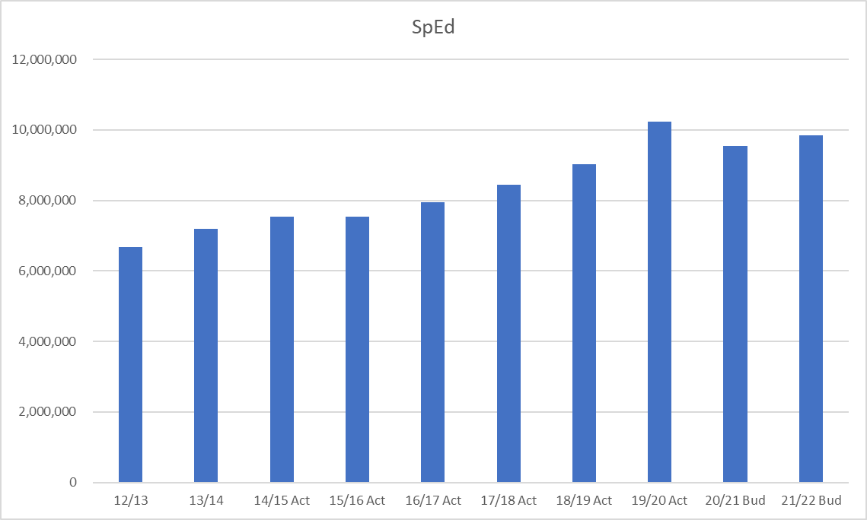
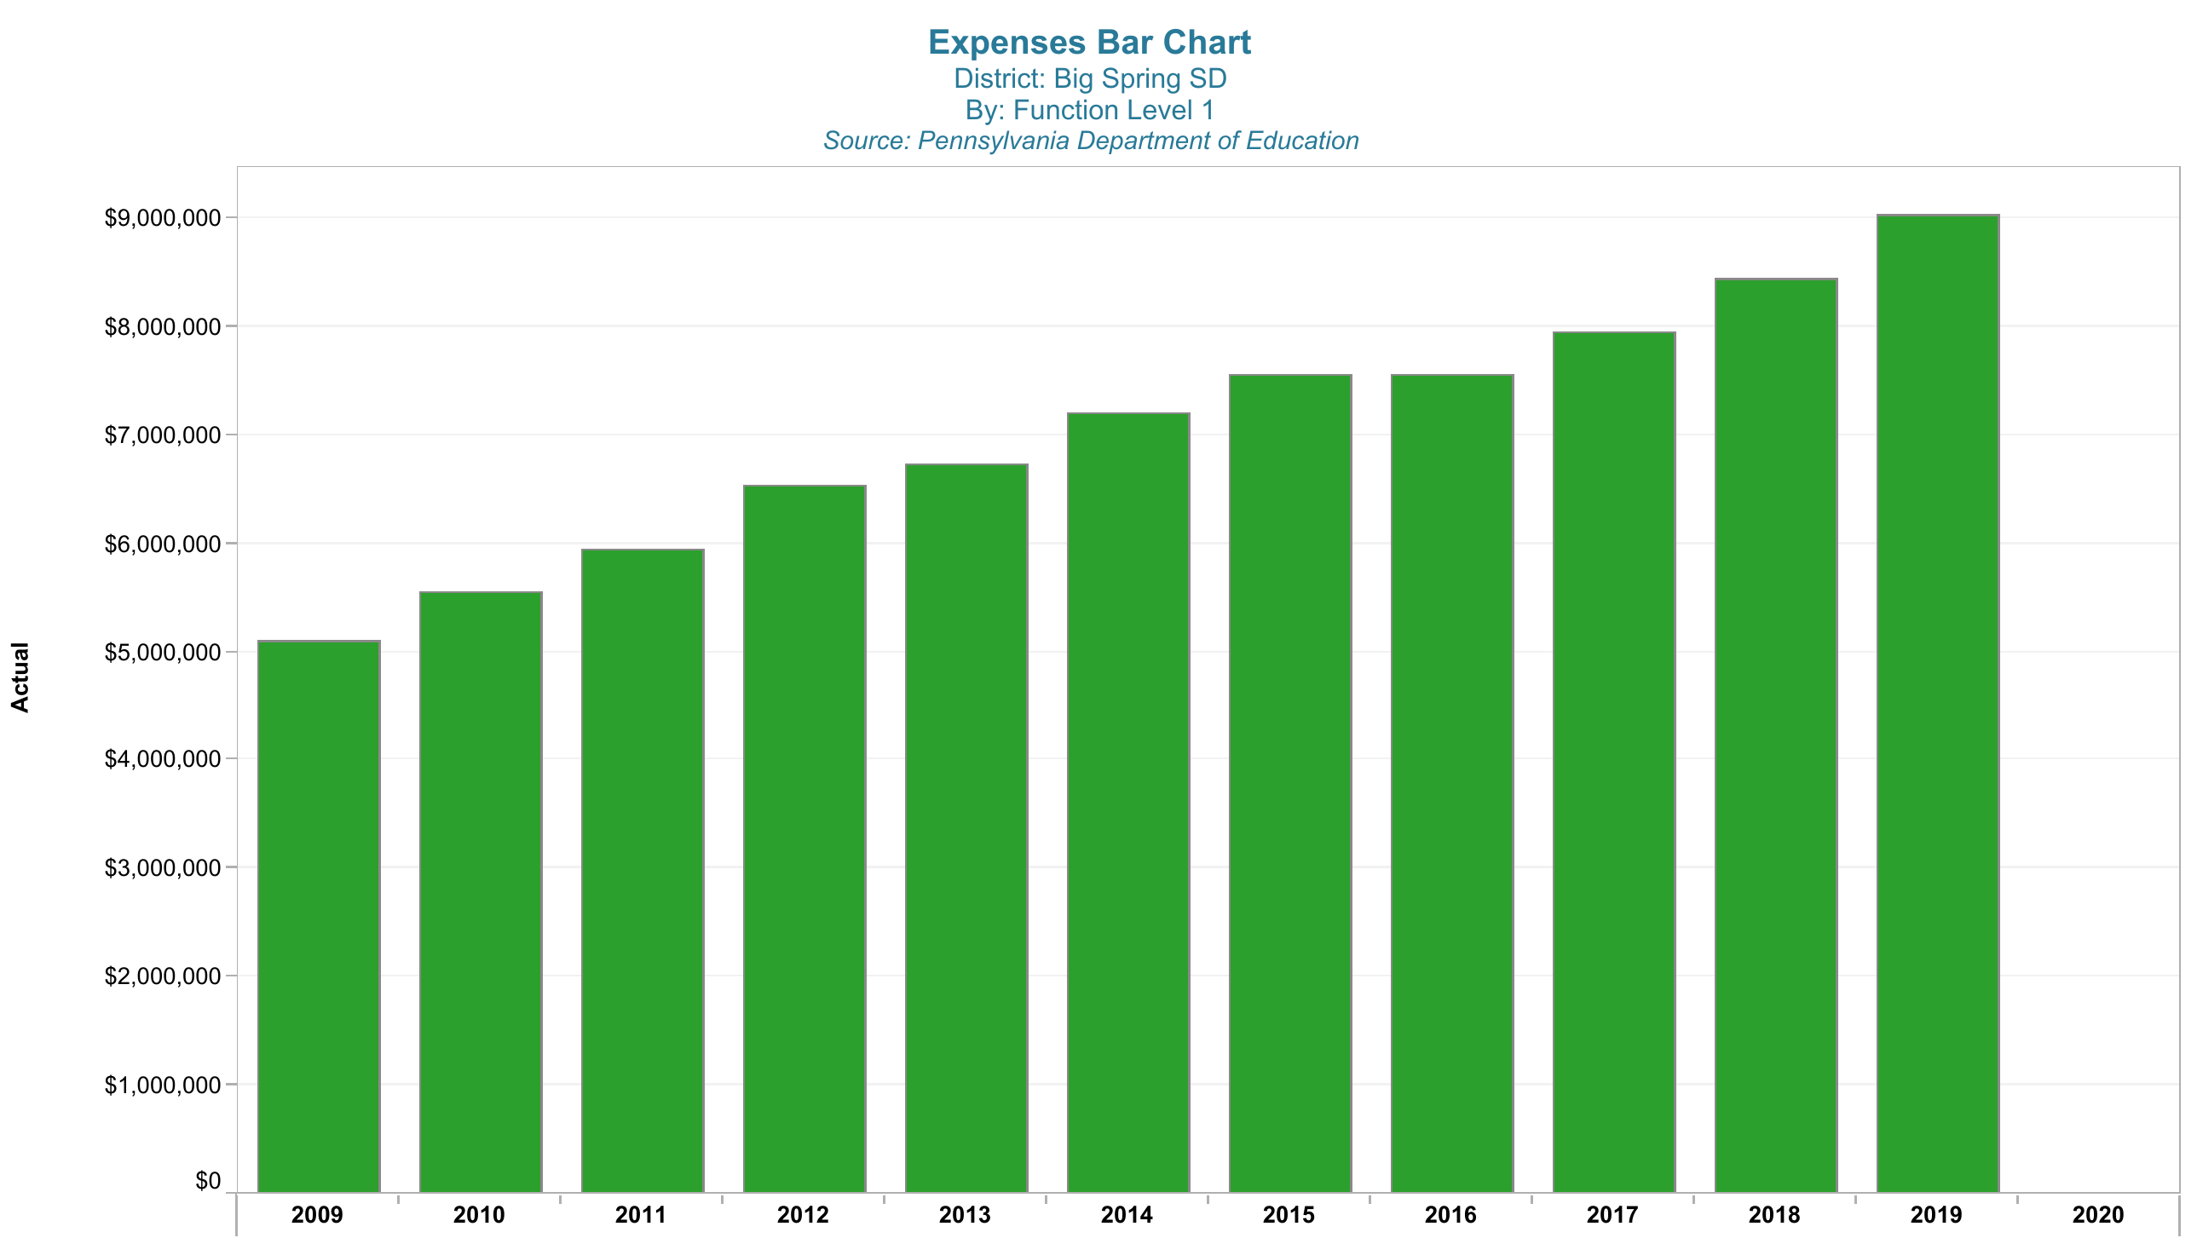
SpEd Budget

Slide 25
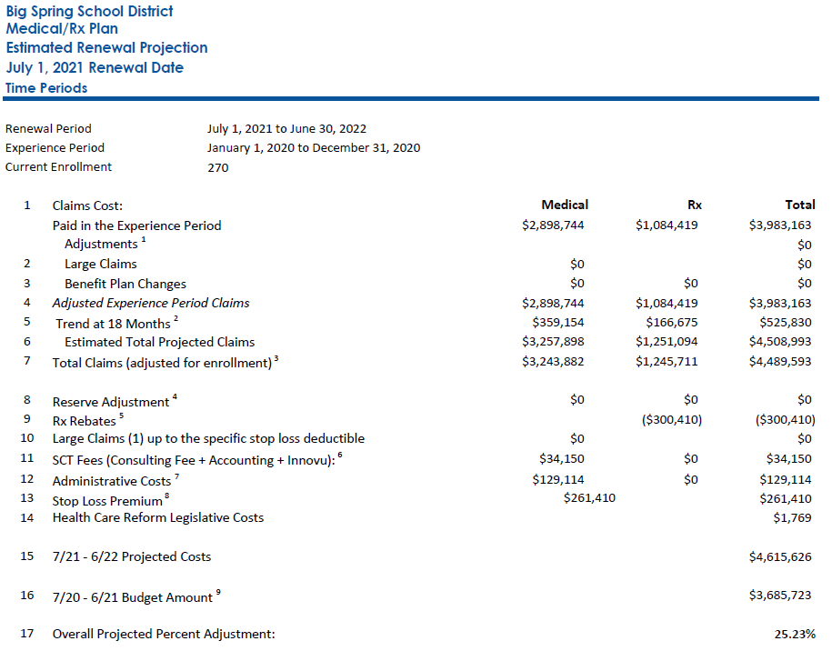
Medical

Slide 26
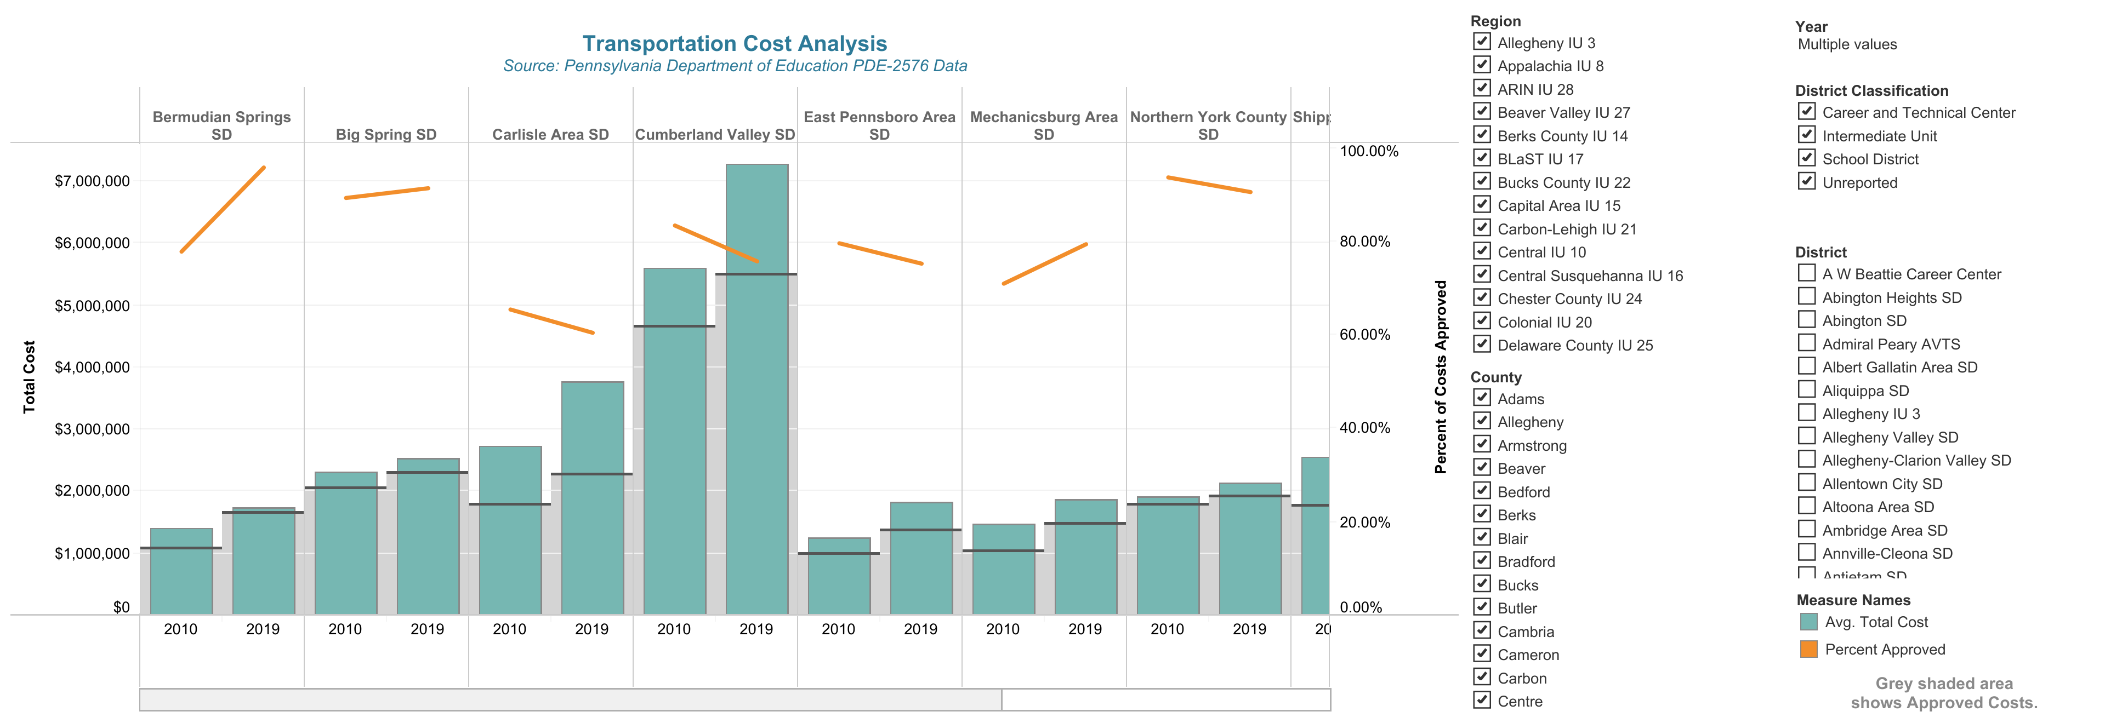
Transportation

Slide 27
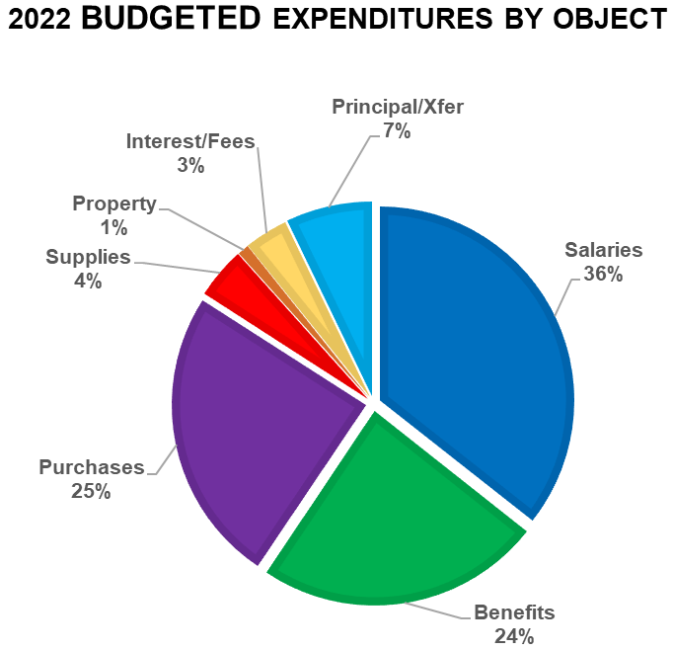
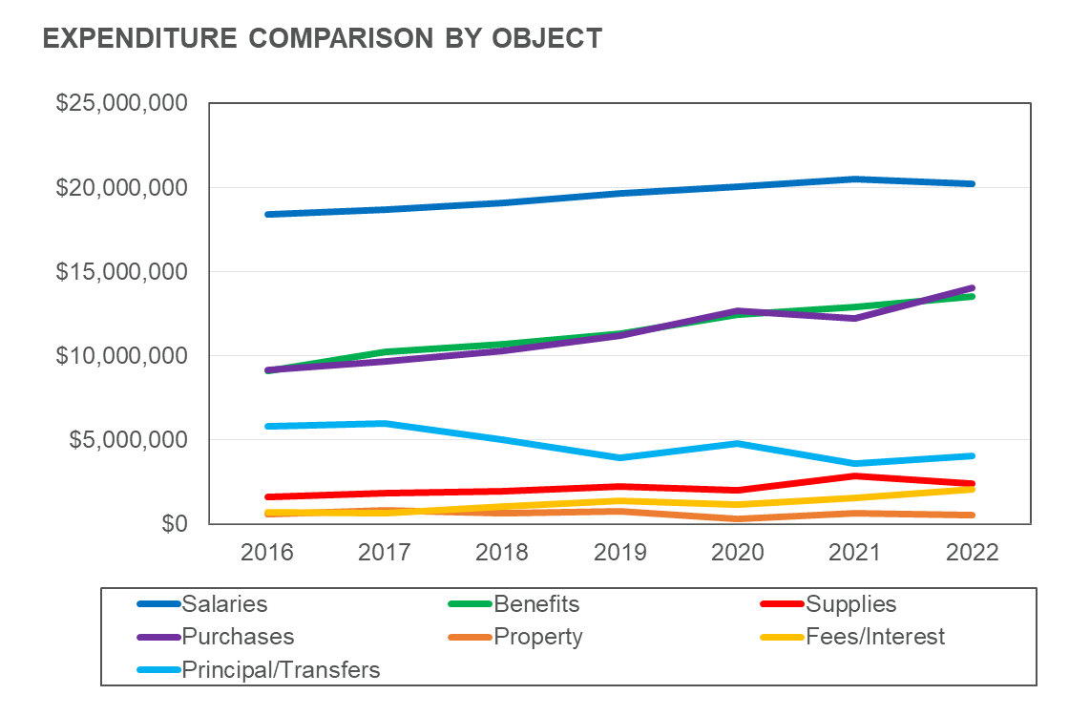
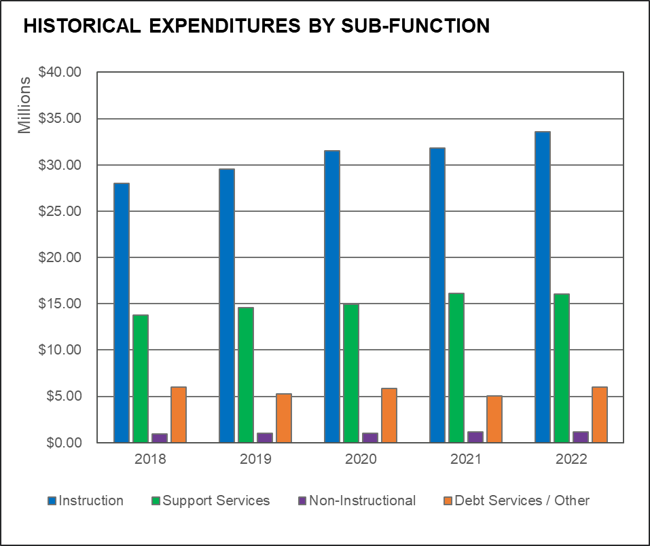
Spending

Slide 29

Revenue Challenge

Slide 30
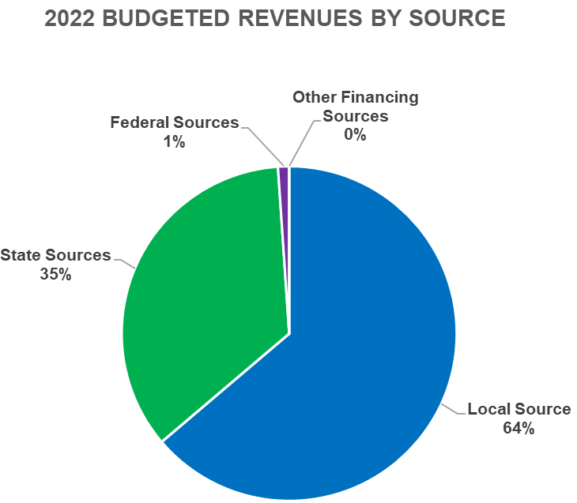
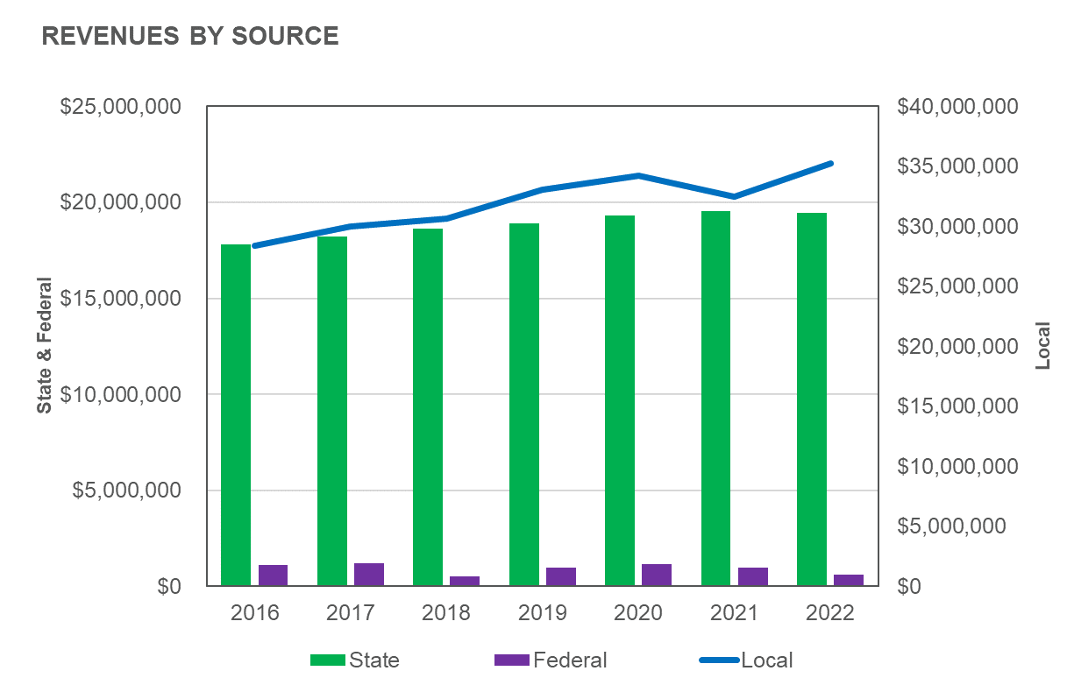
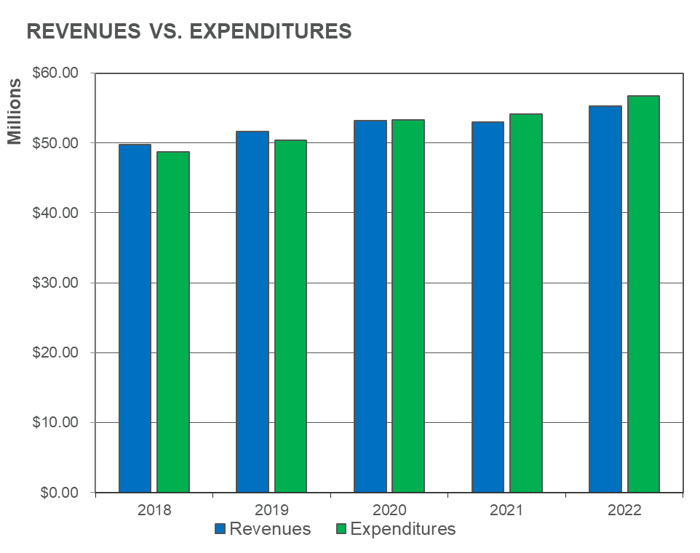
Revenue

Slide 31
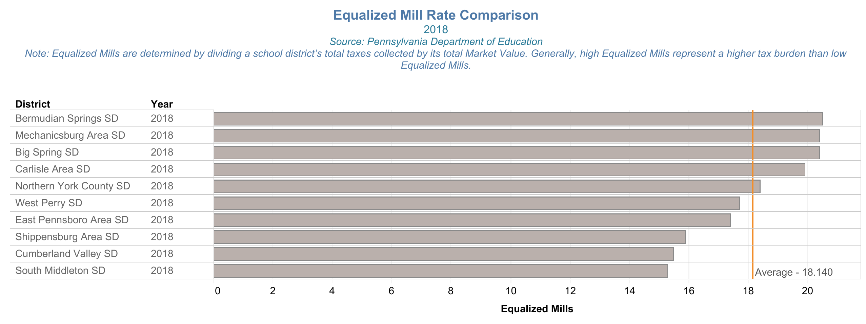
Property Tax

Slide 32
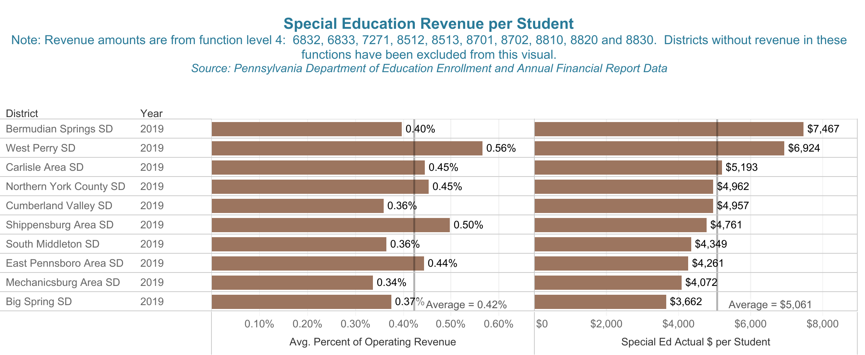
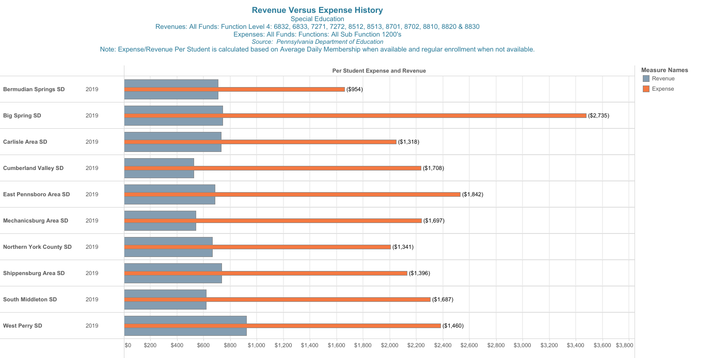
SpEd Revenue (2019)

Slide 33
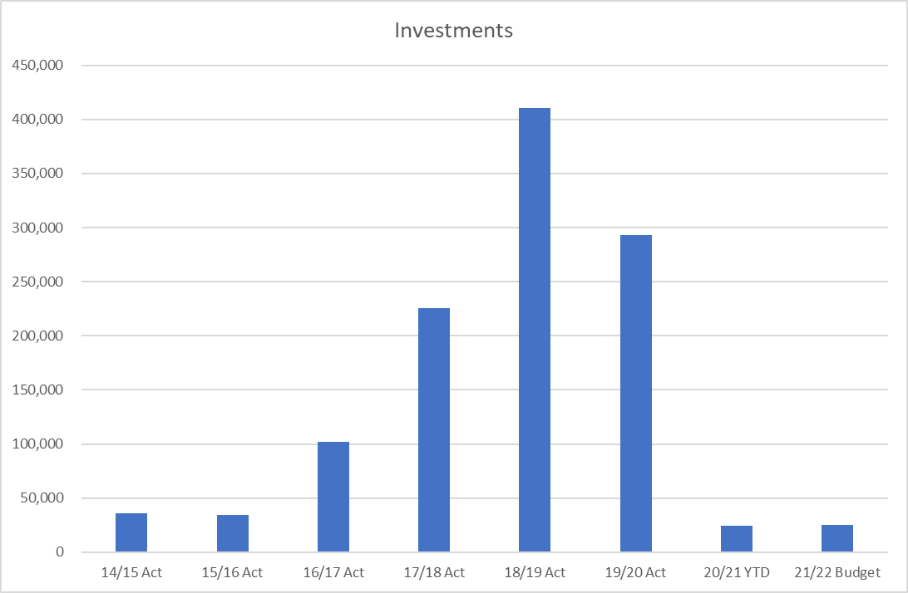
Earnings on Investments

Slide 34
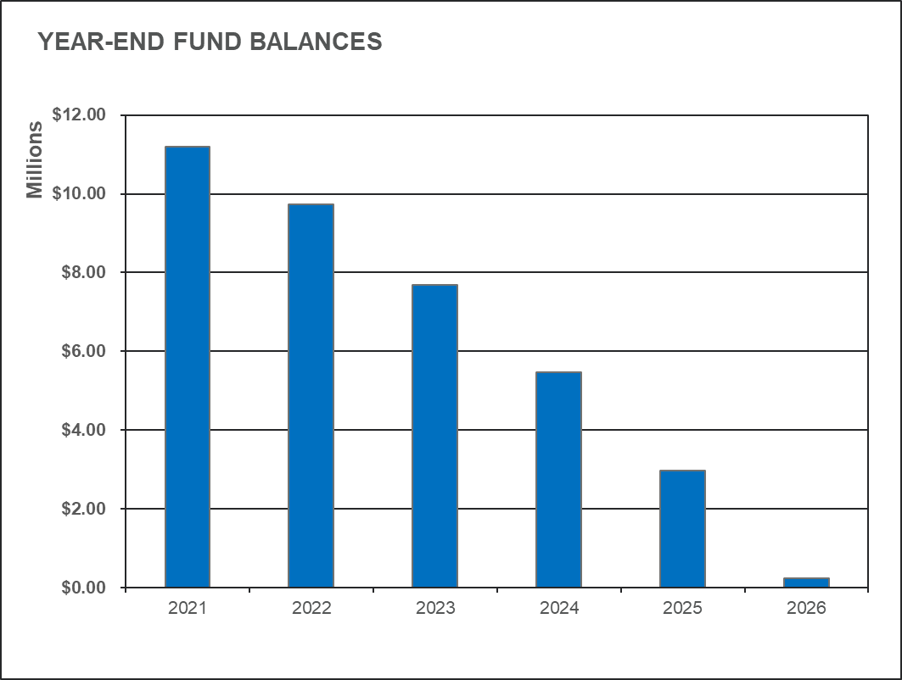
Projections

Slide 35
Schedule

Slide 36

Questions
BSSD’s Forecast 5 Website

