Slide 1

Building & Property
Committee
Meeting
2020 02 03

Slide 2
Summer 2020
Project Estimates
Change to Item L
On Board Agenda:

Slide 3
Smart
Panel
History
  Fifteen years ago the district first partnered with Smart for installation of display touch panels
  Two years ago we upgraded to 86” Smart Interactive TVs at Newville
  Last summer we upgraded to 86” Smart Interactive TVs at Mount Rock/Oak Flat
  Elementary teachers have strongly expressed their approval of the technology
  The district has a repository of lesson plans developed in Smart Notebook

Slide 4
MS & HS
Panel RFP
  RFP released December 20
  Presentations on January 23 by Smart, Promethean, ViewSonic, NEC
  Proposals received January 31
  Vendors scored on:
  Meeting the general specifications outlined in the RFP
  Demonstrated ability of the vendor to provide products and services in the timeline
  Product Pricing
  Adequacy and completeness of the plan offered for the scope of services requested

Slide 5
Why
SMART?
  Consistency across the district
  One platform to support and create professional development training materials,
  Teachers and students learn to use one device K-12
  Simple and familiar interface
  Demonstrated ability to deliver on all capabilities as outlined in the RFP
  Meets all specifications as outlined in the RFP
    Best-in-class “real” multi-user collaboration experience and tool differentiation
    Only product that supports writing, erasing, moving objects at the same time

Slide 6
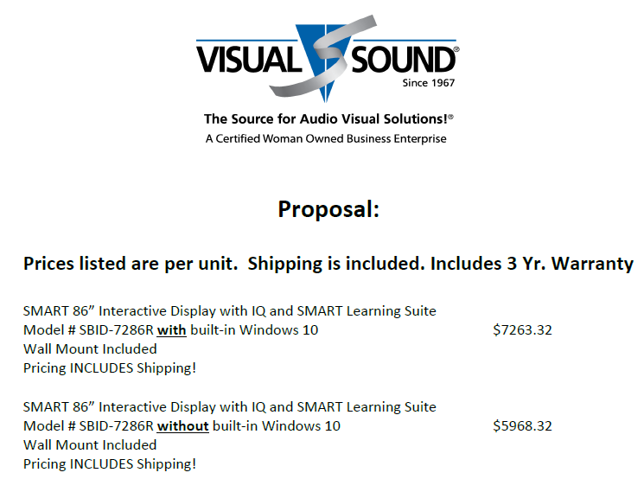
Interactive Panel Project Costs

Slide 7
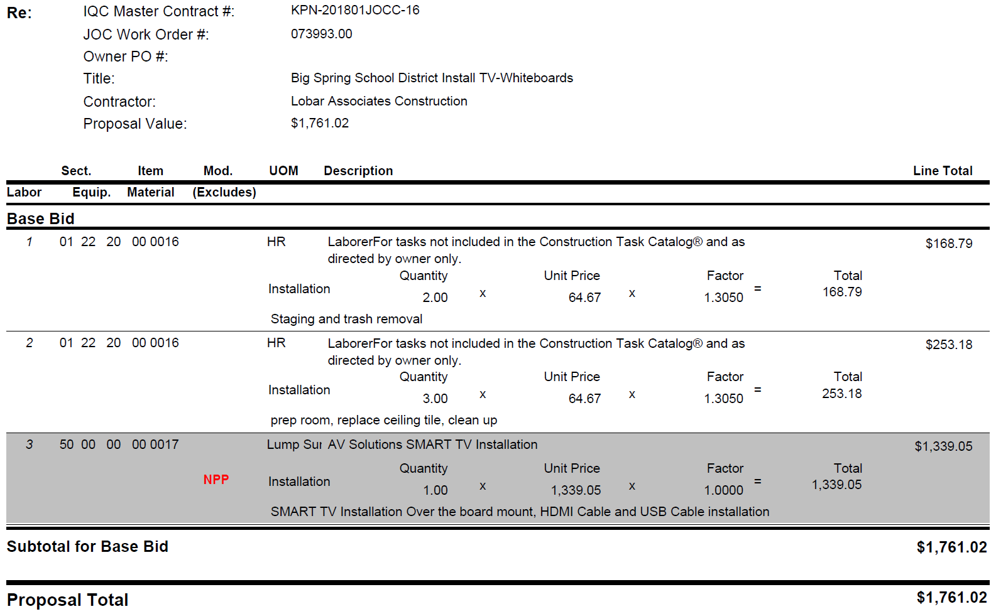
KPN Proposal:
Panel
Installation
cost per panel

Slide 8
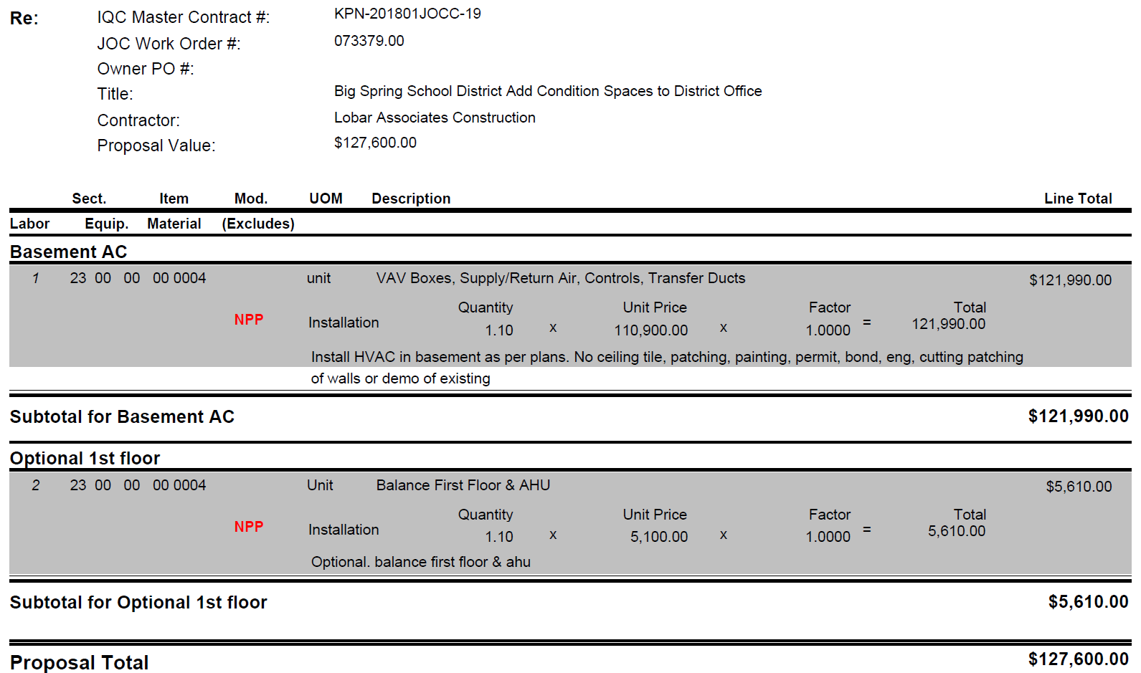
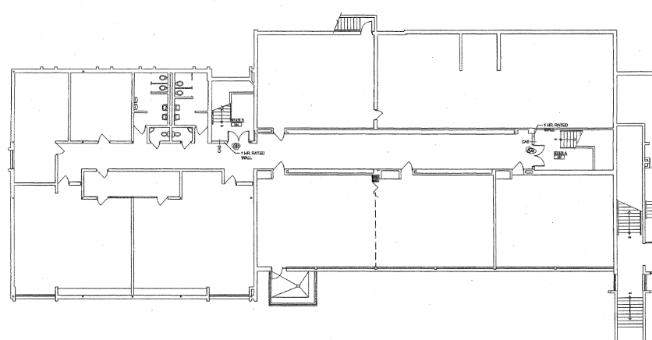
DAO Fix
Basement
10,724 SF

Slide 9
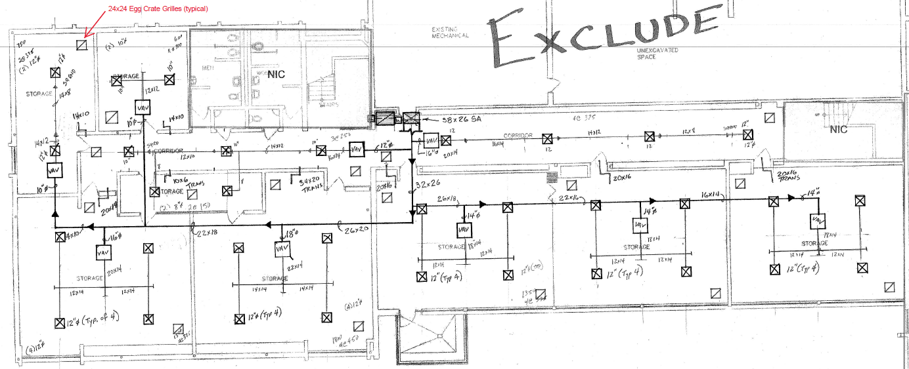

Slide 10
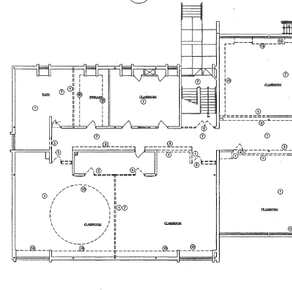
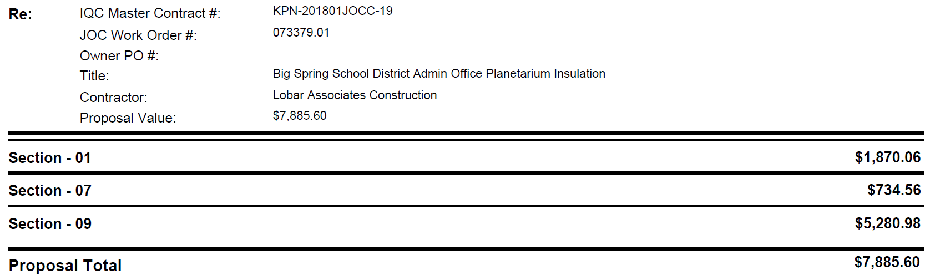
DAO Fix
Planetarium

Slide 11
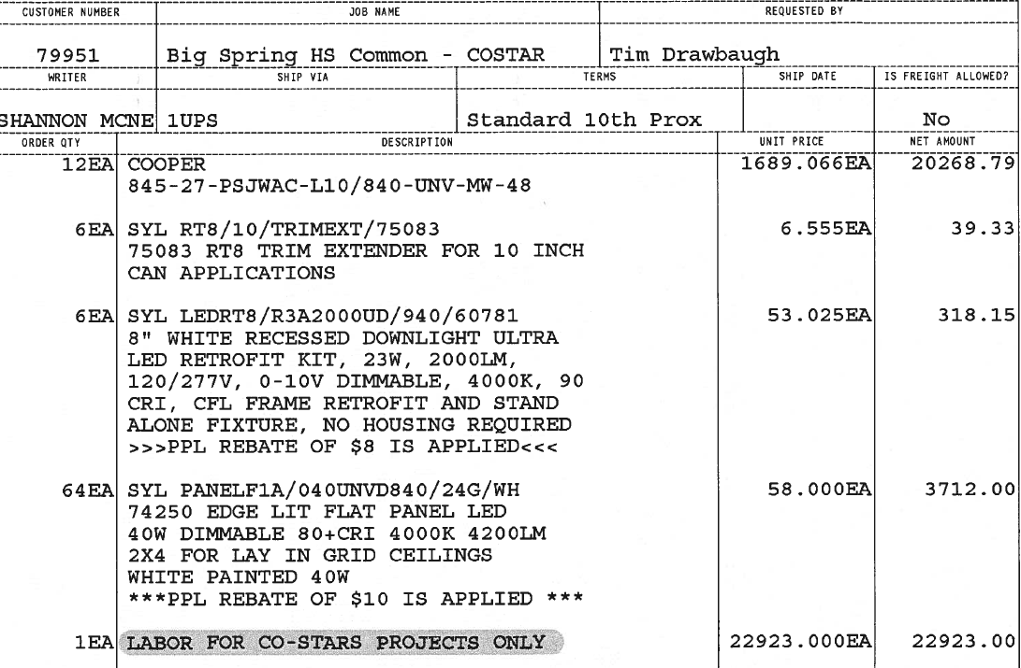
HS Commons
LED Lighting
$ 47,261.27

Slide 12
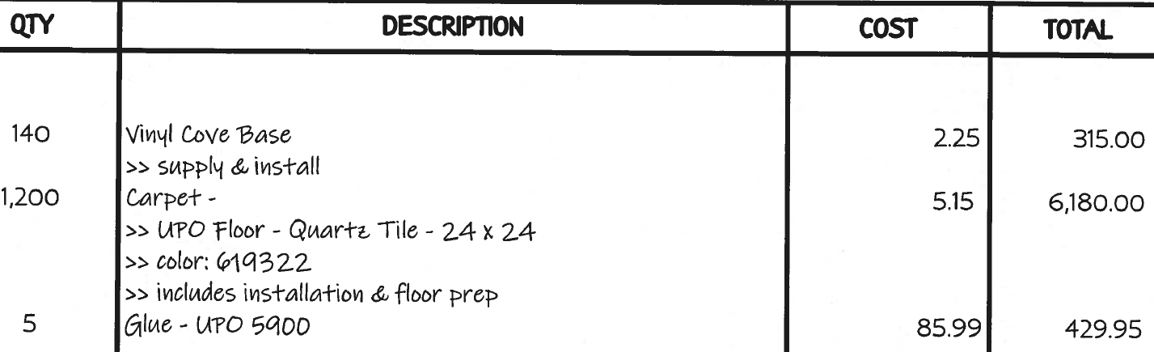
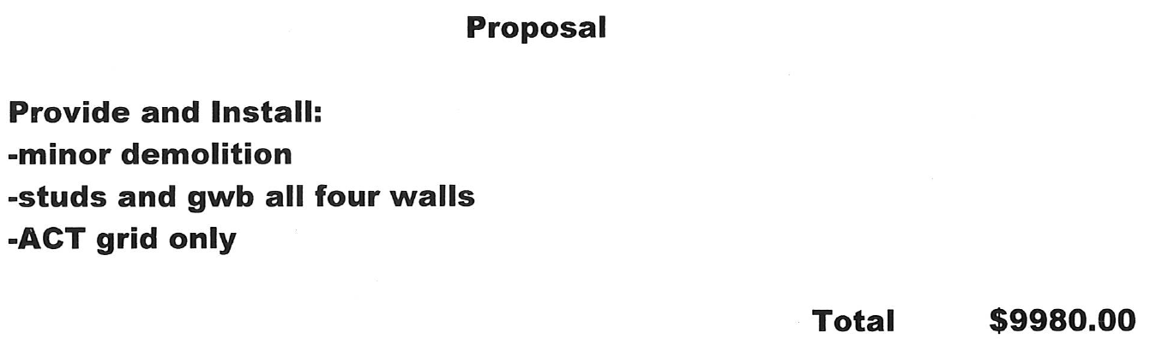
Tech / Warehouse
Reno

Slide 13
Recommend a Motion to Approve
Make a motion to approve the
Visual Sound Proposal of Jan 31, 2020 at a cost of $5,968.32 per panel; and
KPN Job# 073379.0 to add conditioned space to DAO lower level (incl air balance option) at a cost of $127,600; and
KPN Job# 073379.01 to Insulate the DAO Planetarium at a cost of $7885.60; and
authorize the administration to sign the appropriate contract documents.

Slide 14

Funds
Update

Slide 15
Capital Projects
Fund

Slide 16
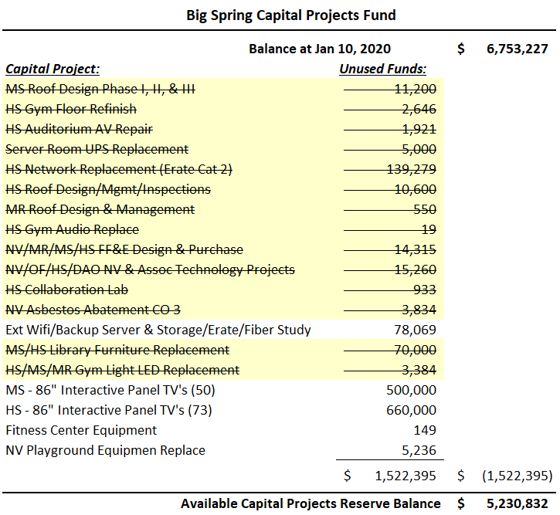
Close
Capital Projects
Reserve
Projects

Slide 17
Capital
Projects
Reserve
Fund

Slide 18
NV & MR Bond Fund
Balance

Slide 19

Budget 21 Update

Slide 20
Assessed Value -
January Update

Slide 21
FY 21 Projection:
January Update

Slide 22
FY 21
Expenditures

Slide 23
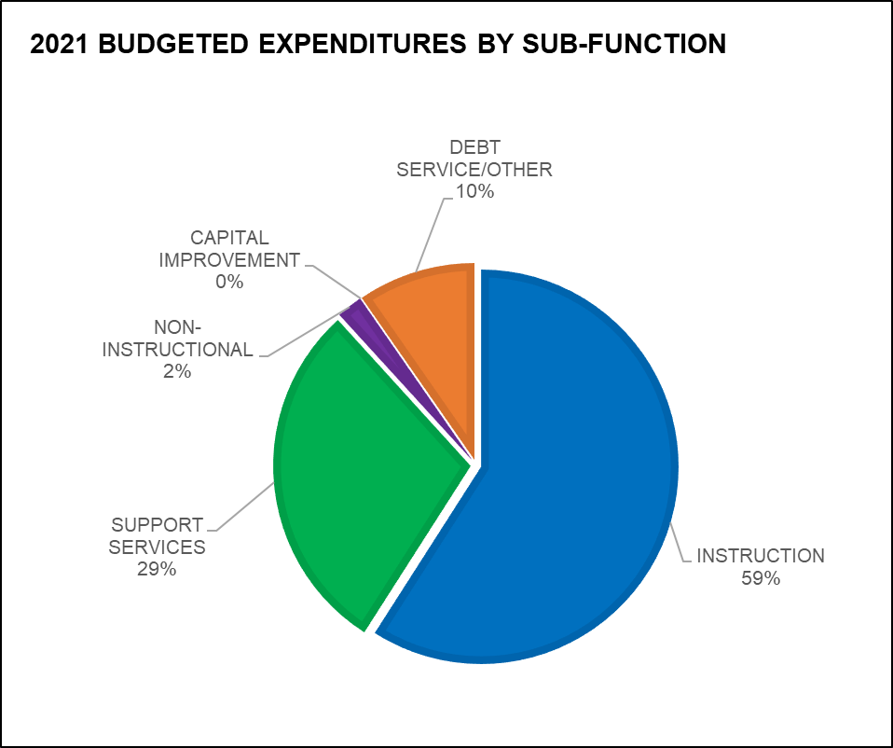
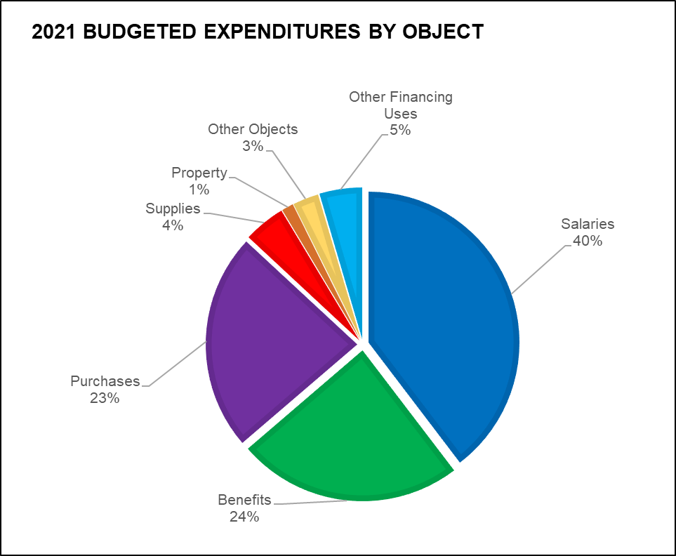
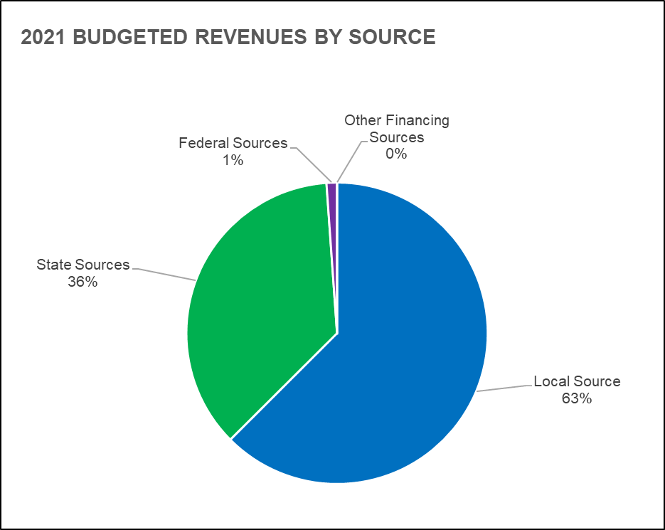
FY 21
Functions, Objects & Revenues

Slide 24

Questions

