Slide 1

Building & Property
Meeting
2020 01 13

Slide 2

Funds Update
As of 2020 01 13

Slide 3
General Fund

Slide 4
Capital Projects
Fund

Slide 5
MR Bond Fund

Slide 6
Summer 2020
Project Estimates
Interactive TV retrofit to HS/MS $1,116,500
  Hardware
  Installation
Fiber WAN (via Erate) $500,000 tbd
Move Tech Dept from MS 520 to Warehouse $19,000
DAO Fix
HS Commons LED Lighting $50,000
Total $1,685,500
Note: Erate should pay ~60% of the Fiber WAN

Slide 7
Interactive Panel Bid Process
High School & Middle School
RFP released December 20
Vendor demonstrations and presentations – January 23
  Smart, Promethean, ViewSonic, NEC invited
Proposals due January 31
Vendors will be scored on:
  Meeting the general specifications outlined in the RFP
  Demonstrated ability of the vendor to provide products and services in the timeline
  Product Pricing
  Adequacy and completeness of the plan offered for the scope of services requested

Slide 8
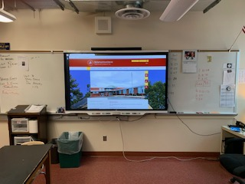
Middle School Protype
Consideration was given to:
Removal of center whiteboard in the middle school
Full removal of whiteboard in the high school and redoing the wall with the TV and two new whiteboards as was done in the elementary buildings
OR…
Using an over/under wall mount for the TV
Notes:
T

Slide 9
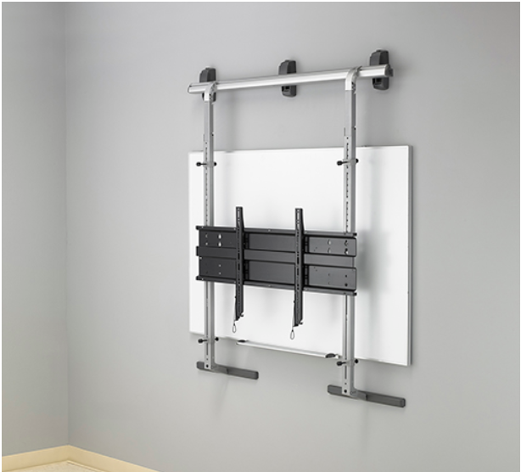
Over Under Wall Mount
Mounts over existing structure
Some exceptions
Provides future flexibility
TV will cover most of mount; but, it won’t look as integrated at Elems

Slide 10
Interactive Panel Install Options
Pricing

Slide 11
Fiber eRate Update
470 Bid posted on E-Rate and district web sites
Obligatory newspaper ads published
Pre-bid meeting held January 8
  One contractor attended – Celerity
  Celerity contacted the district after the meeting and indicated they will submit a bid
Bids due no later than Feb 5, 1 PM
PP&L Pole attachment agreement under negotiation
Next update March 2 Board Meeting

Slide 12
Move
Tech Dept
Proposal to Restore MS 520 to educational space
Requires Tech Dept to move device storage, maintenance & deployment prep area out of 520
Move to warehouse area (old golf room)
Space Requirements
  Workspace for 3 technicians
  Storage for spare parts and spare computers
  Staging area for device inventory during imaging projects
  Device imaging area for 12 to 20 devices
  Electronics graveyard
Estimated cost of $17,000 for walls, suspended ceiling plus flooring ($19,000 total)

Slide 13
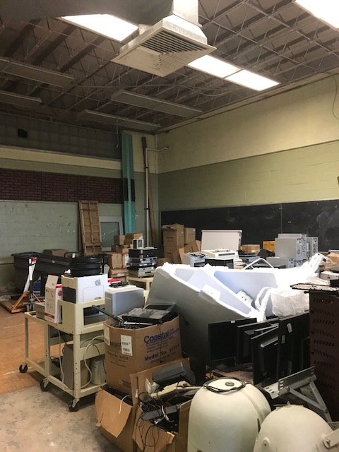
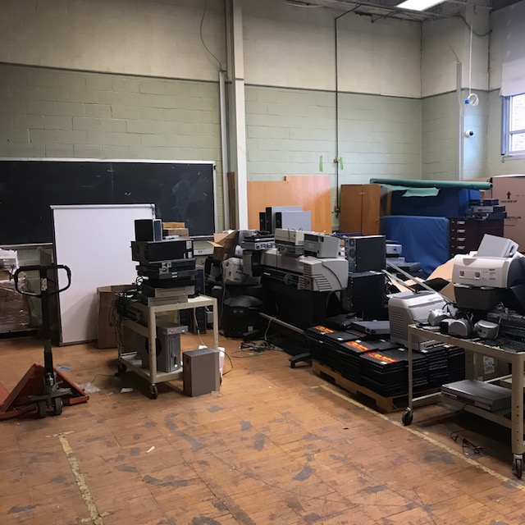
Tech Dept Move
Notes:
Needs:
Work space for 2 technicians
Storage for spare parts and spare computers for every device model
Staging area for device inventory during imaging projects
Device imaging area for 12 to 20 devices
Electronics graveyard

Slide 14
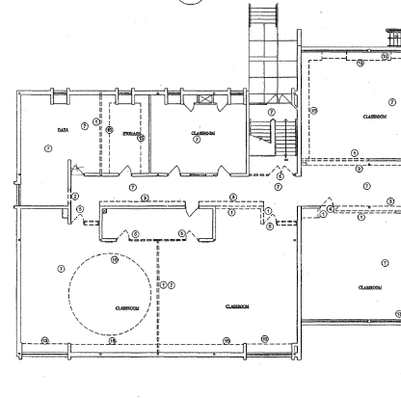
DAO Fix
Planetarium

Slide 15
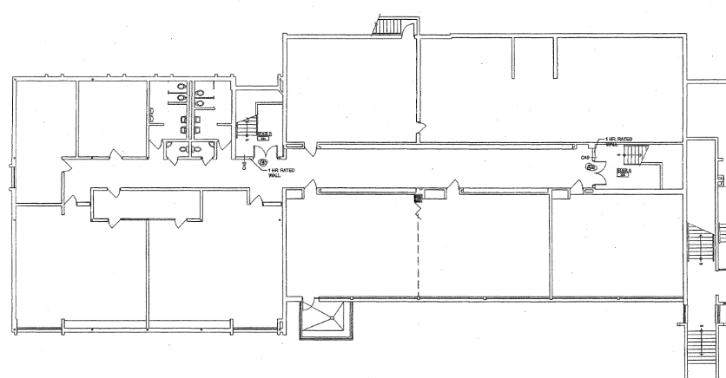
DAO Fix
Basement
10,724 SF
Est for Planetarium & Basement Fix = $130,000

Slide 16
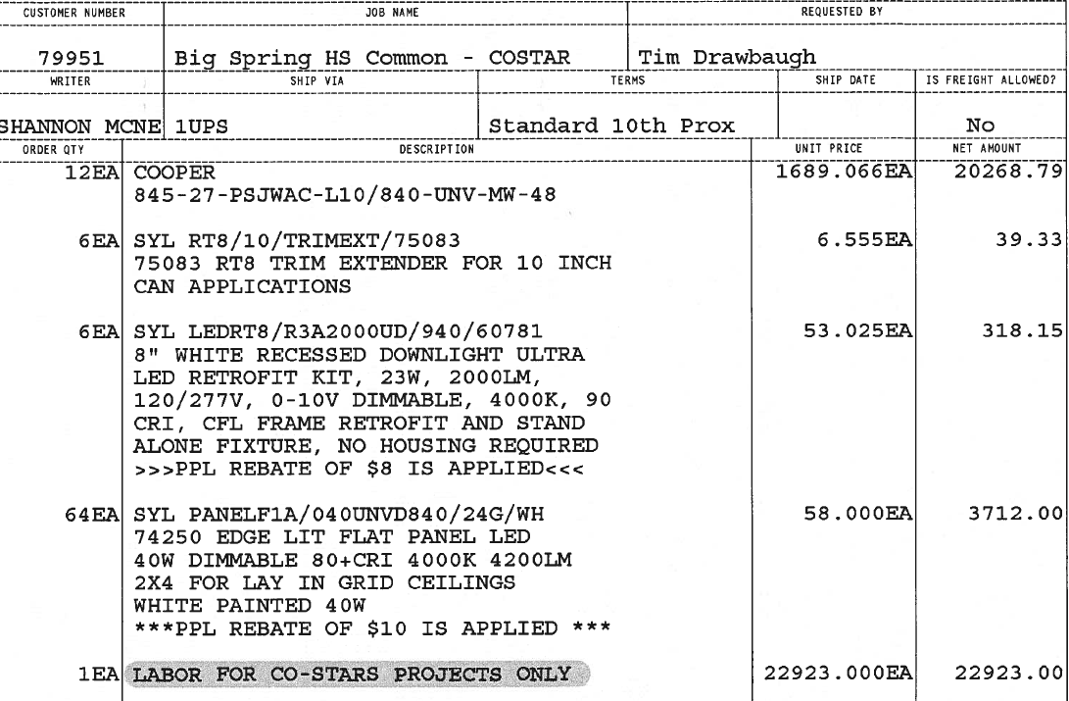
HS Commons
LED Lighting
$ 47,261.27

Slide 17

Budget 21 Update

Slide 18
Budget 21
Assessed Value
2019 Assessed Value = $1,752,507,100

Slide 19
Budget 21
Projection Update

Slide 20


Questions?

