Slide 1

Building & Property Committee
Meeting
19 04 01
v.07

Slide 2
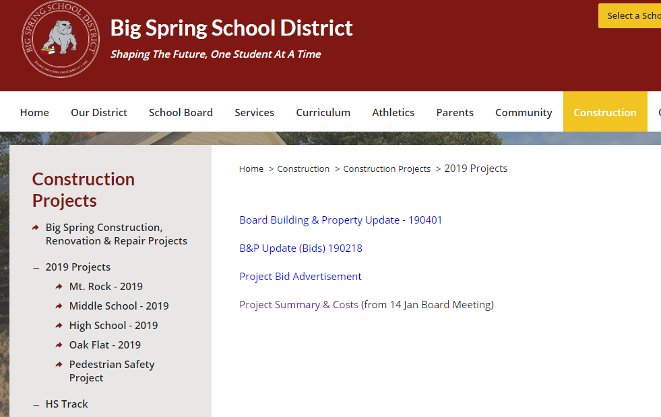
This presentation
Initial construction schedules here

Slide 3
Agenda
Director Updates (Rick Gilliam)
  Newville Terrazzo
  Mowing Bid Results
  Gym Relighting Project
  MR Initial Construction Schedule
  OF Initial Construction Schedule
Superintendent Updates (Dr. Fry)
  HS Furniture Purchase
  Review Capital Projects Approval
Technology Update (Rob Krepps)

Slide 4
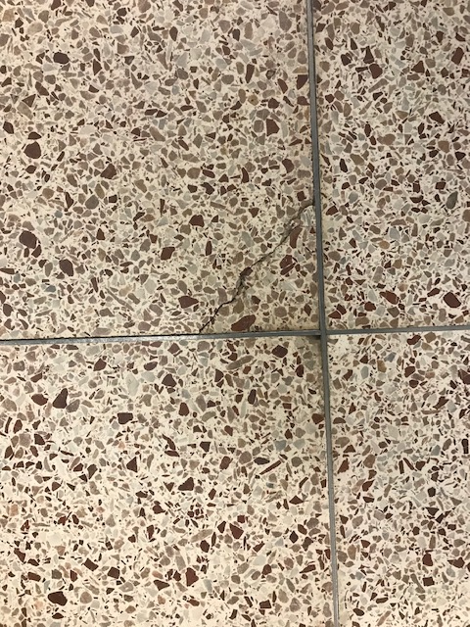
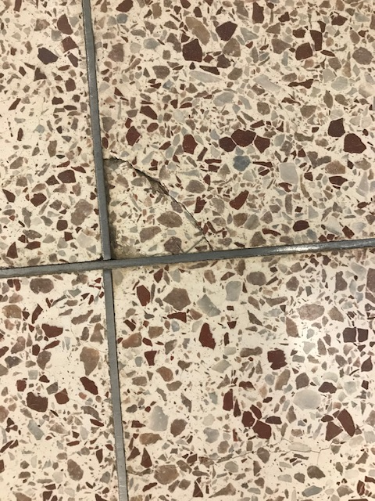
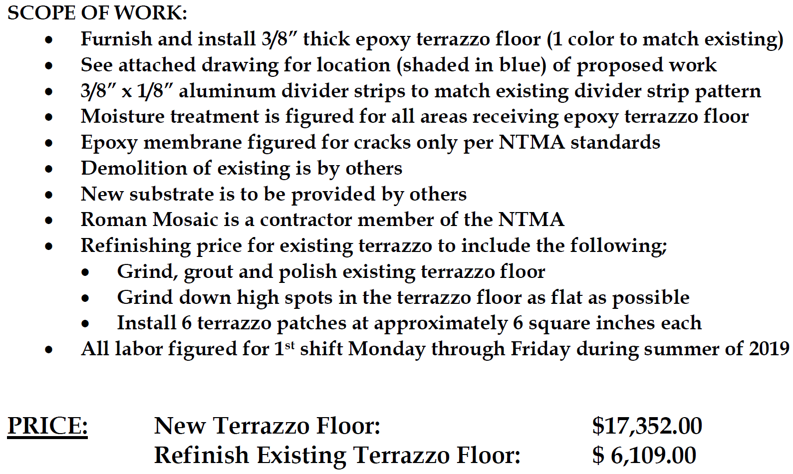
Newville Terrazzo Issue

Slide 5
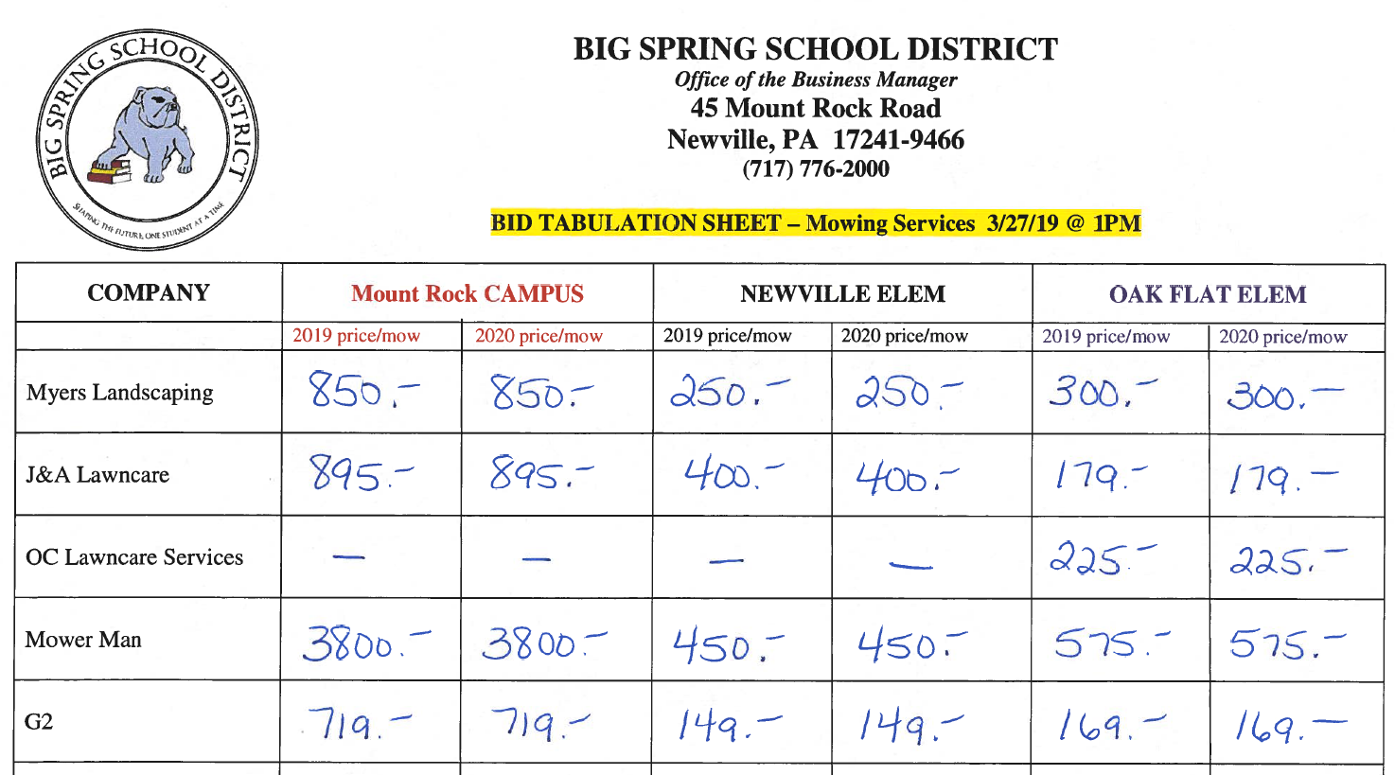
Mowing Service Bid Results

Slide 6
Gym Relighting Project
Better lighting
Savings
Less maintenance
Less high maintenance

Slide 7
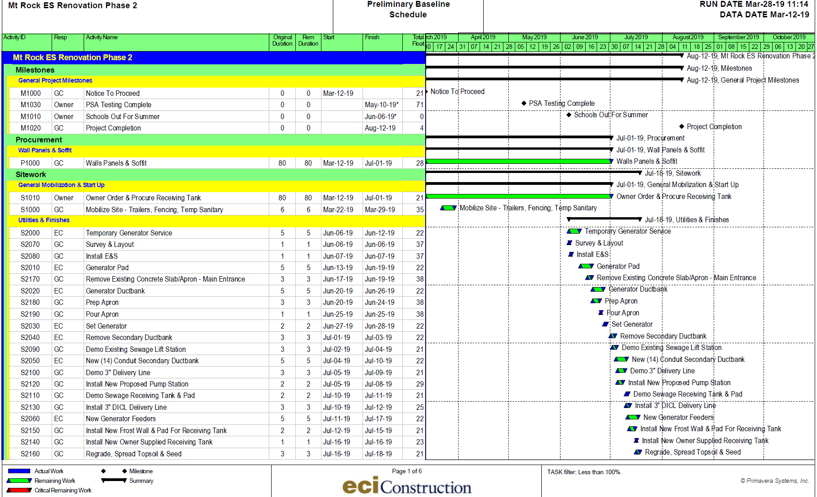
MR Schedule

Slide 8
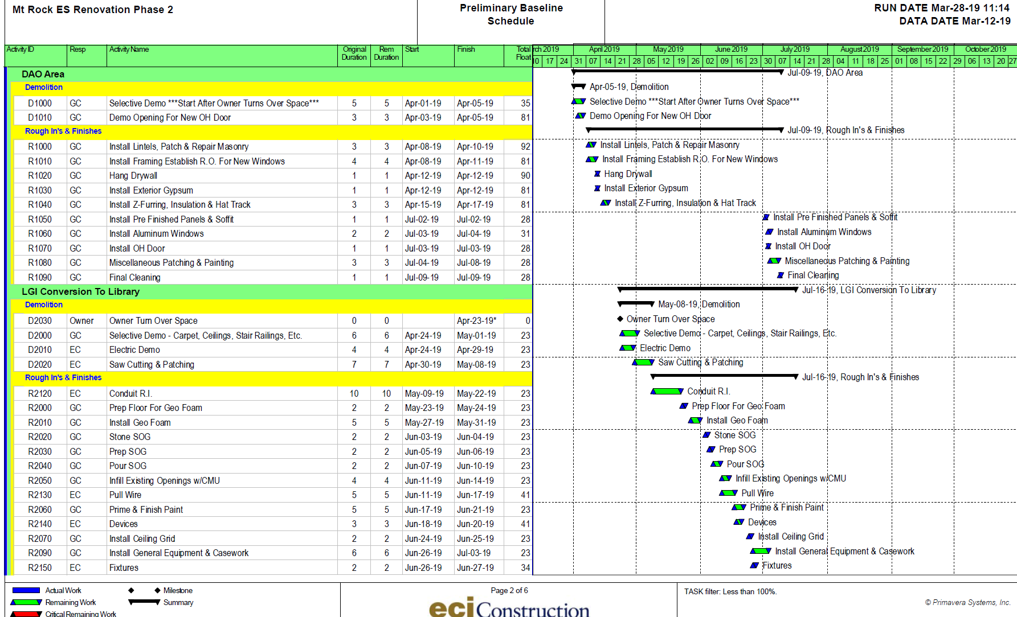

Slide 9
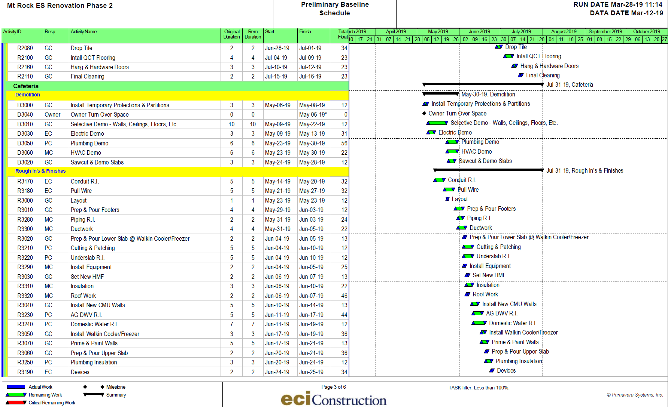

Slide 10
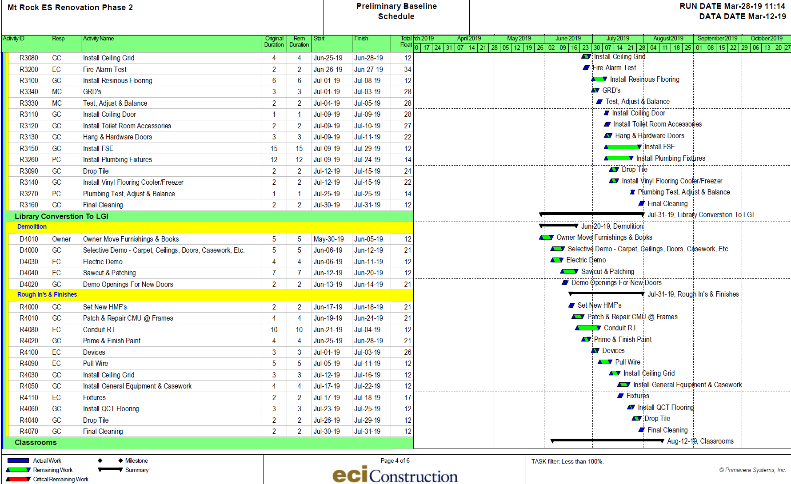

Slide 11
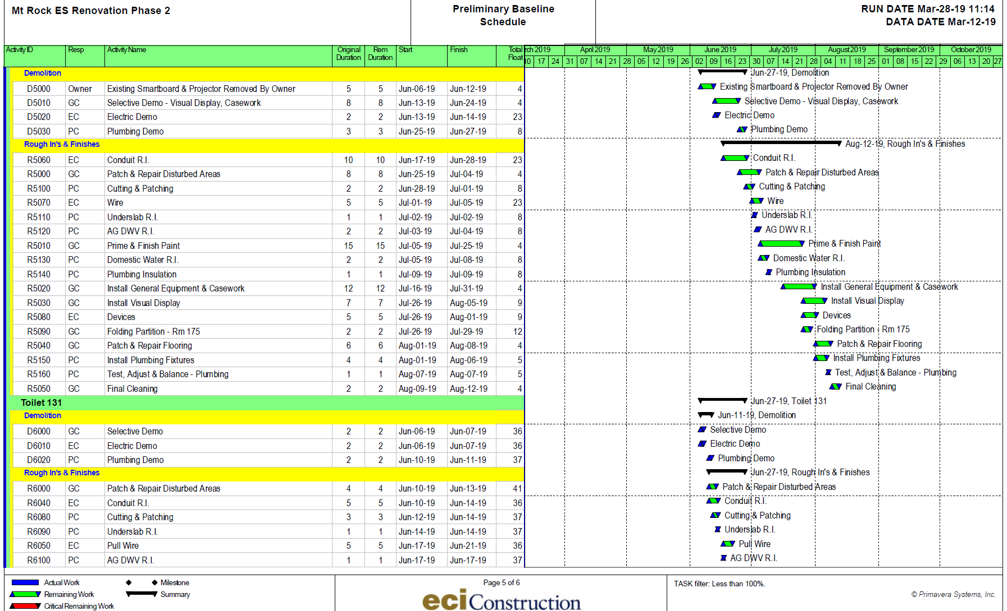

Slide 12
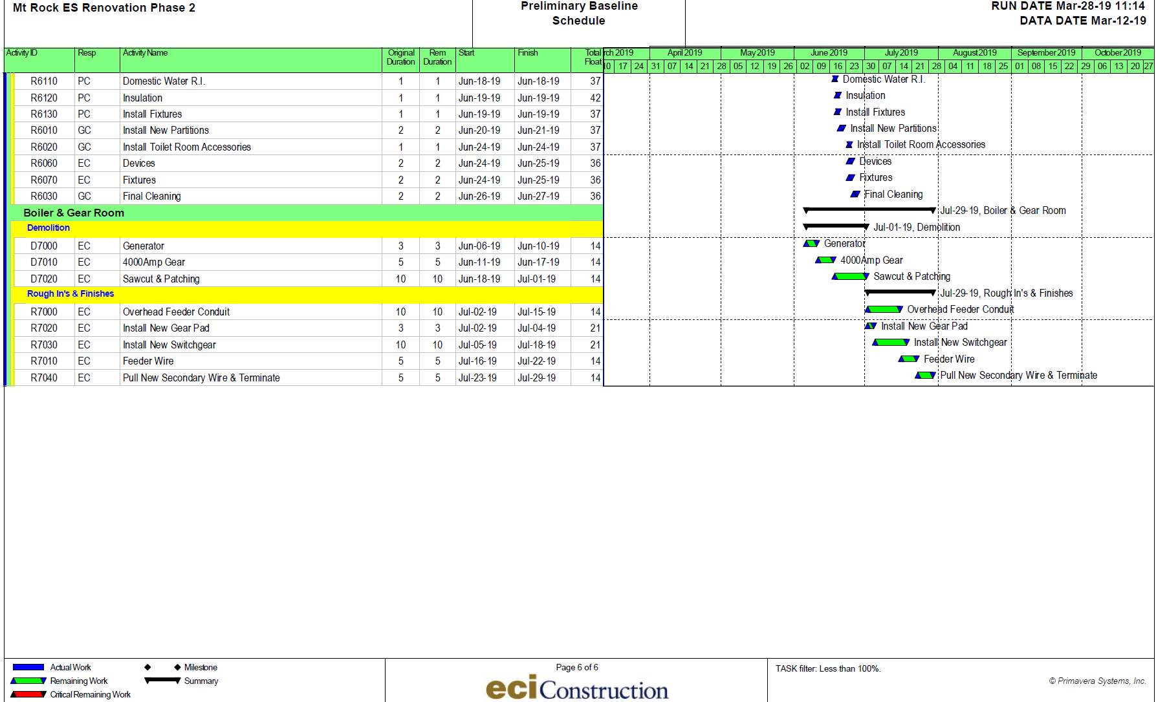

Slide 13
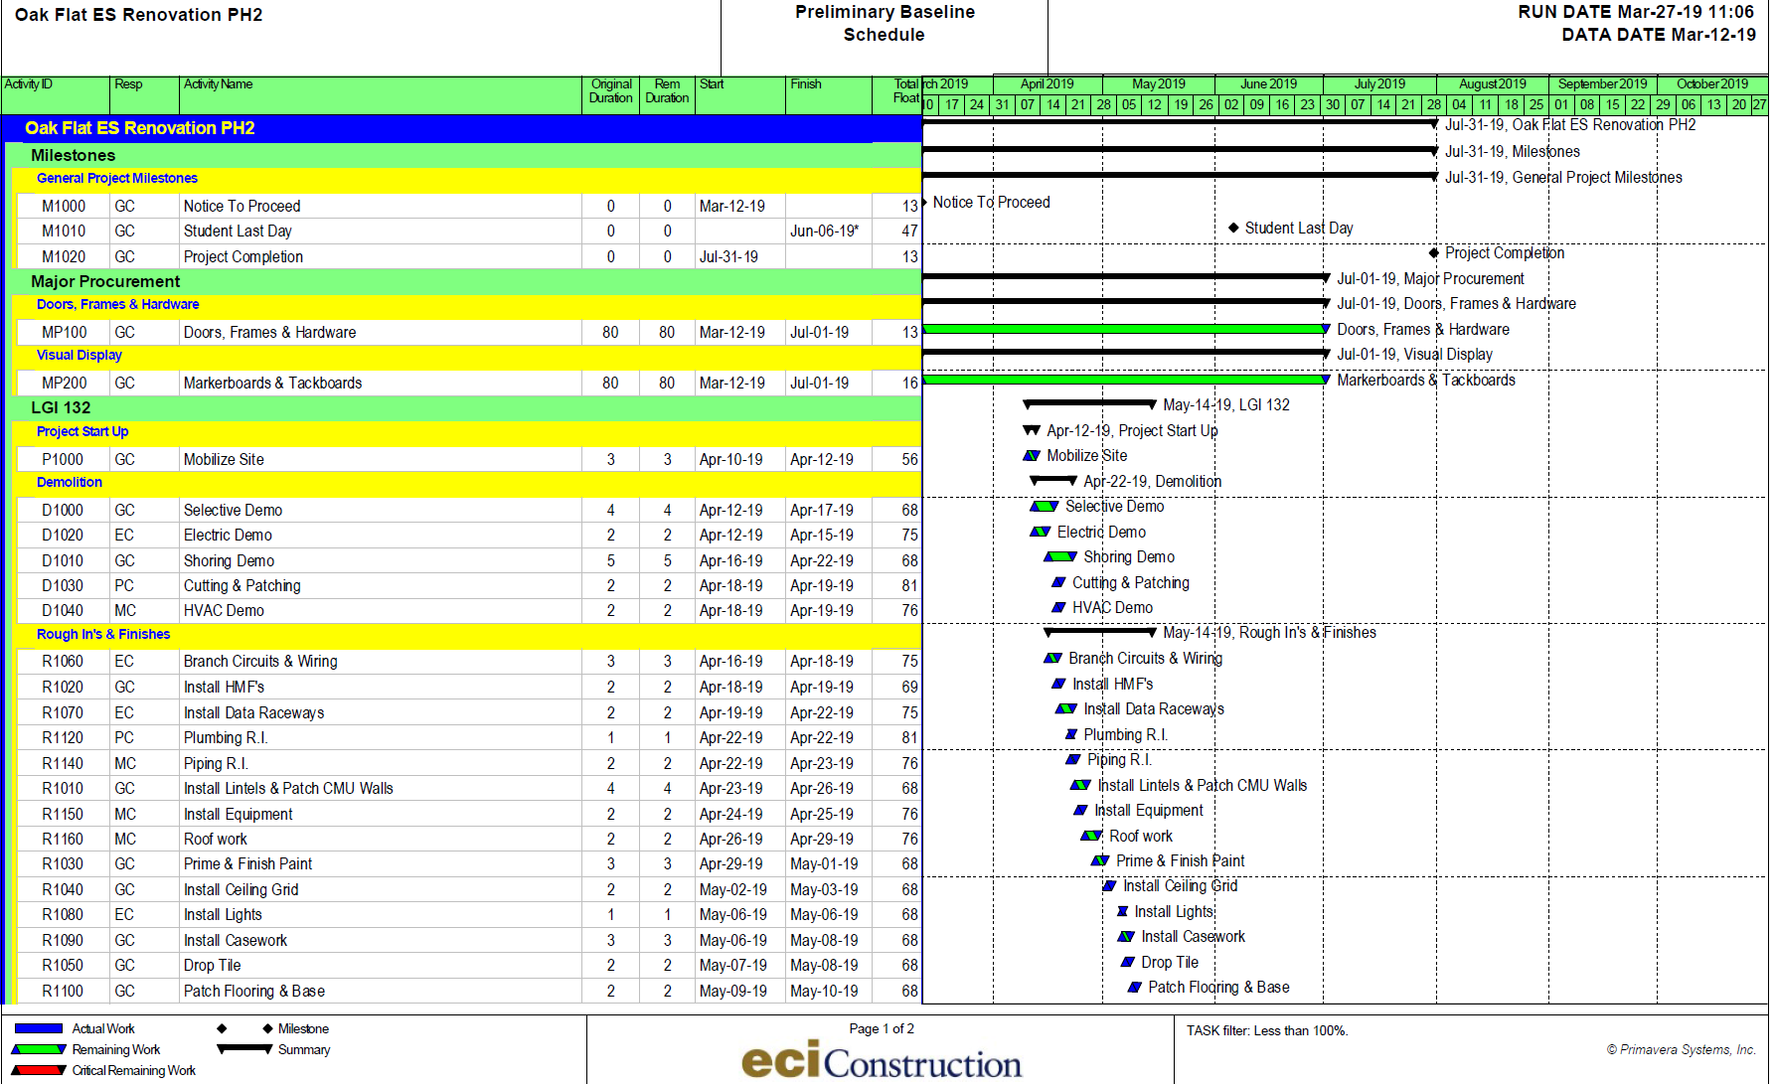

Slide 14
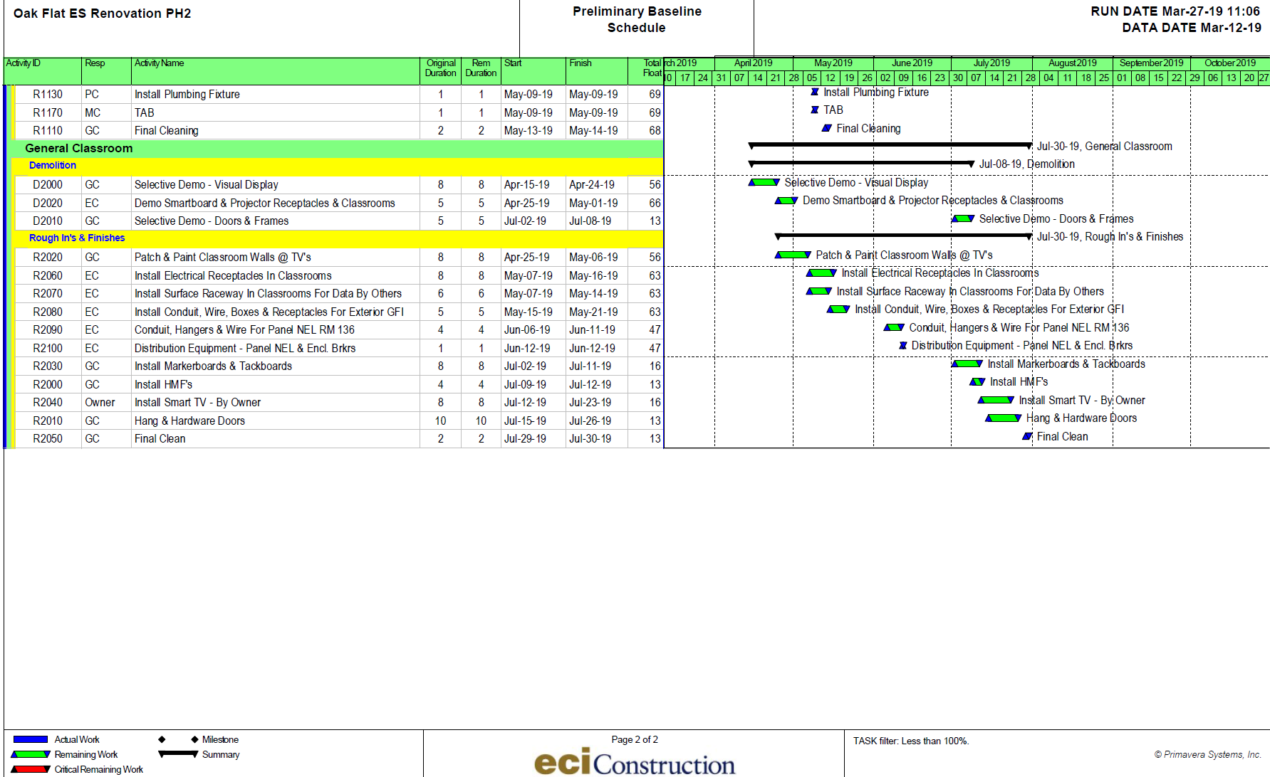

Slide 15
HS Furniture
CRA has change order proposal for the FFE process along with timeline for FFE process in tonight’s voting agenda.
These HS items are not part of construction initiative; rather, the Principal wanted to replace furniture in the 9 rooms with the old uni-desks.
While they are not part of the FFE process, we are taking advantage of construction in the same time/space to authorize Capital Projects Reserve funding and hopping on the FFE bid to get best pricing.
There are three components:
  Replace 9 classrooms
  Allow Flex Furniture Trial Teachers to add a component to their classroom
  Replace select library furniture

Slide 16
Flexible Seating Options
Option 1 (selected by five teachers) | Option 2 (selected by two teachers) | Option 3 (selected by two teachers)
Provides students with collaborative seating options. Students have choice in sitting on regular height chairs or stools at cafe tables. Students also have the option to stand at the cafe style tables. Ribbon tables may be pushed together to create a large discussion table. | Provides students with collaborative and independent seating options. Sit to Stand Desks provide options for students to work at an individual space or push desks together for collaboration. Students have choice in sitting on regular height chairs or standing at the Sit to Stand Desk. Wisp tables may be pushed together for larger collaborative group. | Provides students with collaborative seating options. Students have choice in standing at group table and cafe style tables. Stools are also provided if students choose to sit at the standing height tables. Ribbon tables allow for students to sit at regular height. Ribbon tables may be pushed together for larger collaborative group.

Slide 17
HS Flex Furniture Options
4 Ribbon tables
5 gray chairs
3 Sq café standing height tables
6 stools
4 Wisp Tables
6 Sit 2 stand desks
6 Gray chairs
1 Standing height table
3 square café standing height tables
2 Gray chairs
2 Ribbon tables
12 stools

Slide 18
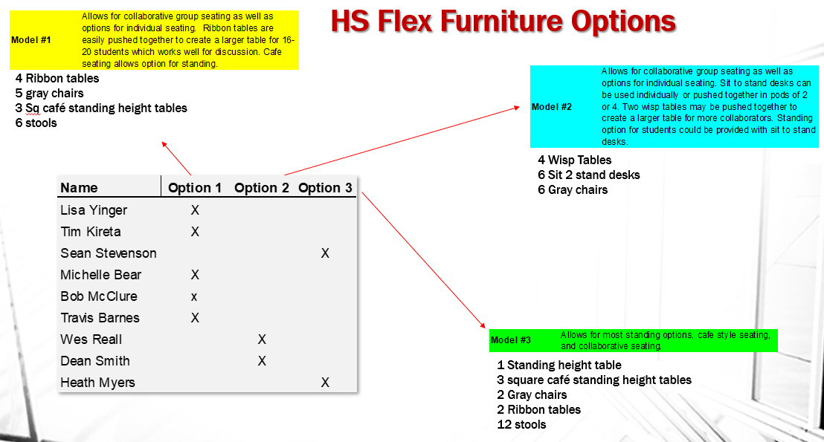
The original Flex Furniture team got to select an item to add to their classroom

Slide 19
Agenda Item: Approve Capital Projects

Slide 20
Questions ?
(next: tech update)

Slide 21
Technology Update
April 1, 2019
BSSD Buildings & Property Meeting

Slide 22
Agenda
Summer 2019 Projects Update
Capital Projects – Smart TV adds
Change order 1
Change order 2
COPPA Compliance update
Fiber to Oak Flat and Newville Feasibility Update
Future Board Action Items
Notes:
Talk about the agenda and mention that tonight’s presentation is to spark discussion of what and why
Not so much a financial presentation as that has been presented in recent meetings but I do have backup financial
slides for informational content

Slide 23
Summer 2019 technology projects
Notes:
The last topic for this evening is a review of the technology projects included with the Summer 2019 construction or capital projects

Slide 24
Not Related to construction
Student 1:1
  New 6th grade Chromebooks and 9th grade laptops
  Refresh HS Classroom Laptop spares
  Refresh Elementary Gen 1 Chromebooks & iPads
Curriculum driven technology needs
  Middle School Laptop carts
    Refresh very old lab equipment (STEM)
    Refresh library computers in support of Technology Education & Library Media courses
  High School refresh 5 year old Computer Aided Design Lab equipment
Notes:
6th $95K
9th $222K
Elem $45K
Curriculum $68K
Other standard refresh ipads/loaners $190K

Slide 25
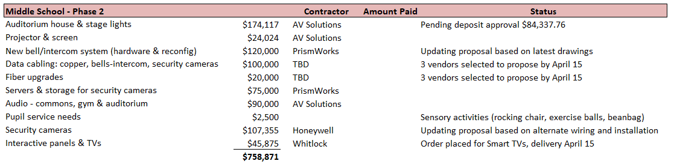
Middle School

Slide 26
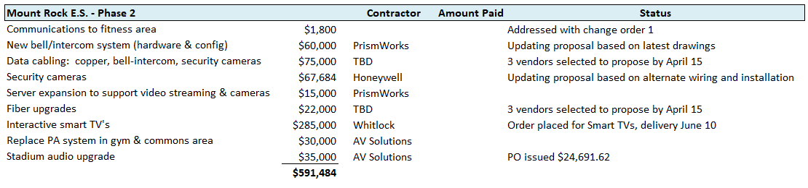
Mount Rock

Slide 27
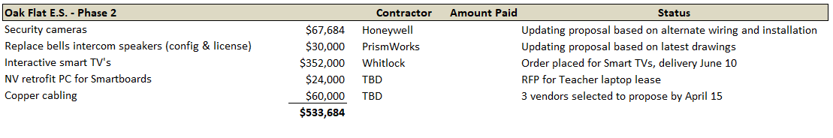
Oak Flat

Slide 28

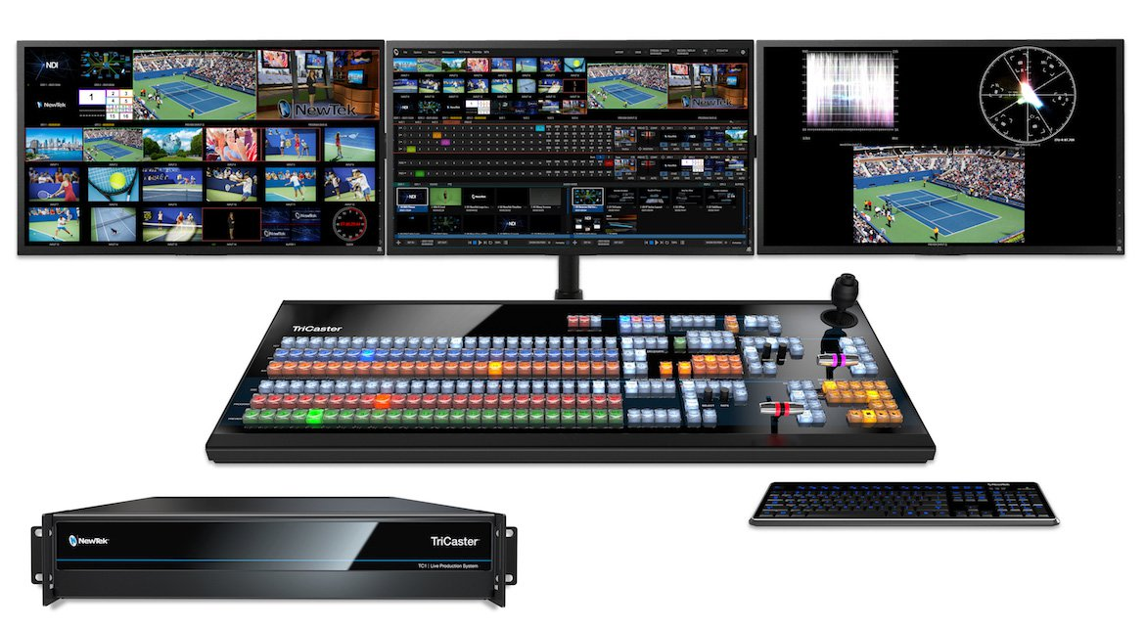
High School

Slide 29
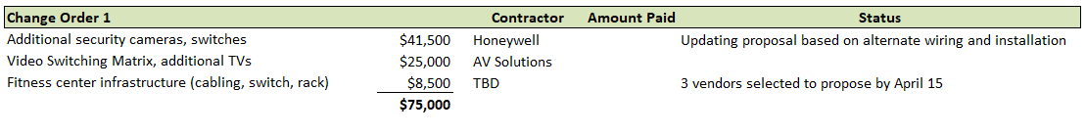
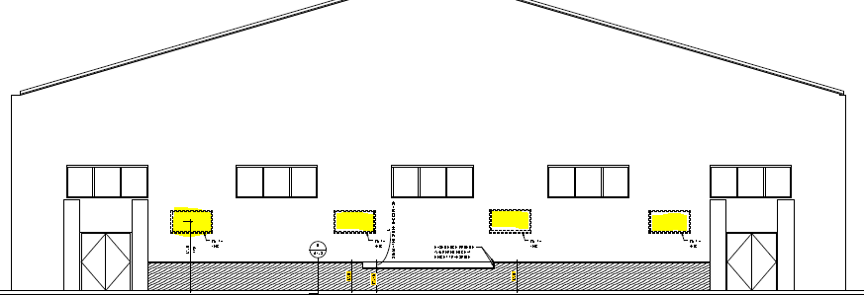
Change Order #1
Notes:
Fitness center is cut off from communications and standard technology infra like bells, clocks, pa

Slide 30
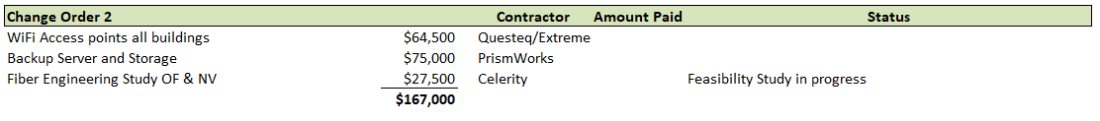
Change Order #2
  WiFi access points all buildings
    MS & HS currently have minimal outdoor WiFi access
    Utilized during fire and emergency drills – Navigate Prepared
    Secondary benefit – provides WiFi access for the community
    Supplemental WiFi indoor access for kitchens at all buildings
  Backup Server and Backup Storage
    Primary backup copy of all district servers
    Existing equipment over 5 years old – multiple disk drive failures in the past 30 days

Slide 31
Coppa (Children’s Online Privacy Protection Act
Any Web site that collects personal information from children under the age of 13 has to abide by COPPA (IE: email address, birth date)
  Website operator must post an online privacy policy that describes:
    Practices for personal information collected online
    Provide direct notice to parents with regard to the collection, use, or disclosure of personal information
    Obtain verifiable parental consent prior to the collection, use, and/or disclosure of personal information
Notes:
Act passed by congress, took effect in 2000

Slide 32
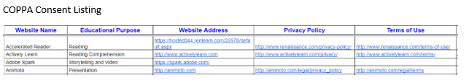
Coppa – District Responsibility
Post a COPPA Compliance letter to parents/guardians on the district web site
Post a list of websites used by the district along with the operator’s privacy policy and terms of use (continually updated)
Include a parental consent checkbox on the back to school portal

Slide 33
Fiber to Oak Flat & Newville

Slide 34
Celerity Fiber Feasibility Proposal
Phase 1 – Feasibility $5,650
Deliverables
Proposed routes map
Clearly defined proposal for Engineering Phase
Budgetary Estimate of cost to construct the project
Phase 2 – Full Engineering study $27,500
Deliverables
Construction plan
Make Ready Charges identified
Pole leasing costs

Slide 35
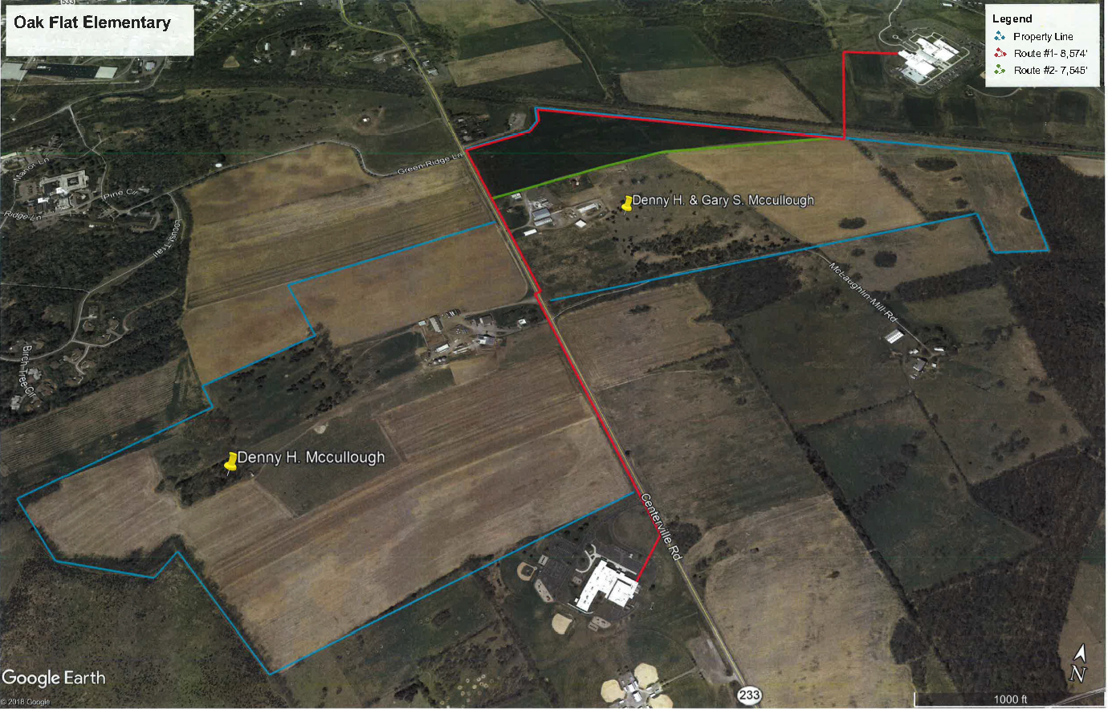

Slide 36
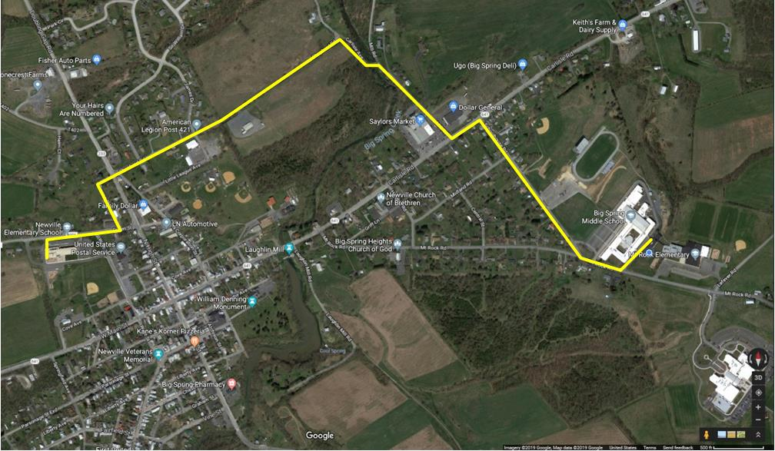
Newville Elementary
Notes:
Fred Potzer was given a courtesy summary of the fiber study and will be kept updated

Slide 37
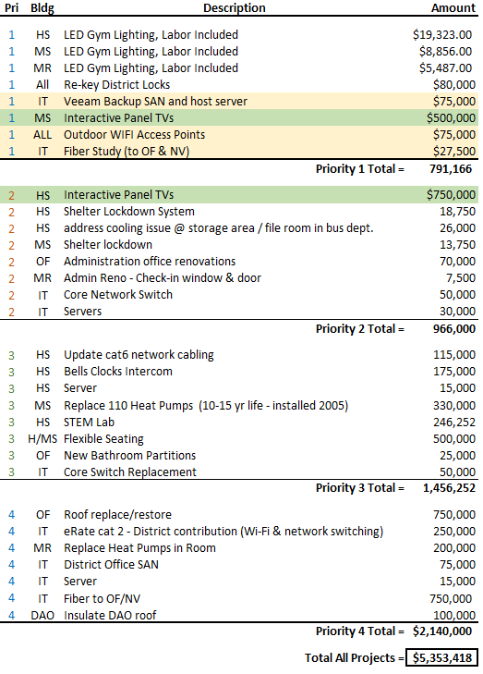
Capital Projects
Notes:
On the board agenda for approval this evening

Slide 38
Future Board Actions
Microsoft Agreement Extension Approval – April 15
  5 year extension through Lancaster Lebanon IU13
  Total contract cost $198,777
Teacher Laptop Lease – July 2019
COPPA Compliance
Notes:
EES paid annual 5% increase each year

Slide 39
Questions?

